Slide 1
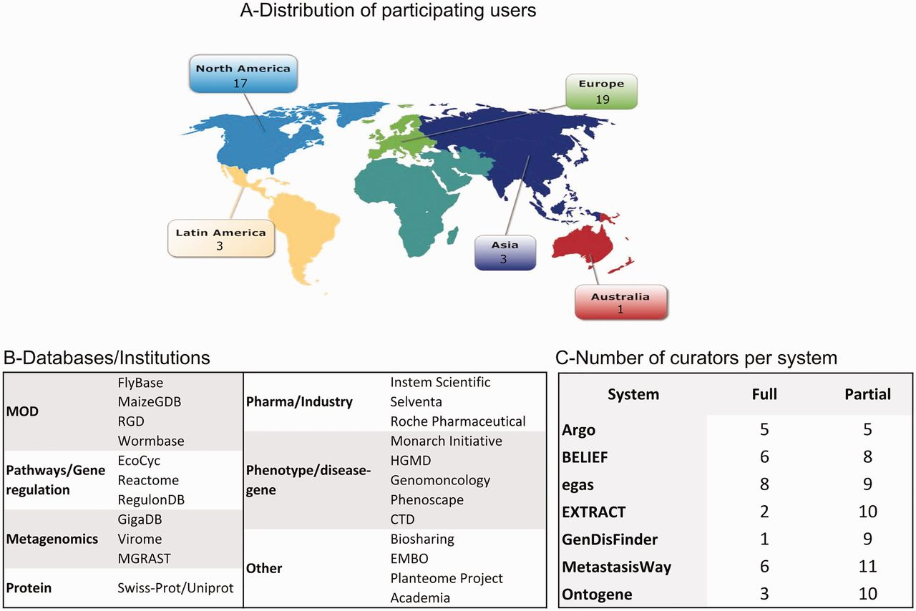
Figure 1. Distribution of biocurators (A) by geographic area, (B) by type of database/institution, and (C) by level of ...
Notes:
Figure 1. Distribution of biocurators (A) by geographic area, (B) by type of database/institution, and (C) by level of participation. A total of 43 biocurators participated in this activity. Notice that the total number in (C) is higher because some biocurators tested more than one system, and all curators participated in the partial activity.
Unless provided in the caption above, the following copyright applies to the content of this slide: Published by Oxford University Press 2016. This work is written by US Government employees and is in the public domain in the US.

