Slide 1
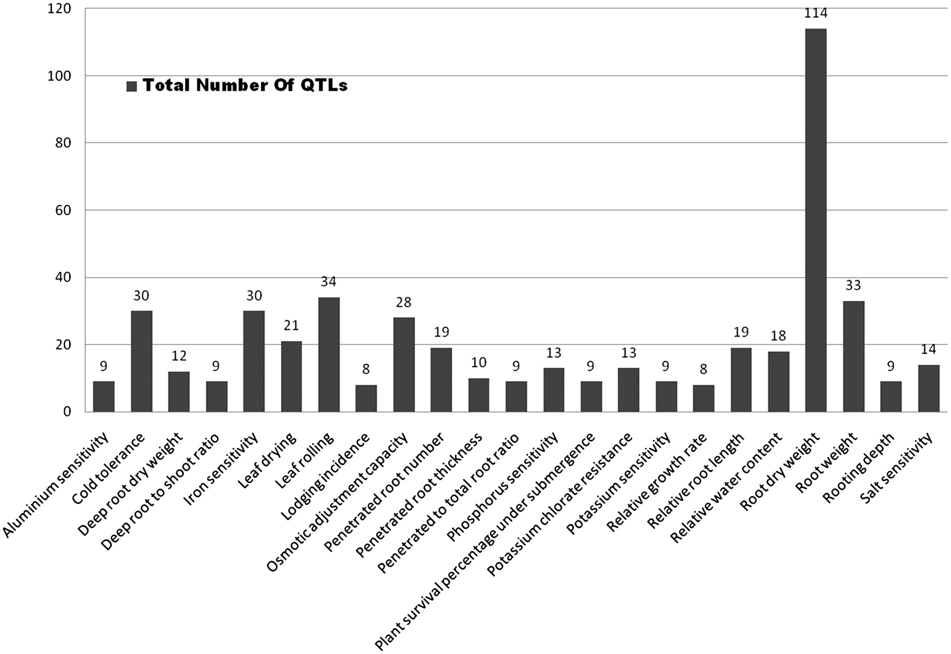
Figure 1. Number of QTLs scored for a short list of traits selected by their distribution on at least 6 out of 12 ...
Notes:
Figure 1. Number of QTLs scored for a short list of traits selected by their distribution on at least 6 out of 12 chromosomes (Supplementary Table S1). Note that ‘root dry weight’ has the highest number of QTLs by a wide margin.
Unless provided in the caption above, the following copyright applies to the content of this slide: © The Author(s) 2011. Published by Oxford University Press.This is Open Access article distributed under the terms of the Creative Commons Attribution Non-Commercial License (http://creativecommons.org/licenses/by-nc/2.5), which permits unrestricted non-commercial use, distribution, and reproduction in any medium, provided the original work is properly cited.

Slide 2
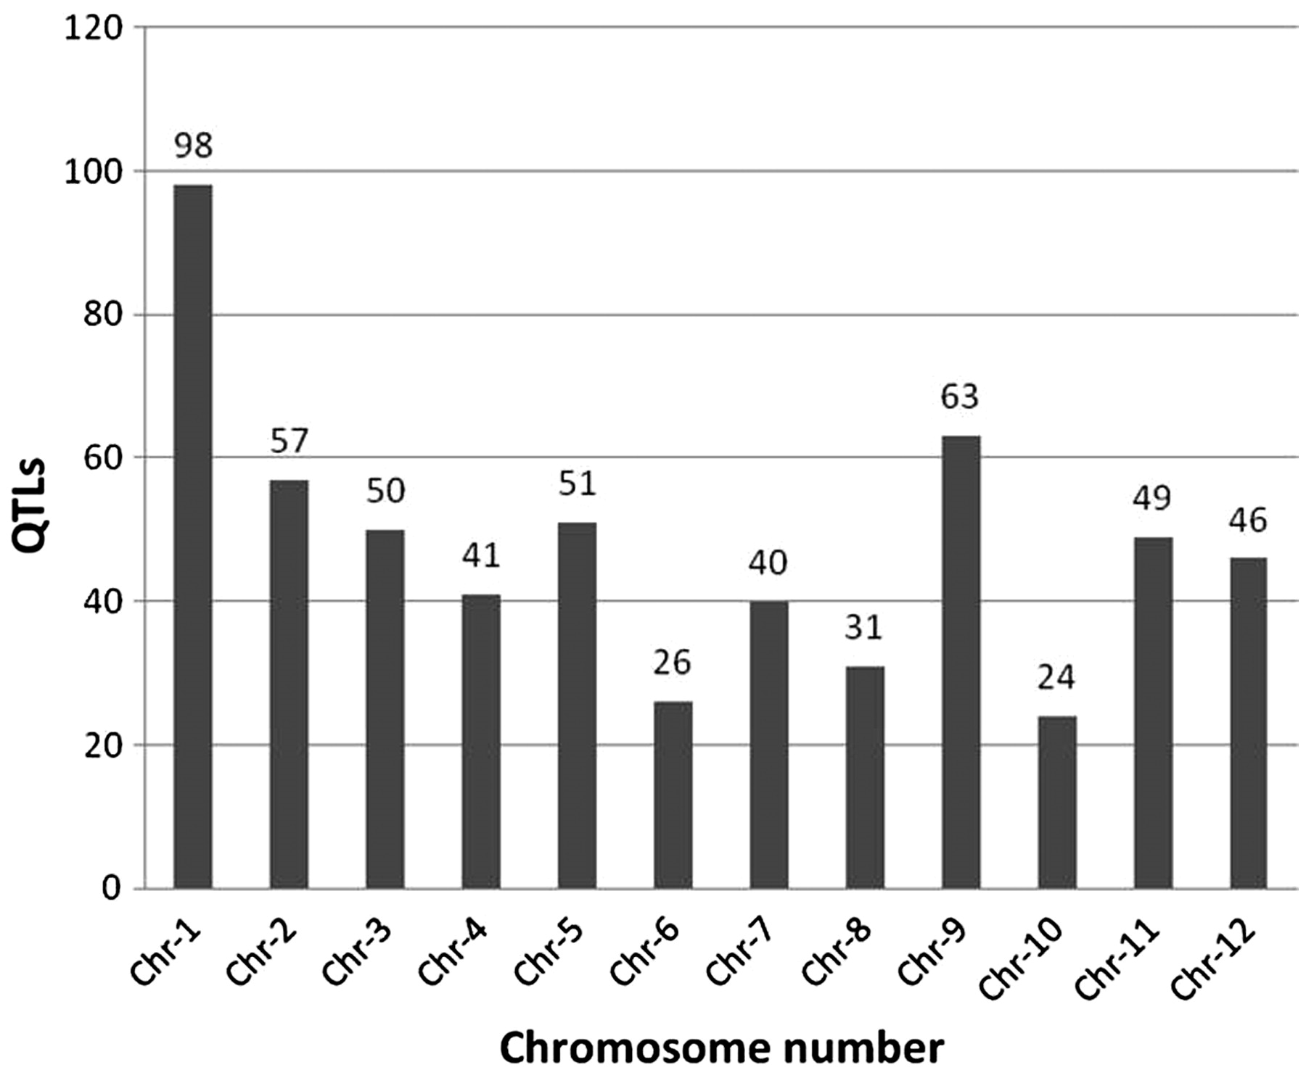
Figure 2. Overall distribution of 583 abiotic stress-associated QTLs scored for 53 traits mapped to 12 rice ...
Notes:
Figure 2. Overall distribution of 583 abiotic stress-associated QTLs scored for 53 traits mapped to 12 rice chromosomes, including those listed in Figure 1. Chromosome 1 has the highest number of identified QTLs (98) while chromosome 10 has the lowest (24).
Unless provided in the caption above, the following copyright applies to the content of this slide: © The Author(s) 2011. Published by Oxford University Press.This is Open Access article distributed under the terms of the Creative Commons Attribution Non-Commercial License (http://creativecommons.org/licenses/by-nc/2.5), which permits unrestricted non-commercial use, distribution, and reproduction in any medium, provided the original work is properly cited.

Slide 3
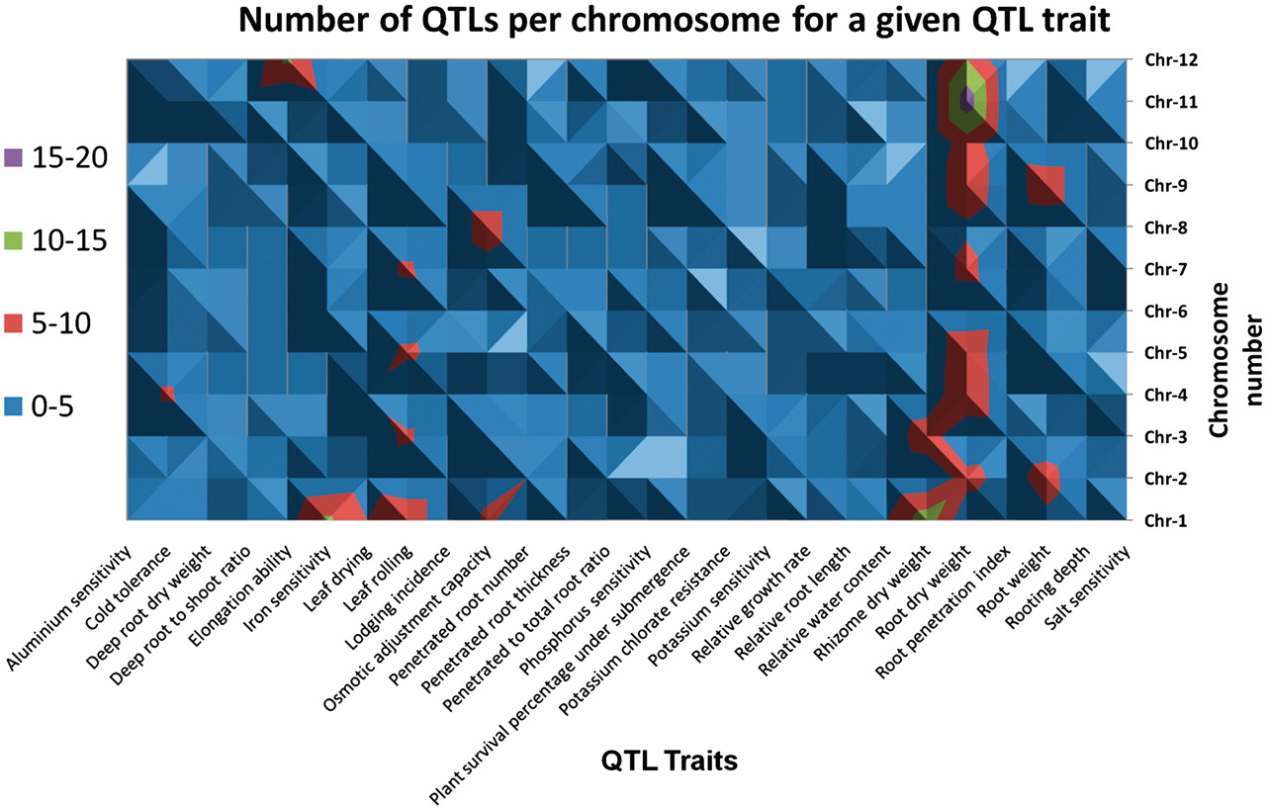
Figure 3. A topological display of the number of QTLs scored and associated traits selected by their distribution on at ...
Notes:
Figure 3. A topological display of the number of QTLs scored and associated traits selected by their distribution on at least 6 out of 12 chromosomes (Supplementary Table S1).
Unless provided in the caption above, the following copyright applies to the content of this slide: © The Author(s) 2011. Published by Oxford University Press.This is Open Access article distributed under the terms of the Creative Commons Attribution Non-Commercial License (http://creativecommons.org/licenses/by-nc/2.5), which permits unrestricted non-commercial use, distribution, and reproduction in any medium, provided the original work is properly cited.

Slide 4
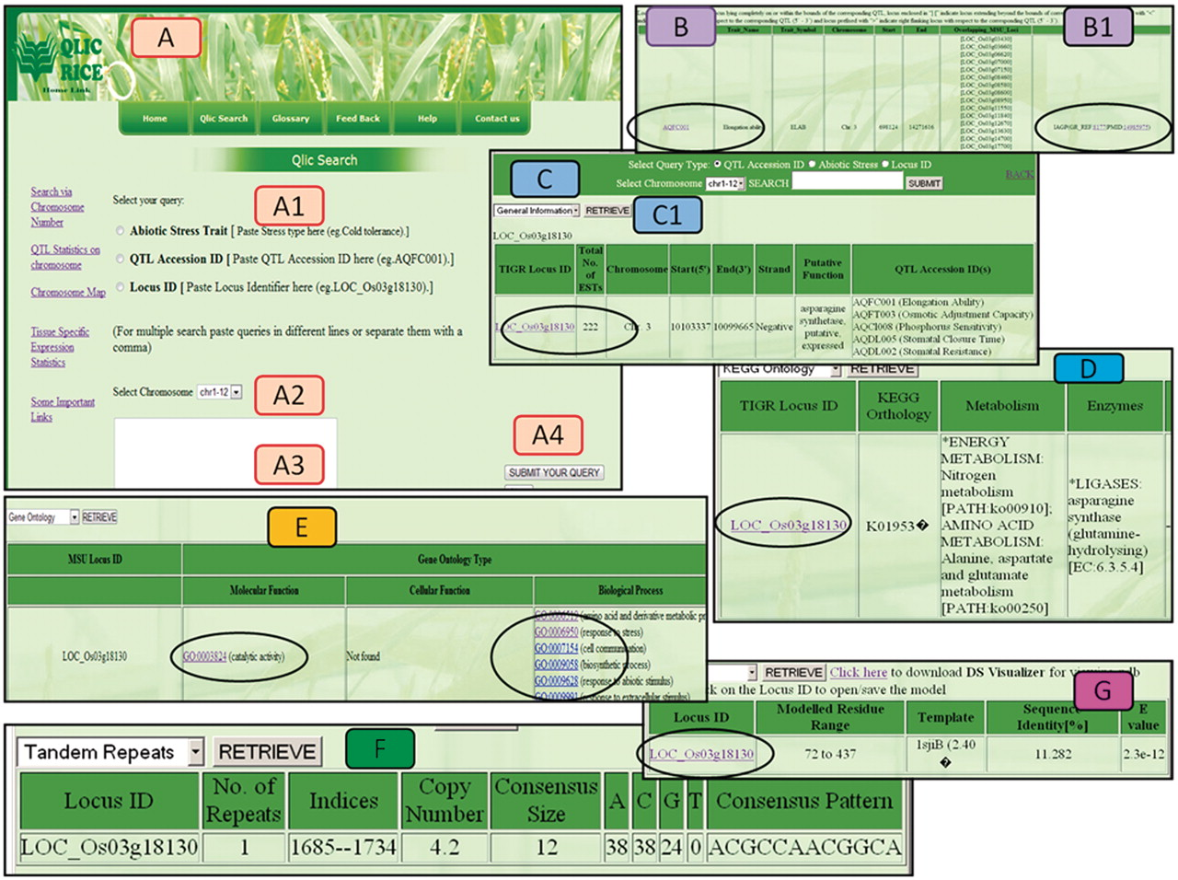
Figure 4. Different views of the QlicRice search user interface. (A) Query interface: (A1) select the query type, (A2) ...
Notes:
Figure 4. Different views of the QlicRice search user interface. (A) Query interface: (A1) select the query type, (A2) select chromosome, (A3) type your query in the given search box and (A4) submit your query. (B/B1) QTL search results for a given QTL ID. (C) Gene search result for a given Gene ID. (C1) View details of the given gene, which include: (D) the KEGG ontology and pathway mappings, (E) GO assignments, (F) scored tandem repeat(s) and (G) the protein structure module with a gene ID link to the downloadable PDB-formatted protein structure data file. This PDB file can be uploaded in any of the protein 3D-viewers listed on the page or described in the article.
Unless provided in the caption above, the following copyright applies to the content of this slide: © The Author(s) 2011. Published by Oxford University Press.This is Open Access article distributed under the terms of the Creative Commons Attribution Non-Commercial License (http://creativecommons.org/licenses/by-nc/2.5), which permits unrestricted non-commercial use, distribution, and reproduction in any medium, provided the original work is properly cited.

