Slide 1
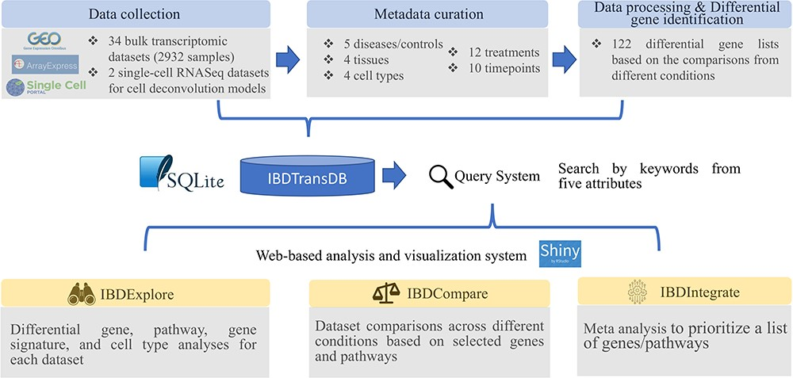
Figure 1. IBDTransDB for exploratory, comparative and integrative datasets to identify and validate the novel IBD ...
Notes:
Figure 1. IBDTransDB for exploratory, comparative and integrative datasets to identify and validate the novel IBD targets. Top panel: data processing and meta data curation for 34 IBD bulk transcriptomics datasets and 2 single-cell RNASeq datasets. Bottom panel: three data analysis modules.
Unless provided in the caption above, the following copyright applies to the content of this slide: © The Author(s) 2024. Published by Oxford University Press.This is an Open Access article distributed under the terms of the Creative Commons Attribution License (https://creativecommons.org/licenses/by/4.0/), which permits unrestricted reuse, distribution, and reproduction in any medium, provided the original work is properly cited.

Slide 2
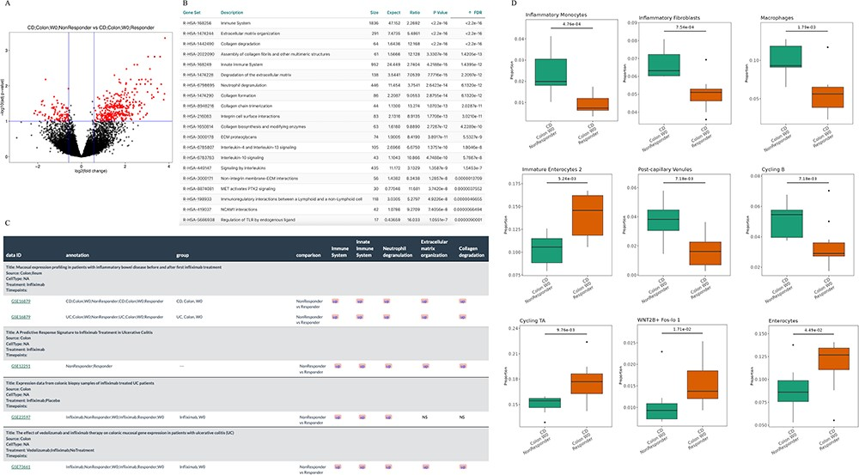
Figure 2. Understanding the infliximab resistance molecular and cellular mechanisms. (A) Volcano plot of differentially ...
Notes:
Figure 2. Understanding the infliximab resistance molecular and cellular mechanisms. (A) Volcano plot of differentially expressed genes between non-responders and responders at baseline in GSE16879 CD colon samples. (B) Top 20 enriched Reactome pathways based on the up-regulated genes from (A). (C) Comparison of five representative Reactome-enriched pathways from (B) in five non-responder vs responder comparisons from four infliximab-treated IBD datasets. (D) Significant cell types between non-responders and responders at baseline in GSE16879 CD colon samples.
Unless provided in the caption above, the following copyright applies to the content of this slide: © The Author(s) 2024. Published by Oxford University Press.This is an Open Access article distributed under the terms of the Creative Commons Attribution License (https://creativecommons.org/licenses/by/4.0/), which permits unrestricted reuse, distribution, and reproduction in any medium, provided the original work is properly cited.

Slide 3
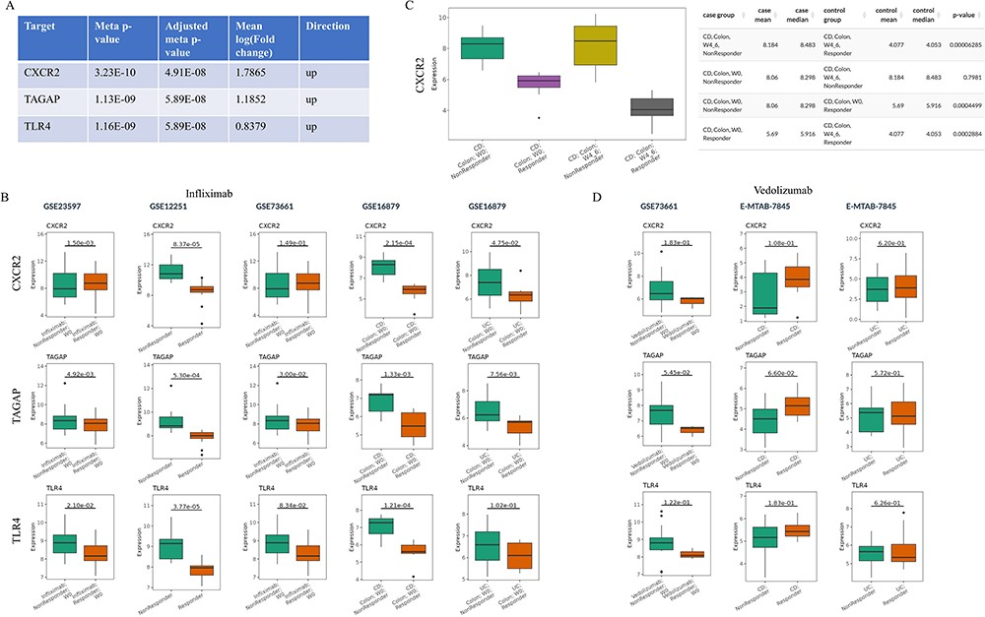
Figure 3. Prioritization of the candidate targets with genetic evidence for the treatment of infliximab non-responders. ...
Notes:
Figure 3. Prioritization of the candidate targets with genetic evidence for the treatment of infliximab non-responders. (A) Top three candidates with adjusted meta P-value 0.58 from IBDIntegrate module. (B) Comparison of three candidates in five non-responder vs responder comparisons from four infliximab-treated IBD datasets. (C) Comparison of CXCR2 expression between after-treatment and baseline samples for responders and non-responders in GSE16879. (D) Comparison of three candidates in three non-responder vs responder comparisons from two vedolizumab-treated IBD datasets.
Unless provided in the caption above, the following copyright applies to the content of this slide: © The Author(s) 2024. Published by Oxford University Press.This is an Open Access article distributed under the terms of the Creative Commons Attribution License (https://creativecommons.org/licenses/by/4.0/), which permits unrestricted reuse, distribution, and reproduction in any medium, provided the original work is properly cited.

