Slide 1
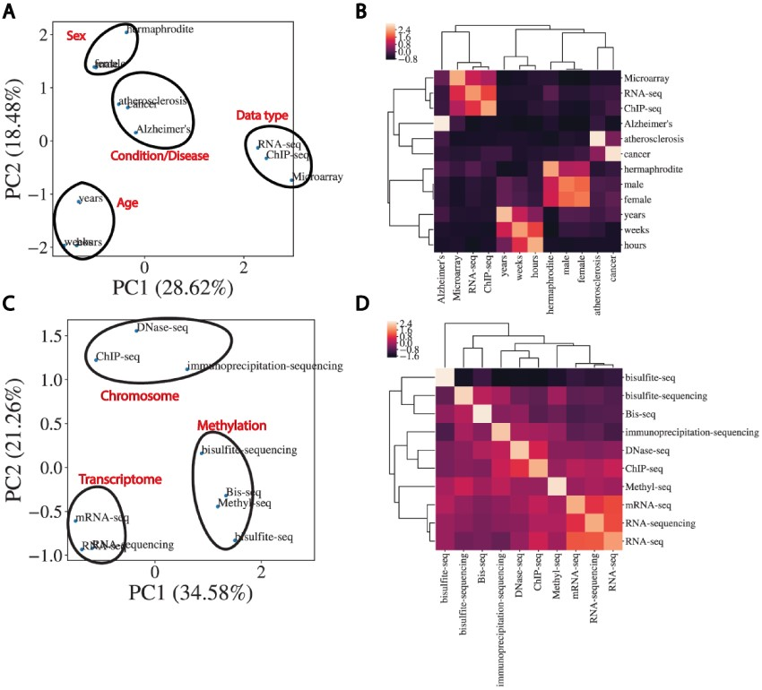
Figure 3. Word embeddings capture semantic similarities between words. (A) Dimensional reduction using PCA to visualize ...
Notes:
Figure 3. Word embeddings capture semantic similarities between words. (A) Dimensional reduction using PCA to visualize vectorized representation of a set of words encapsulating disease, age, data type and sex. (B) Corresponding correlation heatmap of the z-scored cosine similarity between words, with hierarchical clustering shown. (C) Same as (A) for data types. (D) Corresponding correlation heatmap of z-scored cosine similarity between words in (C).
Unless provided in the caption above, the following copyright applies to the content of this slide: © The Author(s) 2021. Published by Oxford University Press.This is an Open Access article distributed under the terms of the Creative Commons Attribution License (http://creativecommons.org/licenses/by/4.0/), which permits unrestricted reuse, distribution, and reproduction in any medium, provided the original work is properly cited.

