Slide 1
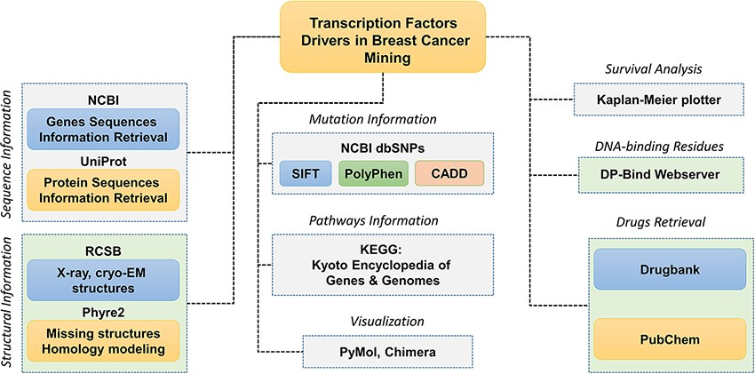
Figure 1. Schematic representation of the database components and data analysis modules used to obtain the specific ...
Notes:
Figure 1. Schematic representation of the database components and data analysis modules used to obtain the specific results. Each tab is tagged, and their respective analyses of webservers or software are also given.
Unless provided in the caption above, the following copyright applies to the content of this slide: © Crown copyright 2021.This Open Access article contains public sector information licensed under the Open Government Licence v3.0 (http://www.nationalarchives.gov.uk/doc/open-government-licence/version/3/).

