Slide 1
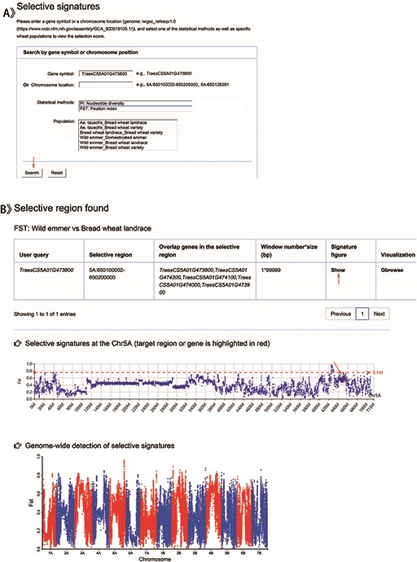
Figure 5. Screenshots of a search for genomic selection data and the result display for example.
Notes:
Figure 5. Screenshots of a search for genomic selection data and the result display for example. A. Search items including gene symbol, chromosome location, one of the statistical tests (Pi and FST) and specific ploidy wheat groups. B. Detailed annotation for the target gene or region in the variant grid and the corresponding selective signatures at the chromosome and whole-genome levels, respectively. An example of selective signal Fst of TraesS5A01G473800 gene between wild emmer and bread wheat landrace.
Unless provided in the caption above, the following copyright applies to the content of this slide: © The Author(s) 2020. Published by Oxford University Press.This is an Open Access article distributed under the terms of the Creative Commons Attribution License (http://creativecommons.org/licenses/by/4.0/), which permits unrestricted reuse, distribution, and reproduction in any medium, provided the original work is properly cited.

