Slide 1
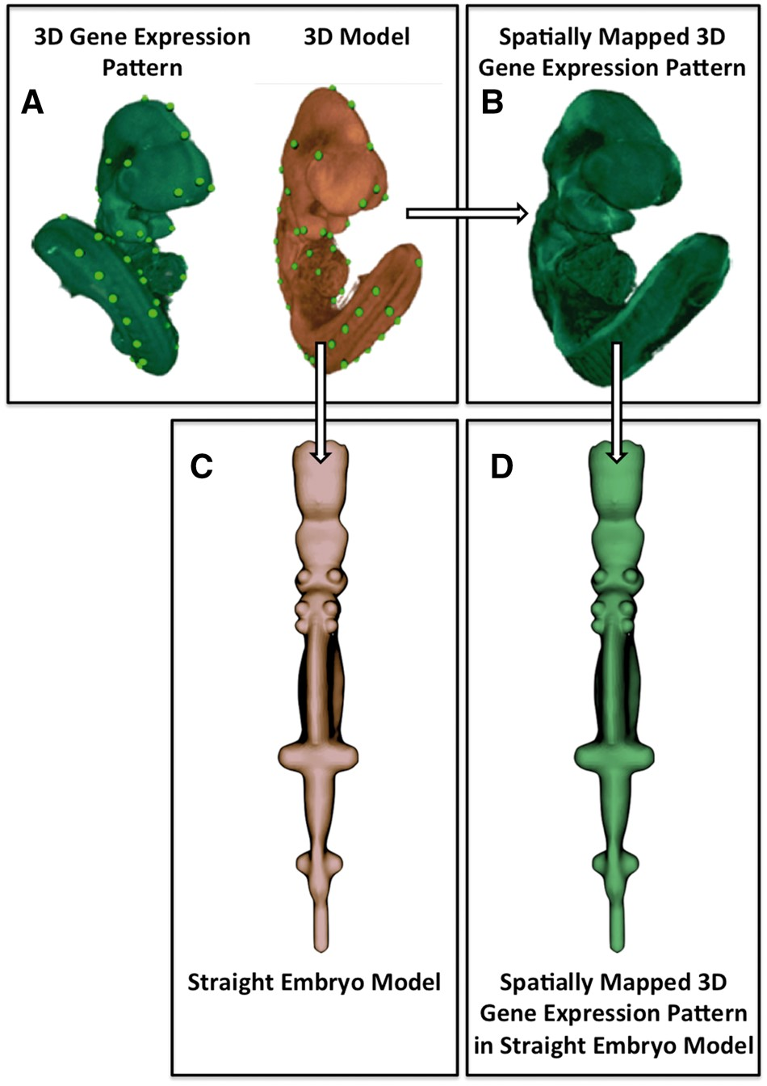
Figure 1. Image processing pipeline used to generate the straight mouse embryo. (A) Spatial warping using WlzWarp ...
Notes:
Figure 1. Image processing pipeline used to generate the straight mouse embryo. (A) Spatial warping using WlzWarp allows a user to place landmark points on a source image with gene expression (green) and a 3D model (orange) that utilizes a volumetric mesh. The green dots represent equivalent landmark points. (B) The spatial transform enables the gene expression pattern (green) to be mapped into the 3D model. Spatial warping of gene expression patterns using WlzWarp has been described previously in (10). (C) Spatial warping using WlzWarp was additionally used to straighten the mouse embryo model (landmark points not shown). The WlzWarp processing utilizes a CDT that enables complex non-linear deformations to be applied to 3D objects. (D) Gene expression patterns that were mapped into the 3D model (green) can be visualized in the context of the straight mouse embryo model.
Unless provided in the caption above, the following copyright applies to the content of this slide: © The Author(s) 2017. Published by Oxford University Press.This is an Open Access article distributed under the terms of the Creative Commons Attribution License (http://creativecommons.org/licenses/by/4.0/), which permits unrestricted reuse, distribution, and reproduction in any medium, provided the original work is properly cited.

