Slide 1
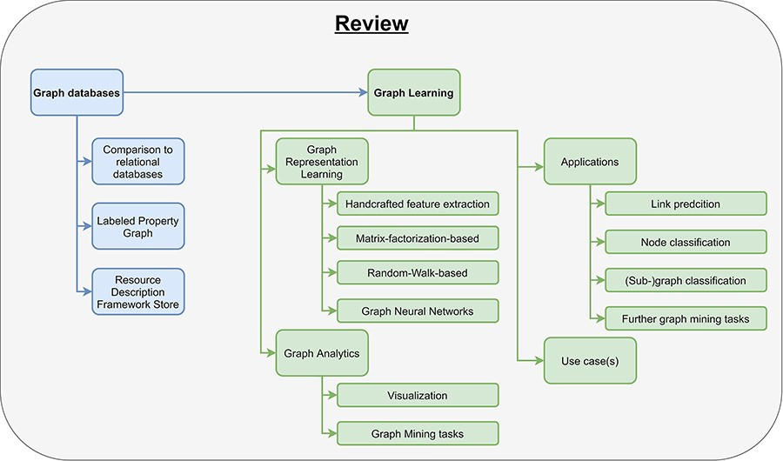
Notes:
Unless provided in the caption above, the following copyright applies to the content of this slide: © The Author(s) 2024. Published by Oxford University Press.This is an Open Access article distributed under the terms of the Creative Commons Attribution License (https://creativecommons.org/licenses/by/4.0/), which permits unrestricted reuse, distribution, and reproduction in any medium, provided the original work is properly cited.

Slide 2
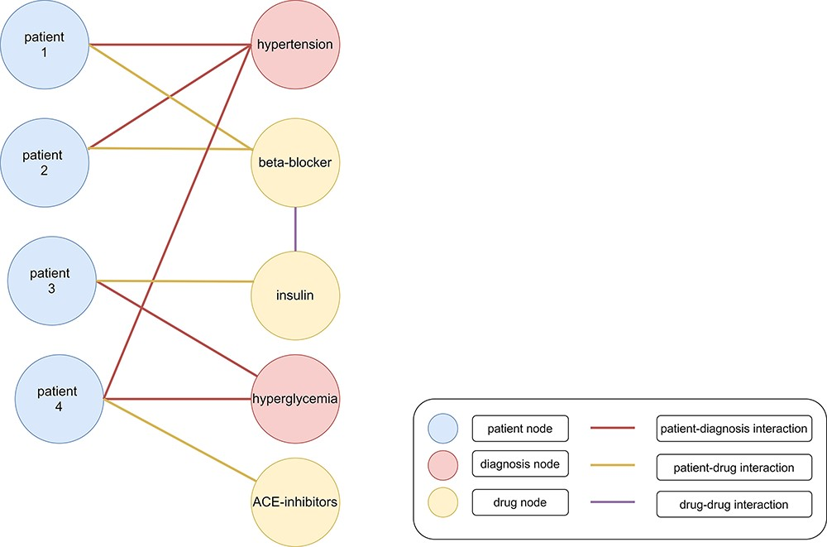
Figure 1. Heterogenous graph with clinical data. Patients (blue nodes) are connected with diagnoses (red nodes) with a ...
Notes:
Figure 1. Heterogenous graph with clinical data. Patients (blue nodes) are connected with diagnoses (red nodes) with a red edge and drugs (yellow nodes) with a yellow edge. Interactions between different drugs are represented as a purple edge. Patients 1 and 2 were diagnosed with hypertension. Therefore, beta-blockers were administered as treatment. Patient 3 was diagnosed with hyperglycemia and cured with insulin. However, patient 4 was diagnosed with hypertension and hyperglycemia (199). The administration of beta-blockers and insulin would lead to negative side effects because of an increased risk for hypoglycemia. Therefore, angiotensin-converting enzyme (ACE) inhibitors might be administered as treatment (200).
Unless provided in the caption above, the following copyright applies to the content of this slide: © The Author(s) 2024. Published by Oxford University Press.This is an Open Access article distributed under the terms of the Creative Commons Attribution License (https://creativecommons.org/licenses/by/4.0/), which permits unrestricted reuse, distribution, and reproduction in any medium, provided the original work is properly cited.

Slide 3
Figure 2. Example of a graph. A graph consists of nodes (represented as circles) and edges (represented as arrows) that ...
Notes:
Figure 2. Example of a graph. A graph consists of nodes (represented as circles) and edges (represented as arrows) that connect nodes with each other. Nodes and edges can have labels, e.g., symptom or patient, and additional attributes. Attributes (often referred to as features) contain additional information about nodes or edges, e.g., the age and sex of a patient node.
Unless provided in the caption above, the following copyright applies to the content of this slide: © The Author(s) 2024. Published by Oxford University Press.This is an Open Access article distributed under the terms of the Creative Commons Attribution License (https://creativecommons.org/licenses/by/4.0/), which permits unrestricted reuse, distribution, and reproduction in any medium, provided the original work is properly cited.

Slide 4
Figure 3. Pipeline for processing graph data. The pipeline consists of two parts, data storage and graph learning. As ...
Notes:
Figure 3. Pipeline for processing graph data. The pipeline consists of two parts, data storage and graph learning. As input users have data and a specific use case. After they have chosen a graph database, they need to design a graph data model to store their data appropriately (data storage). In the second part, high-dimensional graph data are reduced to obtain low-dimensional embeddings using graph representation learning. These embeddings are used in graph analytics for several different clinical applications, e.g., predicting interactions between drugs.
Unless provided in the caption above, the following copyright applies to the content of this slide: © The Author(s) 2024. Published by Oxford University Press.This is an Open Access article distributed under the terms of the Creative Commons Attribution License (https://creativecommons.org/licenses/by/4.0/), which permits unrestricted reuse, distribution, and reproduction in any medium, provided the original work is properly cited.

Slide 5
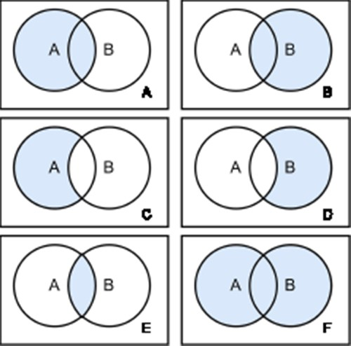
Figure 4. Join Types. There are six different join types: left Outer Join (A), right Outer Join (B), left Outer Join ...
Notes:
Figure 4. Join Types. There are six different join types: left Outer Join (A), right Outer Join (B), left Outer Join with Null (C), right Outer Join with Null (D), inner Join (E) and full Outer Join (F). Each circle represents a table and the blue color highlights the retrieved data from the joined tables.
Unless provided in the caption above, the following copyright applies to the content of this slide: © The Author(s) 2024. Published by Oxford University Press.This is an Open Access article distributed under the terms of the Creative Commons Attribution License (https://creativecommons.org/licenses/by/4.0/), which permits unrestricted reuse, distribution, and reproduction in any medium, provided the original work is properly cited.

Slide 6
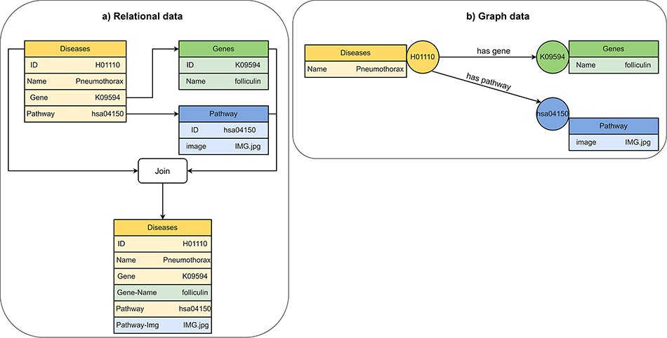
Figure 5. Visualization of (A) relational data and (B) graph data of disease, gene and pathway entities in KEGG (201). ...
Notes:
Figure 5. Visualization of (A) relational data and (B) graph data of disease, gene and pathway entities in KEGG (201). A disease references to a pathway entity and to a gene entity. For receiving information from multiple tables in a relational database, we must perform join operations on the tables. In a graph database, we traverse edges to receive information from multiple nodes.
Unless provided in the caption above, the following copyright applies to the content of this slide: © The Author(s) 2024. Published by Oxford University Press.This is an Open Access article distributed under the terms of the Creative Commons Attribution License (https://creativecommons.org/licenses/by/4.0/), which permits unrestricted reuse, distribution, and reproduction in any medium, provided the original work is properly cited.

Slide 7
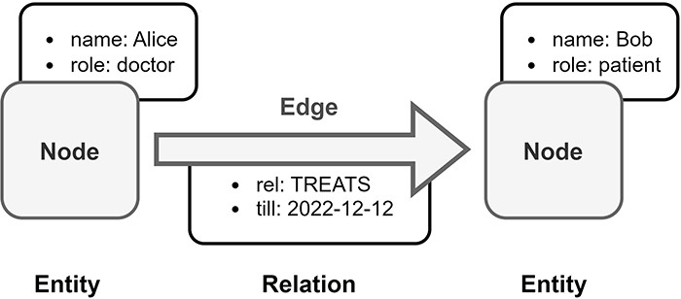
Figure 6. Overview of Labeled Property Graph (LPG). In this example, medical data is transformed into an LPG format. ...
Notes:
Figure 6. Overview of Labeled Property Graph (LPG). In this example, medical data is transformed into an LPG format. Alice is a doctor and Bob is a patient, both are represented as nodes in the LPG. The doctor–patient relationship between Alice and Bob is modeled by a directed edge in the LPG with an assigned property, which is the end date of Bob’s treatment by Alice.
Unless provided in the caption above, the following copyright applies to the content of this slide: © The Author(s) 2024. Published by Oxford University Press.This is an Open Access article distributed under the terms of the Creative Commons Attribution License (https://creativecommons.org/licenses/by/4.0/), which permits unrestricted reuse, distribution, and reproduction in any medium, provided the original work is properly cited.

Slide 8
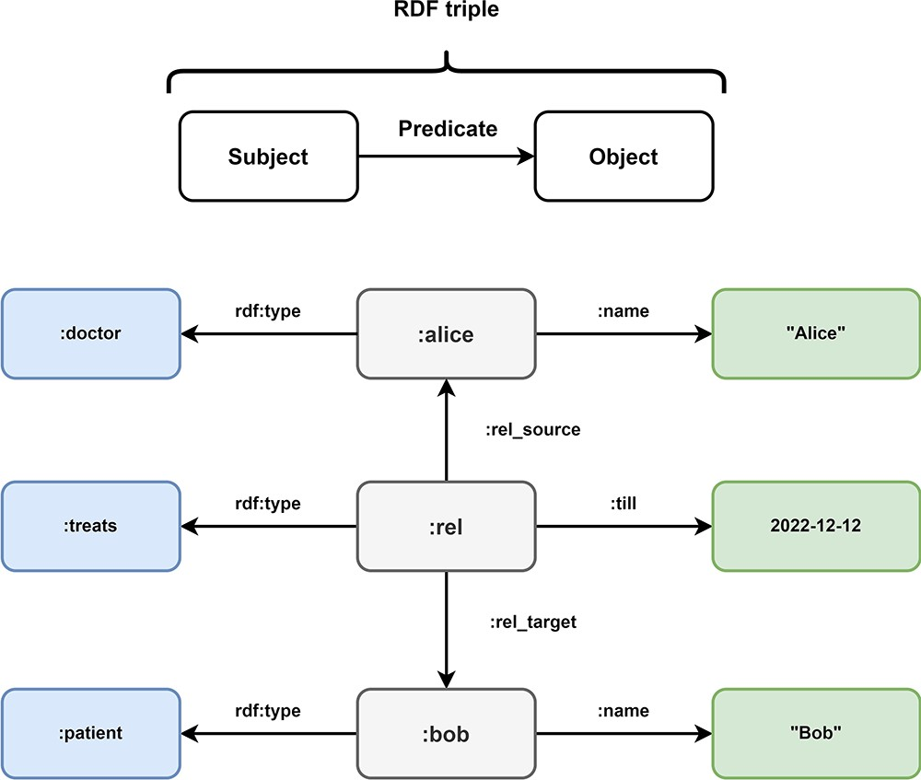
Figure 7. Overview of Resource Description Framework (RDF). Every information in the Resource Description Framework is ...
Notes:
Figure 7. Overview of Resource Description Framework (RDF). Every information in the Resource Description Framework is organized as a triple and every triple follows a subject predicate object structure. In this example, the medical data of Figure 5 is transformed into the RDF format. The subject:alice has the predicate rdf:type with the object:doctor and the predicate:name with object ‘Alice’. These RDF triples represent the node of doctor Alice in the LPG. The directed nature of the edge TREATS in the LPG is represented by the RDF triples (:rel,:rel_source,:alice) and (:rel,:rel_target,:bob). The properties of the edge are represented by the triples (:rel, rdf:type,:treats) and (:rel,:till, 2022–12-12). Bob is represented by the triples (:bob, rdf:type,:patient) and (:bob,:name, “Bob).
Unless provided in the caption above, the following copyright applies to the content of this slide: © The Author(s) 2024. Published by Oxford University Press.This is an Open Access article distributed under the terms of the Creative Commons Attribution License (https://creativecommons.org/licenses/by/4.0/), which permits unrestricted reuse, distribution, and reproduction in any medium, provided the original work is properly cited.

Slide 9
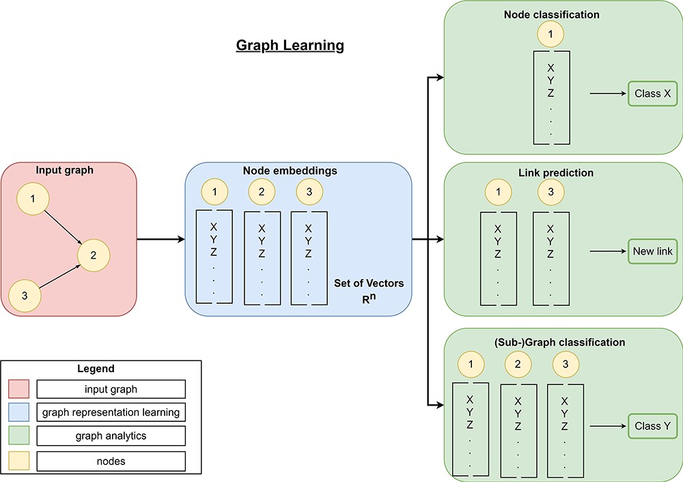
Figure 8. Overview of graph learning (machine learning on graphs). Graph learning can process a high-dimensional input ...
Notes:
Figure 8. Overview of graph learning (machine learning on graphs). Graph learning can process a high-dimensional input graph (red rectangle) using graph representation learning (blue rectangles) and graph analytics (green rectangles). Graph representation learning allows the generation of low-dimensional node embeddings using graph representation approaches (manual feature extraction, matrix-factorization-based, random-walk-based, or graph neural networks). These embeddings represent feature information and topological information about a node efficiently. Then, graph analytics use these low-dimensional embeddings for graph mining tasks like link prediction to predict new links, node classification to classify nodes or (sub-)graph classification to classify entire (sub-)graphs.
Unless provided in the caption above, the following copyright applies to the content of this slide: © The Author(s) 2024. Published by Oxford University Press.This is an Open Access article distributed under the terms of the Creative Commons Attribution License (https://creativecommons.org/licenses/by/4.0/), which permits unrestricted reuse, distribution, and reproduction in any medium, provided the original work is properly cited.

Slide 10
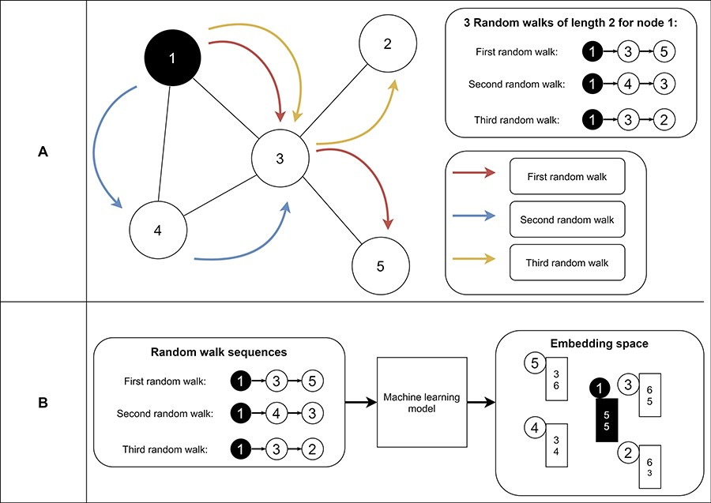
Figure 9. Example of random walks on a graph (A) and the transformation into node embeddings (B). In (A), three random ...
Notes:
Figure 9. Example of random walks on a graph (A) and the transformation into node embeddings (B). In (A), three random walks with length two are sampled from node 1 to receive node sequences as a result. These node sequences represent the neighborhood of node 1. Then, we aim to find node embeddings such that nodes that co-occur often on random walks are embedded closer to each other (B). Note that the sequences generated from the random walks and the numbers for representing the final node embeddings are fictitious to make the embedding generation clearer.
Unless provided in the caption above, the following copyright applies to the content of this slide: © The Author(s) 2024. Published by Oxford University Press.This is an Open Access article distributed under the terms of the Creative Commons Attribution License (https://creativecommons.org/licenses/by/4.0/), which permits unrestricted reuse, distribution, and reproduction in any medium, provided the original work is properly cited.

Slide 11
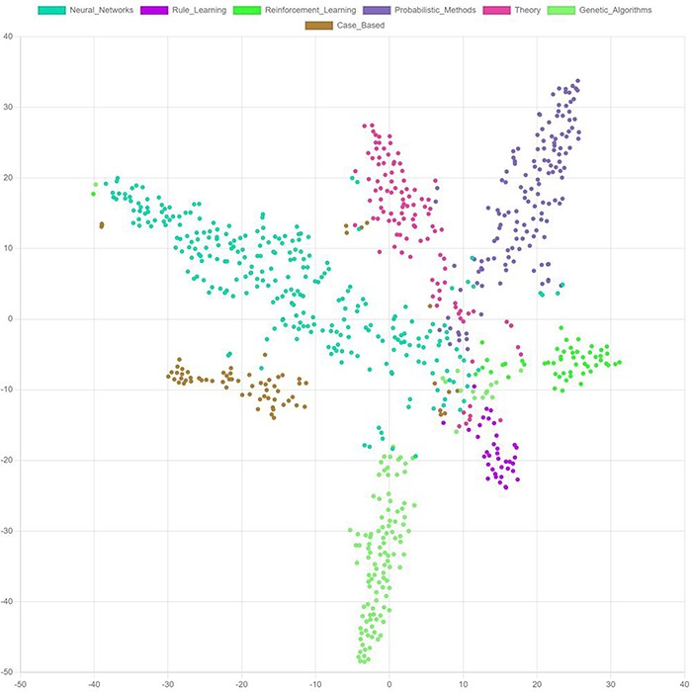
Figure 10. t-SNE. Visualization of final node embeddings after applying two graph convolutional layers on the Cora ...
Notes:
Figure 10. t-SNE. Visualization of final node embeddings after applying two graph convolutional layers on the Cora citation dataset (203) (PyTorch Geometric (204), embedding-dimension: 128). Each color represents a research topic for a node (circle).
Unless provided in the caption above, the following copyright applies to the content of this slide: © The Author(s) 2024. Published by Oxford University Press.This is an Open Access article distributed under the terms of the Creative Commons Attribution License (https://creativecommons.org/licenses/by/4.0/), which permits unrestricted reuse, distribution, and reproduction in any medium, provided the original work is properly cited.

