Slide 1
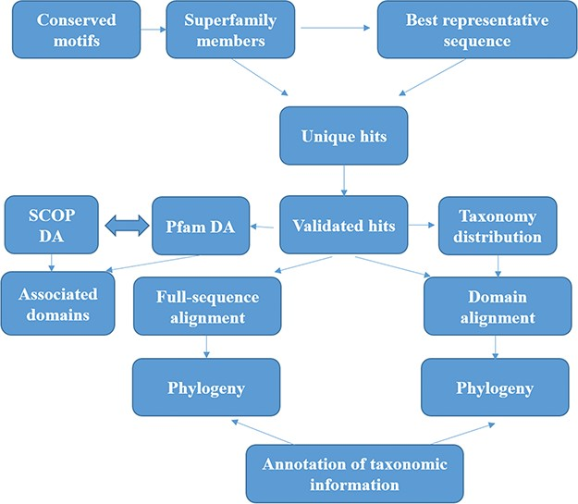
Figure 1 Workflow followed for GenDiS+. The sequence searches were carried out using BRS-MP approach for ...
Notes:
Figure 1 Workflow followed for GenDiS+. The sequence searches were carried out using BRS-MP approach for multi-membered superfamilies, as described in the Materials and Methods section. The hits were validated using a stringent validation using structure-based sequence alignments of superfamily members. From the validated hits, features like DA computation and phylogeny, domain and full-length alignment and phylogeny and conserved motifs were analysed and have been made available in the database.
Unless provided in the caption above, the following copyright applies to the content of this slide: © The Author(s) 2019. Published by Oxford University Press.This is an Open Access article distributed under the terms of the Creative Commons Attribution License (http://creativecommons.org/licenses/by/4.0/), which permits unrestricted reuse, distribution, and reproduction in any medium, provided the original work is properly cited.

Slide 2
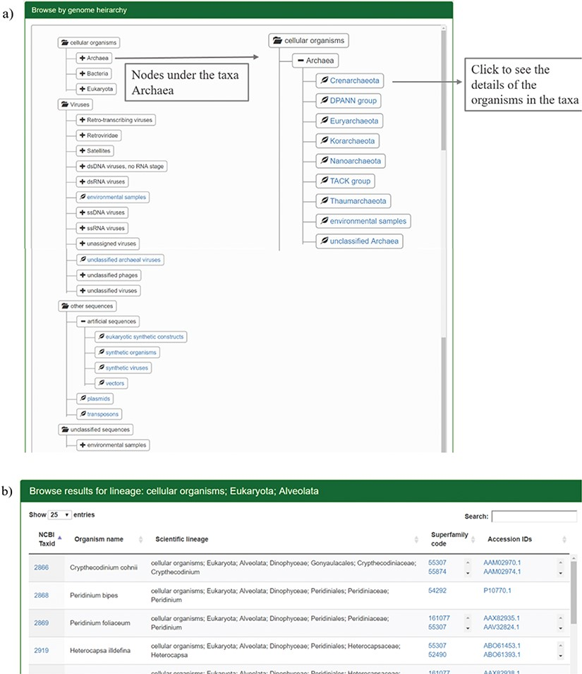
Figure 2 Results for browsing by taxonomy. (a) The taxonomy page lists the superphyla, phyla and family under ...
Notes:
Figure 2 Results for browsing by taxonomy. (a) The taxonomy page lists the superphyla, phyla and family under different categories like cellular organisms, viruses, unclassified sequences and artificial sequences. The users can click on the parent nodes to expand the contents. Clicking on the child nodes with a leaf sign leads to a page listing all the species in the node with the complete hierarchy, accession ids and SCOP superfamilies of homologues. Links have been provided to NCBI taxonomy database on clicking the taxids and GenBank/Refseq page on clicking protein accession ids. Results for the expanded branch of the kingdom `Archaea’ has been shown. (b) Users can also browse the database using names for taxa, phyla, family etc. An example for search result of the keyword `Alveolata’ is shown.
Unless provided in the caption above, the following copyright applies to the content of this slide: © The Author(s) 2019. Published by Oxford University Press.This is an Open Access article distributed under the terms of the Creative Commons Attribution License (http://creativecommons.org/licenses/by/4.0/), which permits unrestricted reuse, distribution, and reproduction in any medium, provided the original work is properly cited.

Slide 3
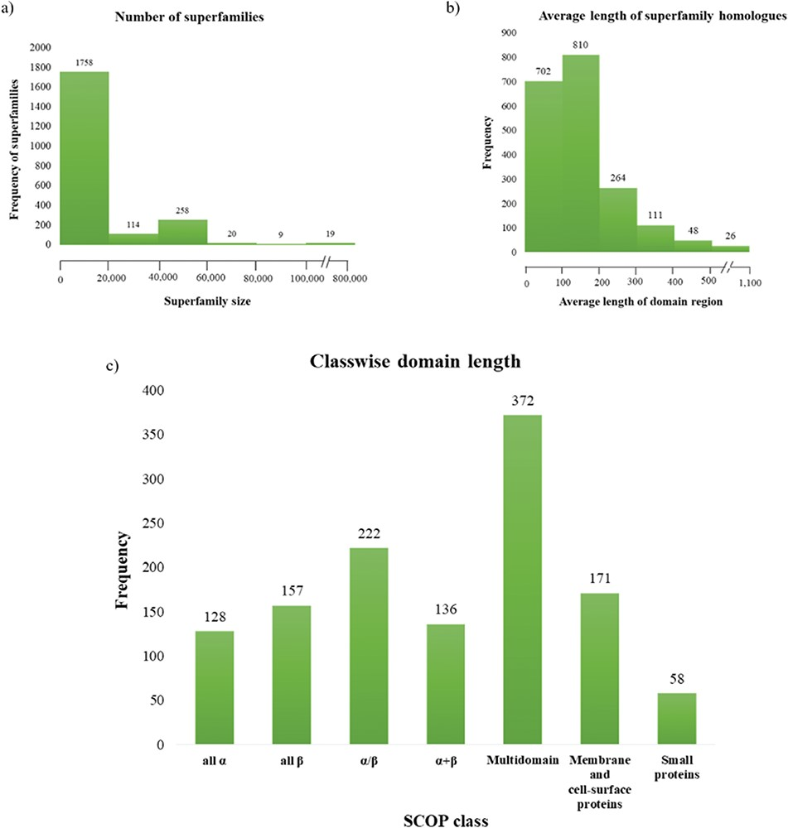
Figure 3 Superfamily statistics in GenDiS+. (a) The distribution of homologues across superfamilies. A majority of the ...
Notes:
Figure 3 Superfamily statistics in GenDiS+. (a) The distribution of homologues across superfamilies. A majority of the superfamilies (89.65%) have up to 20 000 homologues with only 19 (~1%) superfamilies having over 100 000 members. (b) Distribution of domain length across superfamilies. (c) Most of the superfamily homologues have an average length up to 200 residues, with only homologues of multi-domain superfamily class having a domain length above 500 residues.
Unless provided in the caption above, the following copyright applies to the content of this slide: © The Author(s) 2019. Published by Oxford University Press.This is an Open Access article distributed under the terms of the Creative Commons Attribution License (http://creativecommons.org/licenses/by/4.0/), which permits unrestricted reuse, distribution, and reproduction in any medium, provided the original work is properly cited.

Slide 4
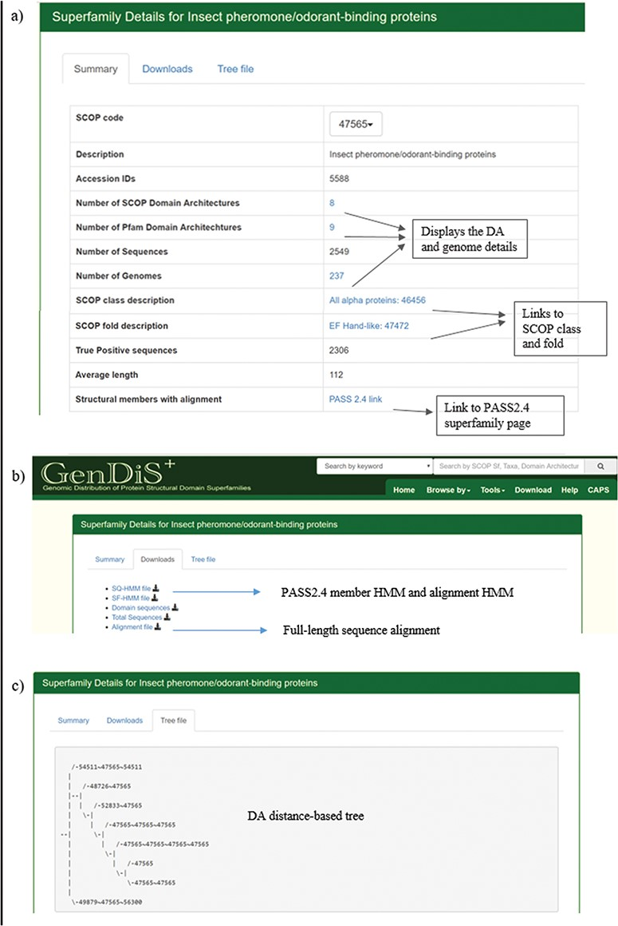
Figure 4 Superfamily description page. Details pertaining to each superfamily like (a) SCOP/Pfam DA, genomes covered, ...
Notes:
Figure 4 Superfamily description page. Details pertaining to each superfamily like (a) SCOP/Pfam DA, genomes covered, full length are available in the summary page; (b) validated sequences, domain sequence alignment and phylogeny are available for download in the `Downloads’ page; and (c) the DA-distance trees can be visualized in the `Tree file’ page.
Unless provided in the caption above, the following copyright applies to the content of this slide: © The Author(s) 2019. Published by Oxford University Press.This is an Open Access article distributed under the terms of the Creative Commons Attribution License (http://creativecommons.org/licenses/by/4.0/), which permits unrestricted reuse, distribution, and reproduction in any medium, provided the original work is properly cited.

Slide 5
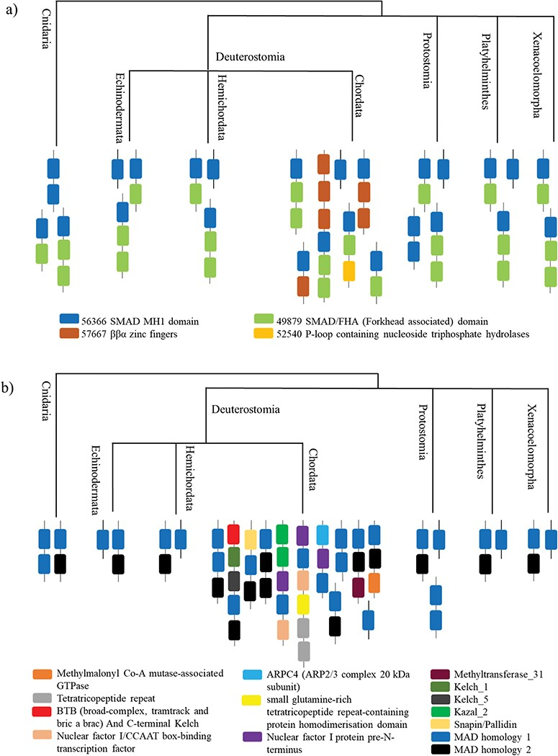
Figure 5 A case study of Smad protein MH1 superfamily. (a) The phylogenetic distribution of the SCOP-DA is ...
Notes:
Figure 5 A case study of Smad protein MH1 superfamily. (a) The phylogenetic distribution of the SCOP-DA is represented, across different taxa in Cnidaria and Bilateria. As shown, the single-domain form and the combination with SMAD/FHA are prevalent in all orders while the other domain combinations occur only in certain taxa. (b) The phylogenetic representation of Pfam DA indicates that there is a correspondence between DA predictions by both methods in spite of using differently derived HMM libraries.
Unless provided in the caption above, the following copyright applies to the content of this slide: © The Author(s) 2019. Published by Oxford University Press.This is an Open Access article distributed under the terms of the Creative Commons Attribution License (http://creativecommons.org/licenses/by/4.0/), which permits unrestricted reuse, distribution, and reproduction in any medium, provided the original work is properly cited.

