Slide 1
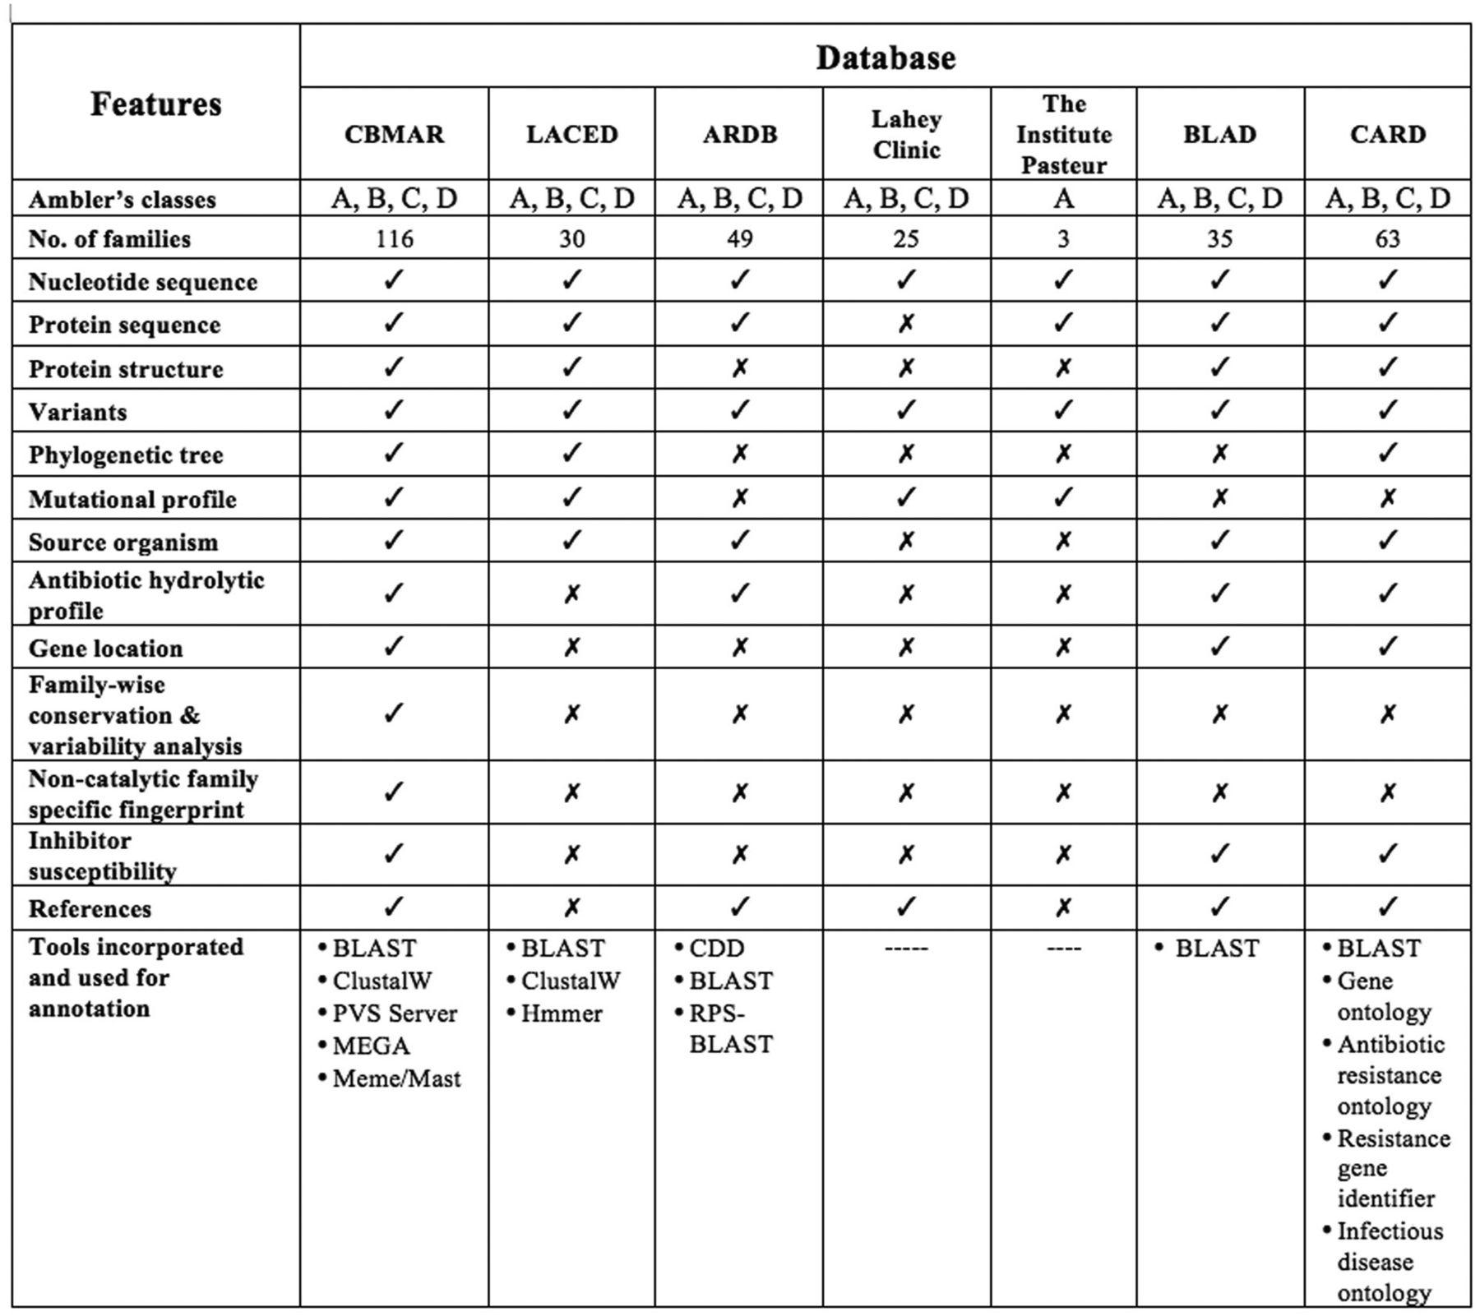
Figure 1. Comparison of CBMAR with existing β-lactamase information resources.
Notes:
Figure 1. Comparison of CBMAR with existing β-lactamase information resources.
Unless provided in the caption above, the following copyright applies to the content of this slide: © The Author(s) 2014. Published by Oxford University Press.This is an Open Access article distributed under the terms of the Creative Commons Attribution License (http://creativecommons.org/licenses/by/4.0/), which permits unrestricted reuse, distribution, and reproduction in any medium, provided the original work is properly cited.

Slide 2
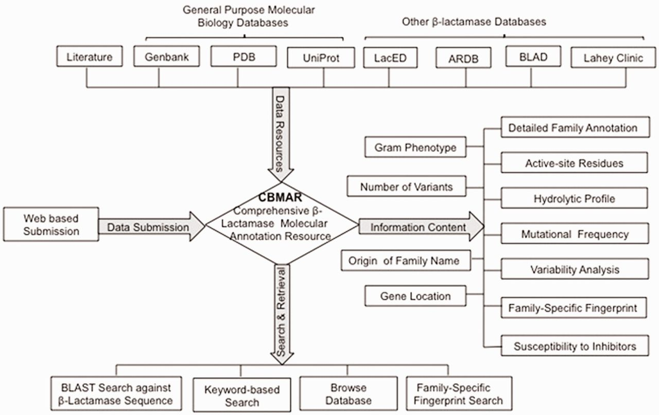
Figure 2. A schematic representation of the CBMAR database.
Notes:
Figure 2. A schematic representation of the CBMAR database.
Unless provided in the caption above, the following copyright applies to the content of this slide: © The Author(s) 2014. Published by Oxford University Press.This is an Open Access article distributed under the terms of the Creative Commons Attribution License (http://creativecommons.org/licenses/by/4.0/), which permits unrestricted reuse, distribution, and reproduction in any medium, provided the original work is properly cited.

Slide 3
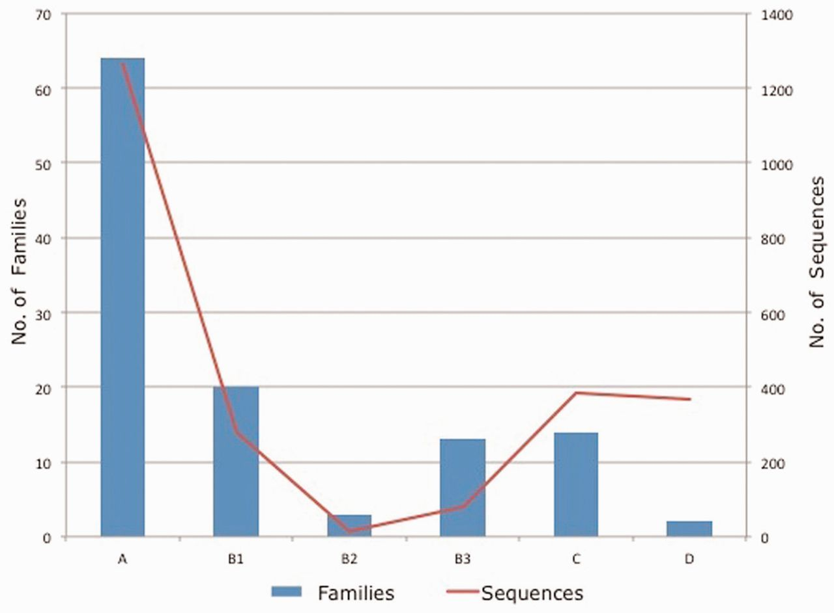
Figure 3. Class/subclass wise statistics of the annotated families and sequences present in CBMAR.
Notes:
Figure 3. Class/subclass wise statistics of the annotated families and sequences present in CBMAR.
Unless provided in the caption above, the following copyright applies to the content of this slide: © The Author(s) 2014. Published by Oxford University Press.This is an Open Access article distributed under the terms of the Creative Commons Attribution License (http://creativecommons.org/licenses/by/4.0/), which permits unrestricted reuse, distribution, and reproduction in any medium, provided the original work is properly cited.

Slide 4
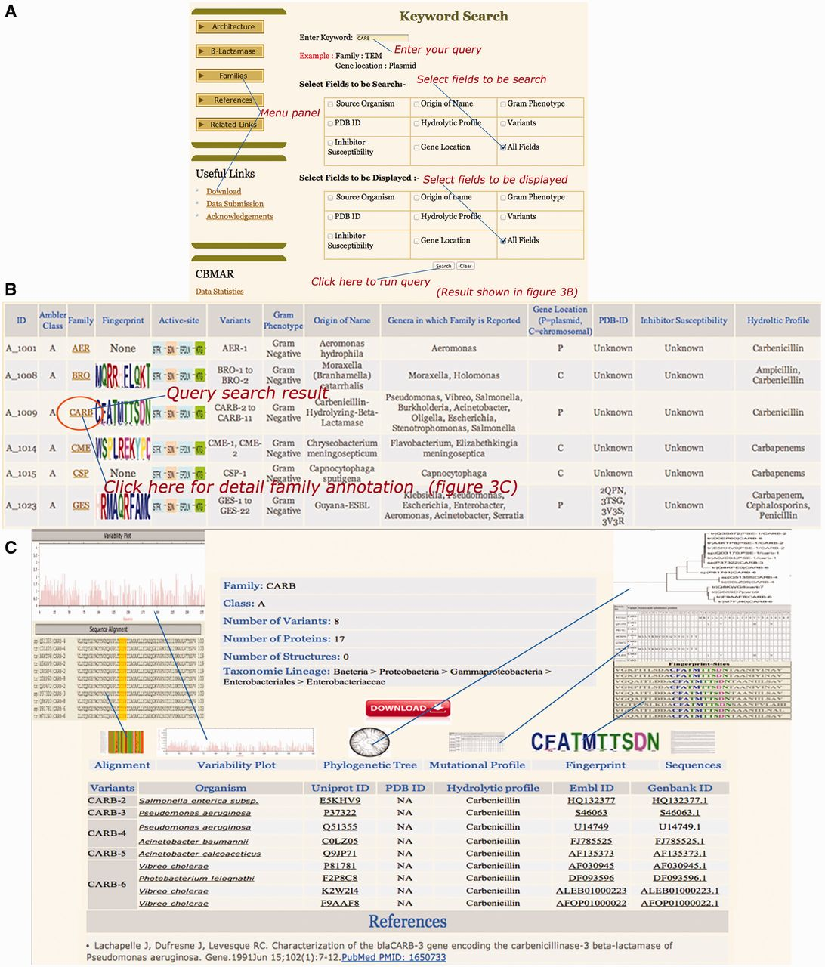
Figure 4. Snapshots of ‘CARB’ keyword search (A), result page (B) and family details (C). The search interface allows ...
Notes:
Figure 4. Snapshots of ‘CARB’ keyword search (A), result page (B) and family details (C). The search interface allows for the query search over one or multiple fields. Similarly, the display of result can also be limited to one or multiple fields. The result displays the search results along with appropriate hyperlinks for detailed family annotation, fingerprint and active site residues.
Unless provided in the caption above, the following copyright applies to the content of this slide: © The Author(s) 2014. Published by Oxford University Press.This is an Open Access article distributed under the terms of the Creative Commons Attribution License (http://creativecommons.org/licenses/by/4.0/), which permits unrestricted reuse, distribution, and reproduction in any medium, provided the original work is properly cited.

