Slide 1
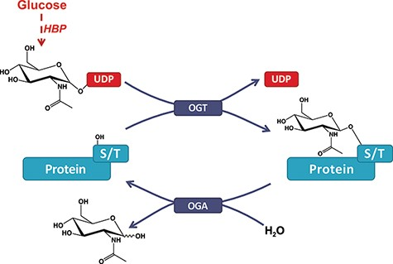
Figure 1. O-GlcNAcylation of proteins. A single β-N-acetyl-glucosamine residue is added by the O-GlcNAc transferase ...
Notes:
Figure 1. O-GlcNAcylation of proteins. A single β-N-acetyl-glucosamine residue is added by the O-GlcNAc transferase (OGT) and removed by the O-GlcNAcase (OGA). The hexosamine biosynthesis pathway drives the production of the O-GlcNAc nucleotide donor (e.g., UDP-GlcNAc) from glucose (Glc). Serine or threonine (S/T) is targeted for modification on intracellular proteins.
Unless provided in the caption above, the following copyright applies to the content of this slide: © The Author(s) 2021. Published by Oxford University Press.This is an Open Access article distributed under the terms of the Creative Commons Attribution License (http://creativecommons.org/licenses/by/4.0/), which permits unrestricted reuse, distribution, and reproduction in any medium, provided the original work is properly cited.

