Slide 1
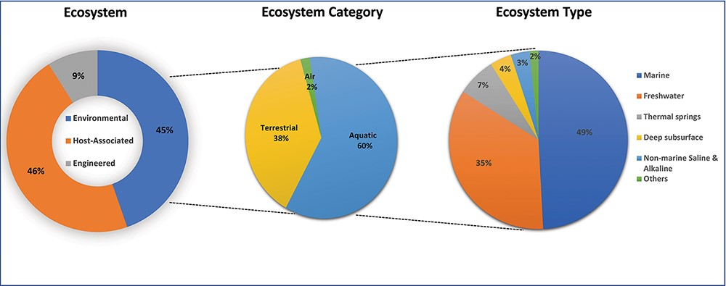
Figure 2. The distribution of 180 677 public biosamples among the top three GOLD ecosystem classification levels.
Notes:
Figure 2. The distribution of 180 677 public biosamples among the top three GOLD ecosystem classification levels.
Unless provided in the caption above, the following copyright applies to the content of this slide: Published by Oxford University Press 2023. This work is written by (a) US Government employee(s) and is in the public domain in the US.This work is written by (a) US Government employee(s) and is in the public domain in the US.

