Slide 1
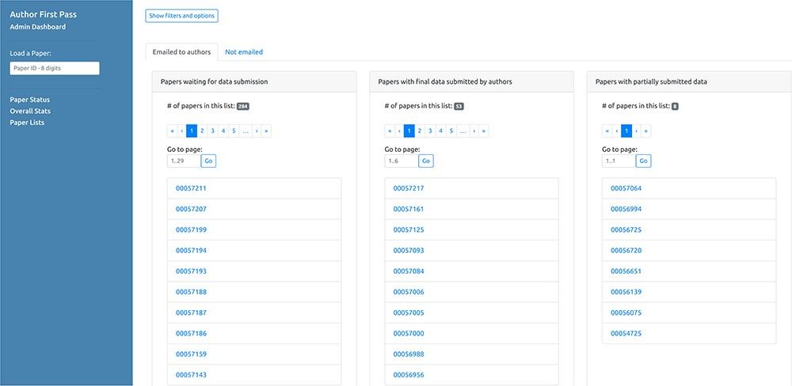
Figure 7 Curator dashboard - Paper lists. This page of the curator dashboard contains links to the feedback form for ...
Notes:
Figure 7 Curator dashboard - Paper lists. This page of the curator dashboard contains links to the feedback form for authors for all papers processed by the pipeline, divided into different groups depending on their status (i.e. processed but not submitted, full submissions and partial submissions).
Unless provided in the caption above, the following copyright applies to the content of this slide: © The Author(s) 2020. Published by Oxford University Press.This is an Open Access article distributed under the terms of the Creative Commons Attribution License (http://creativecommons.org/licenses/by/4.0/), which permits unrestricted reuse, distribution, and reproduction in any medium, provided the original work is properly cited.

