Slide 1
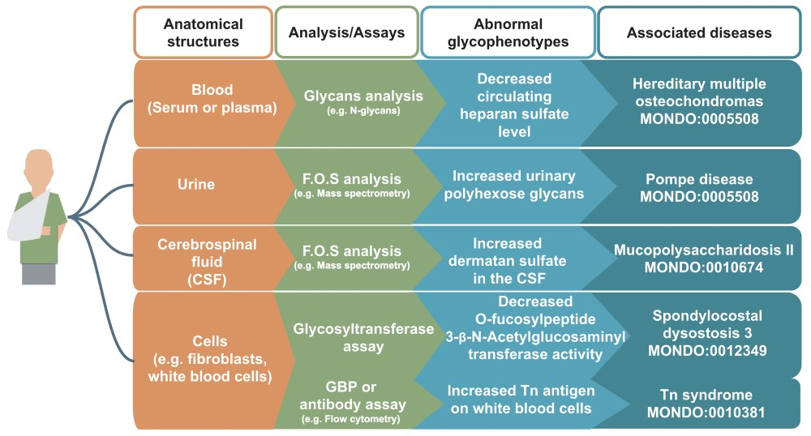
Figure 2 Examples of glycophenotypes that can be captured from various laboratory techniques From a patient’s ...
Notes:
Figure 2 Examples of glycophenotypes that can be captured from various laboratory techniques From a patient’s anatomical structures (indicated in orange boxes, e.g. blood), glycans such as free oligosaccharides (F.O.S.) and glycan-related molecules can be analyzed by standard glycomics assays (indicated in green boxes, e.g. GBP or antibody assay). Patients’ glycophenotypes indicated in the blue boxes can be captured from publications: decreased circulating HS level (82), increased urinary polyhexose glycans (36), increased dermatan sulfate in the CSF (83), decreased O-Fucosylpeptide 3-beta-N-acetylglucosaminyltransferase activity (84) and increased Tn antigen in white blood cells (85). In our preliminary work, we have logically defined design patterns (86) that would generate hundreds of classes, but they are not yet fully integrated in the HPO.
Unless provided in the caption above, the following copyright applies to the content of this slide: © The Author(s) 2019. Published by Oxford University Press.This is an Open Access article distributed under the terms of the Creative Commons Attribution License (http://creativecommons.org/licenses/by/4.0/), which permits unrestricted reuse, distribution, and reproduction in any medium, provided the original work is properly cited.

