Slide 1
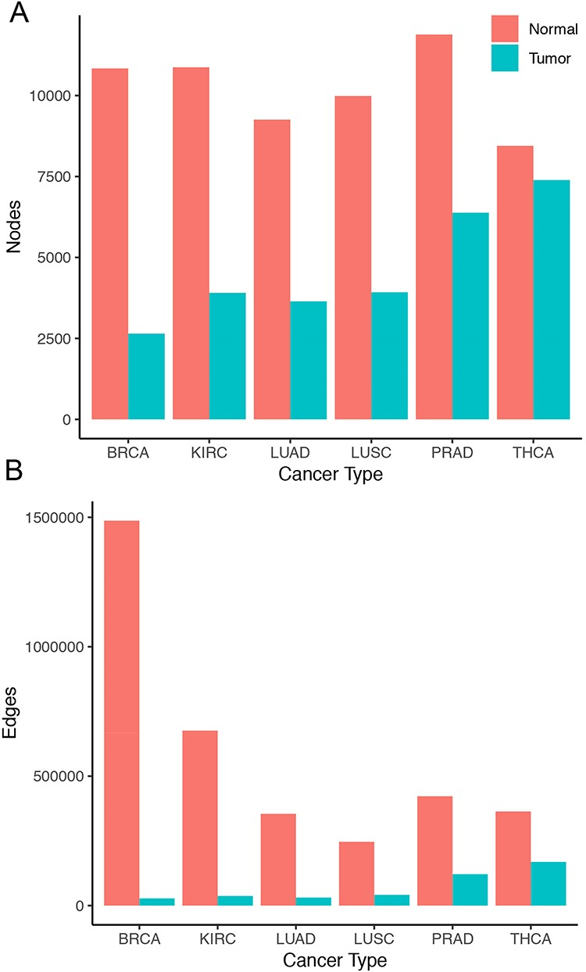
Figure 1. Size of co-expression networks. The bar charts show the total number of (A) nodes and (B) edges in the normal ...
Notes:
Figure 1. Size of co-expression networks. The bar charts show the total number of (A) nodes and (B) edges in the normal (red) and tumor (blue) co-expression graphs.
Unless provided in the caption above, the following copyright applies to the content of this slide: © The Author(s) 2020. Published by Oxford University Press.This is an Open Access article distributed under the terms of the Creative Commons Attribution License (http://creativecommons.org/licenses/by/4.0/), which permits unrestricted reuse, distribution, and reproduction in any medium, provided the original work is properly cited.

