Slide 1
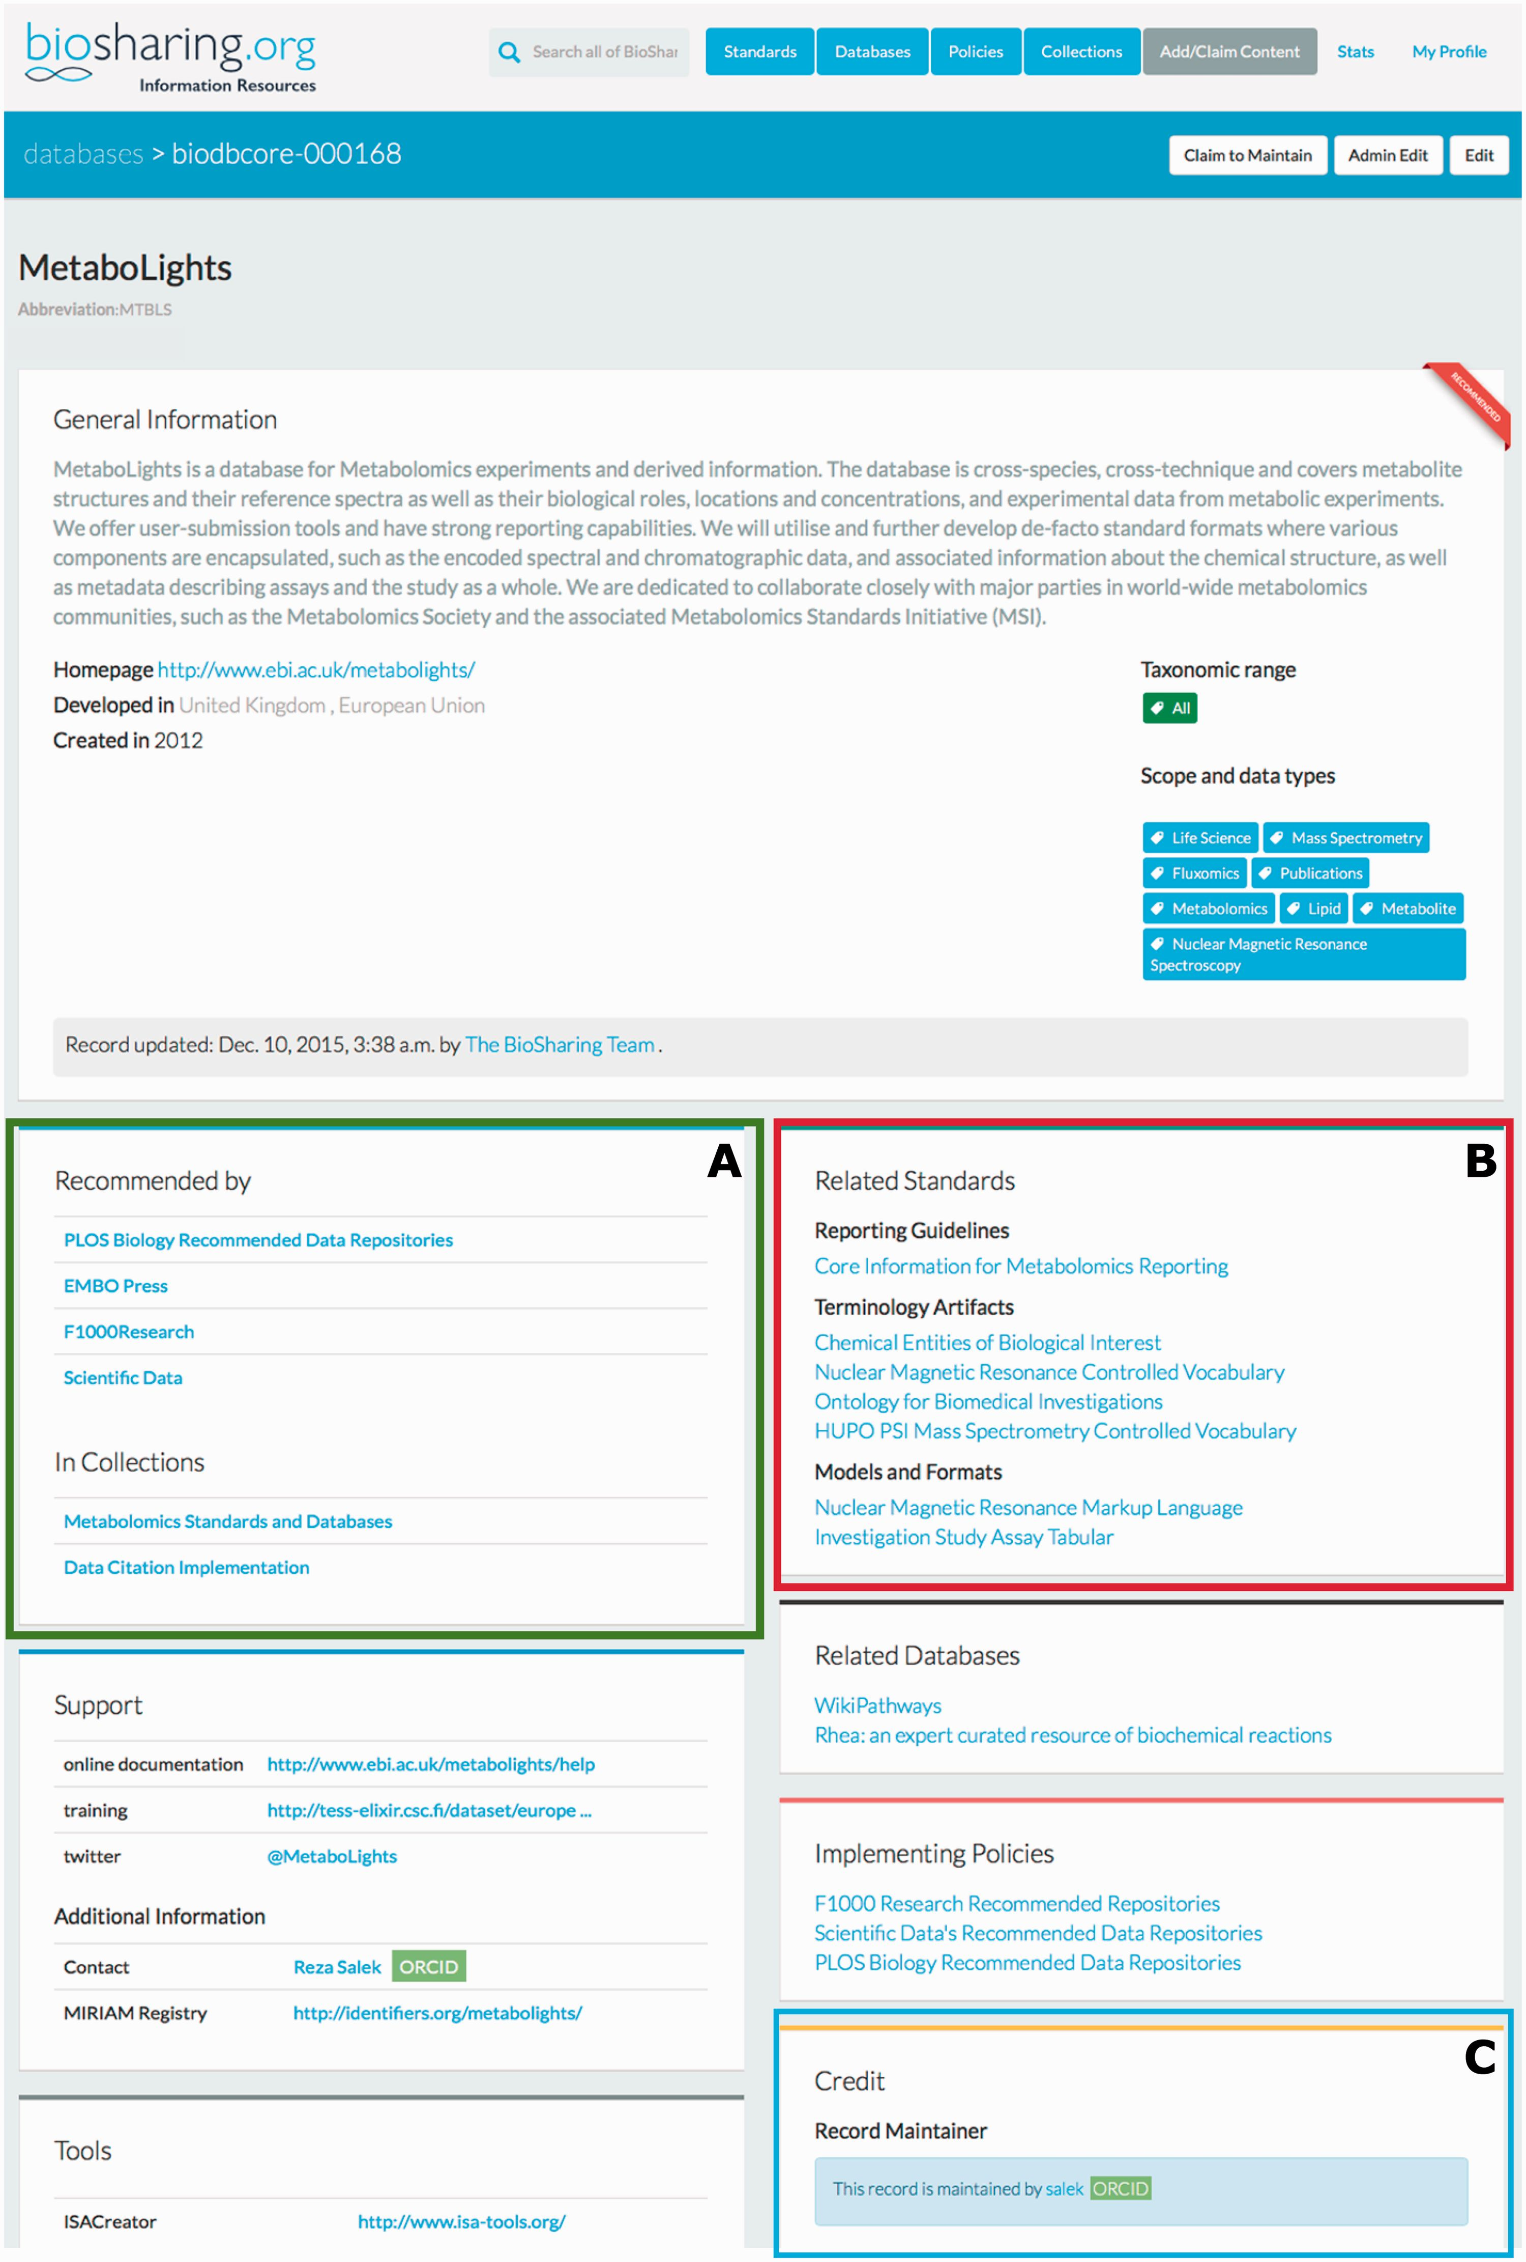
Figure 2 The top section of the BioSharing Metabolights Database Record. Every record on BioSharing starts with a ...
Notes:
Figure 2 The top section of the BioSharing Metabolights Database Record. Every record on BioSharing starts with a general information section, containing a description of the resource, and details of the domains and species that the resource covers. Further, more specific details are found in the boxes beneath this section. If a resource is selected in a Collection or Recommendation, this information is provided in the ‘In Collections’ section ( A —highlighted in green). The standards implemented in the Metabolights database are found in the Related Standards section ( B —highlighted in red), split into the three standard subtypes. The Metabolights database record is maintained by the resource themselves. This information is found in the Credit section ( C —highlighted in blue). Clicking on the maintainer link takes you to the profile for the maintainer, with information linked from their ORCID account, if connected. This section also contains information on the group that has developed the resource and funding information. The Metabolights database is mentioned in four collections (as of November 2015). Clicking on any of the links in this section takes the user directly to the collection.
Unless provided in the caption above, the following copyright applies to the content of this slide: © The Author(s) 2016. Published by Oxford University Press. This is an Open Access article distributed under the terms of the Creative Commons Attribution License ( http://creativecommons.org/licenses/by/4.0/ ), which permits unrestricted reuse, distribution, and reproduction in any medium, provided the original work is properly cited.

