Slide 1
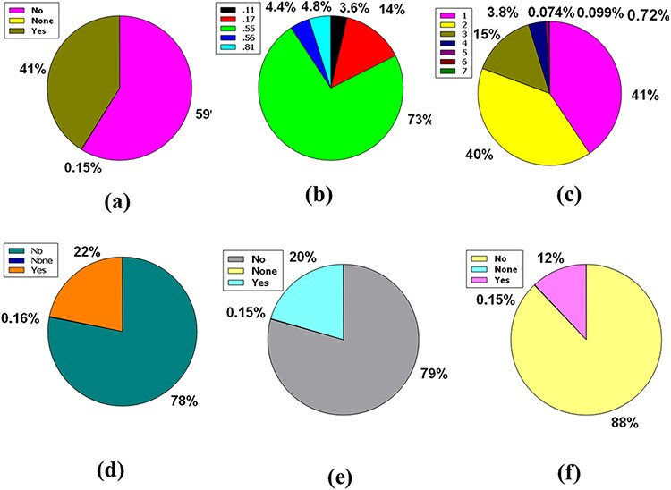
Figure 4. Venn diagram plot illustration of the physicochemical properties of phytochemicals in ‘phytochemdb’ database: ...
Notes:
Figure 4. Venn diagram plot illustration of the physicochemical properties of phytochemicals in ‘phytochemdb’ database: (a) BBB permeable and impermeable proportions of phytochemicals; (b) percentages of phytochemicals that satisfy diverse bioavailability scores; (c) the Brenk structural alert of compounds with different percentages; proportions of (d) CYP1A2, (e) CYP2C9, (f) CYP2C19 inhibitors and non-inhibitors of phytochemicals in the database.
Unless provided in the caption above, the following copyright applies to the content of this slide: © The Author(s) 2022. Published by Oxford University Press.This is an Open Access article distributed under the terms of the Creative Commons Attribution License (https://creativecommons.org/licenses/by/4.0/), which permits unrestricted reuse, distribution, and reproduction in any medium, provided the original work is properly cited.

