Slide 1
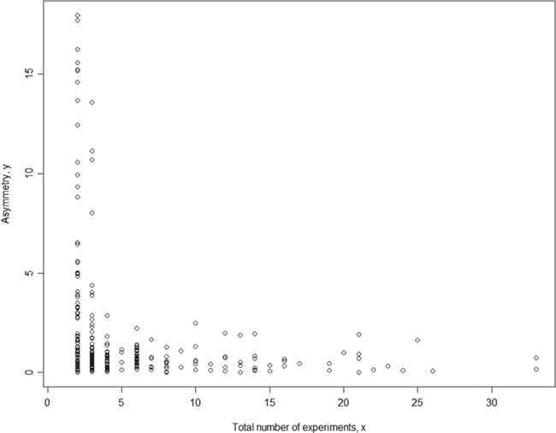
Figure 4 Relationship between asymmetry score and total number of experiments for body weight. While each ...
Notes:
Figure 4 Relationship between asymmetry score and total number of experiments for body weight. While each meta-analysis is based on a unique phenotype-strain pair, for different phenotype-strain pairs, the total number of experiments can vary significantly. The result above shows that the asymmetry score (Asy) was reduced significantly with four or more experiments in one meta-analysis.
Unless provided in the caption above, the following copyright applies to the content of this slide: © The Author(s) 2019. Published by Oxford University Press.This is an Open Access article distributed under the terms of the Creative Commons Attribution License (http://creativecommons.org/licenses/by/4.0/), which permits unrestricted reuse, distribution, and reproduction in any medium, provided the original work is properly cited.

