Slide 1
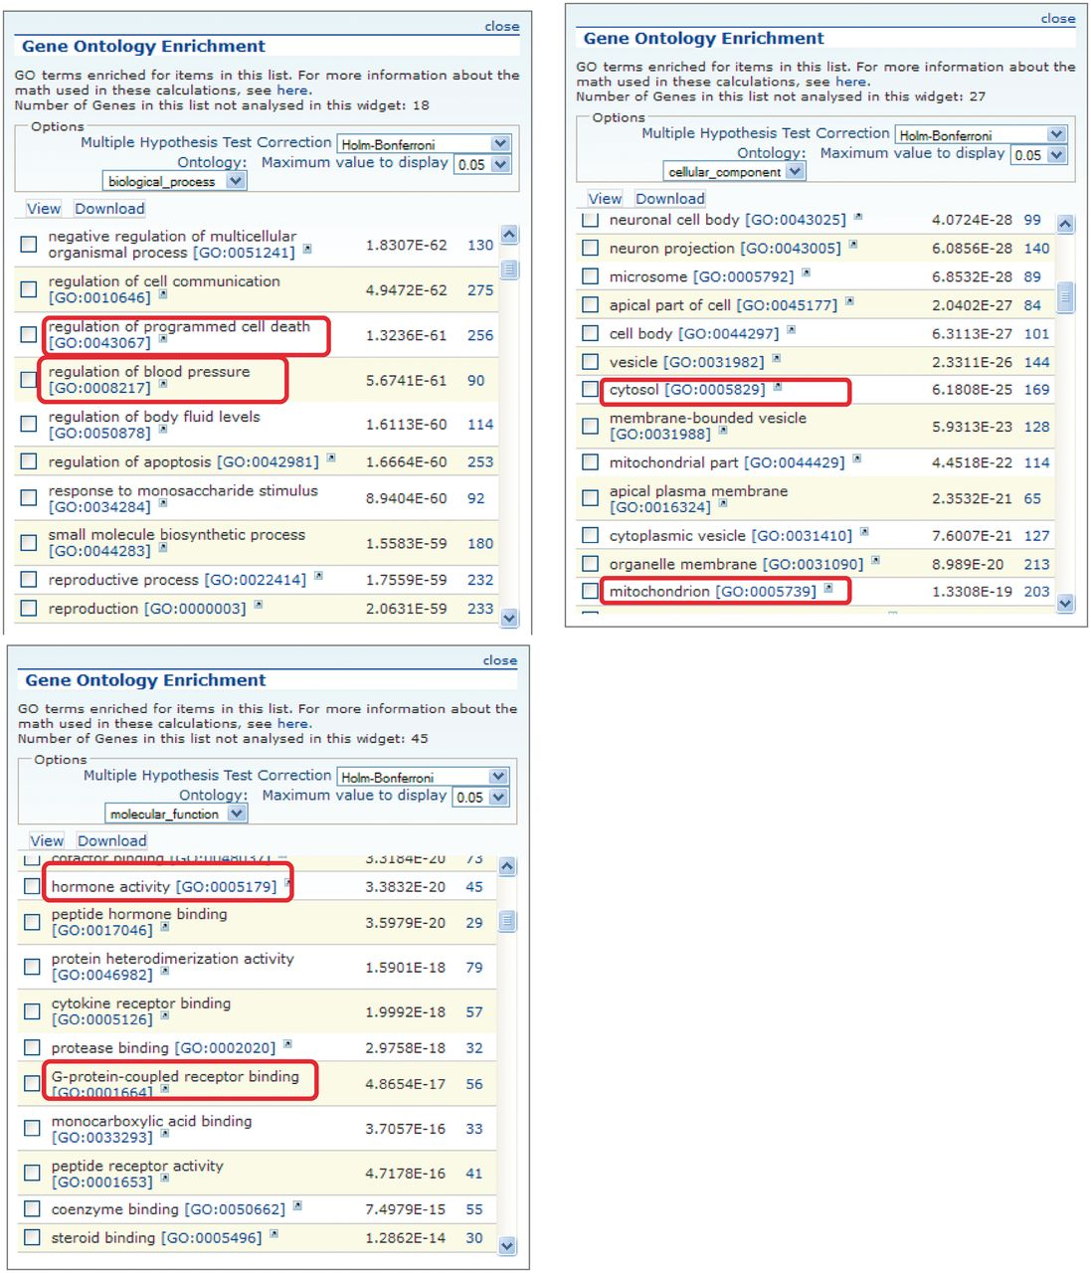
Figure 3. GO enrichment tables for the three GO aspects of genes associated with the obesity/metabolic syndrome portal. ...
Notes:
Figure 3. GO enrichment tables for the three GO aspects of genes associated with the obesity/metabolic syndrome portal. A total of 1049 rat genes associated with this disease portal were subjected to GO enrichment analysis in RatMine. Only the top portions of the enrichment tables are shown. Two GO terms selected from each GO aspect for comparison are highlighted.
Unless provided in the caption above, the following copyright applies to the content of this slide: © The Author(s) 2013. Published by Oxford University Press.This is an Open Access article distributed under the terms of the Creative Commons Attribution License (http://creativecommons.org/licenses/by/3.0/), which permits unrestricted reuse, distribution, and reproduction in any medium, provided the original work is properly cited.

