Slide 1
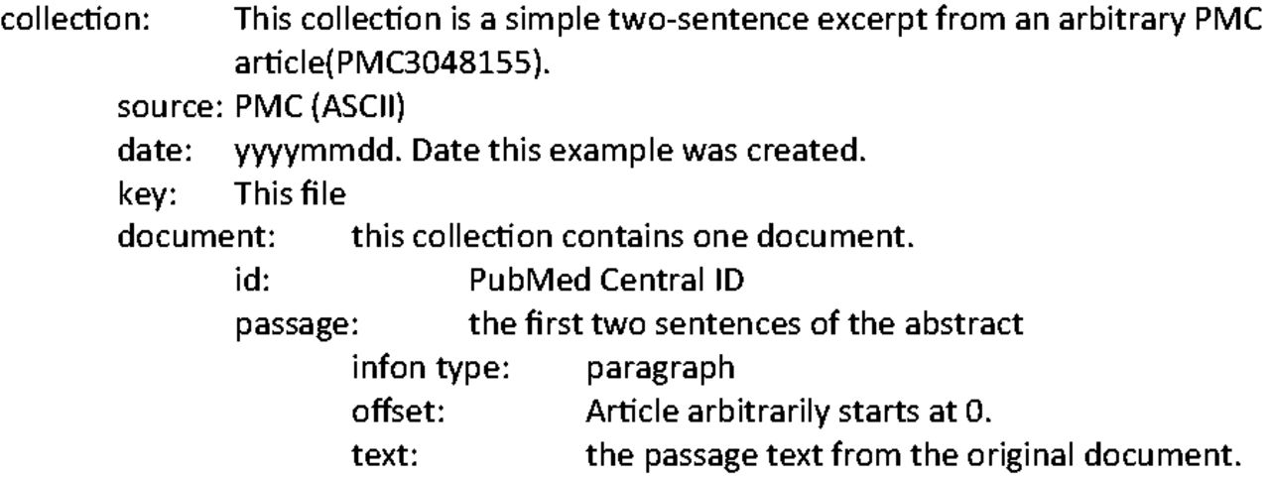
Figure 3. Key file describing BioC file in Figure 2 .
Notes:
Figure 3. Key file describing BioC file in Figure 2 .
Unless provided in the caption above, the following copyright applies to the content of this slide: Published by Oxford University 2014. This work is written by US Government employees and is in the public domain in the US.

