Slide 1
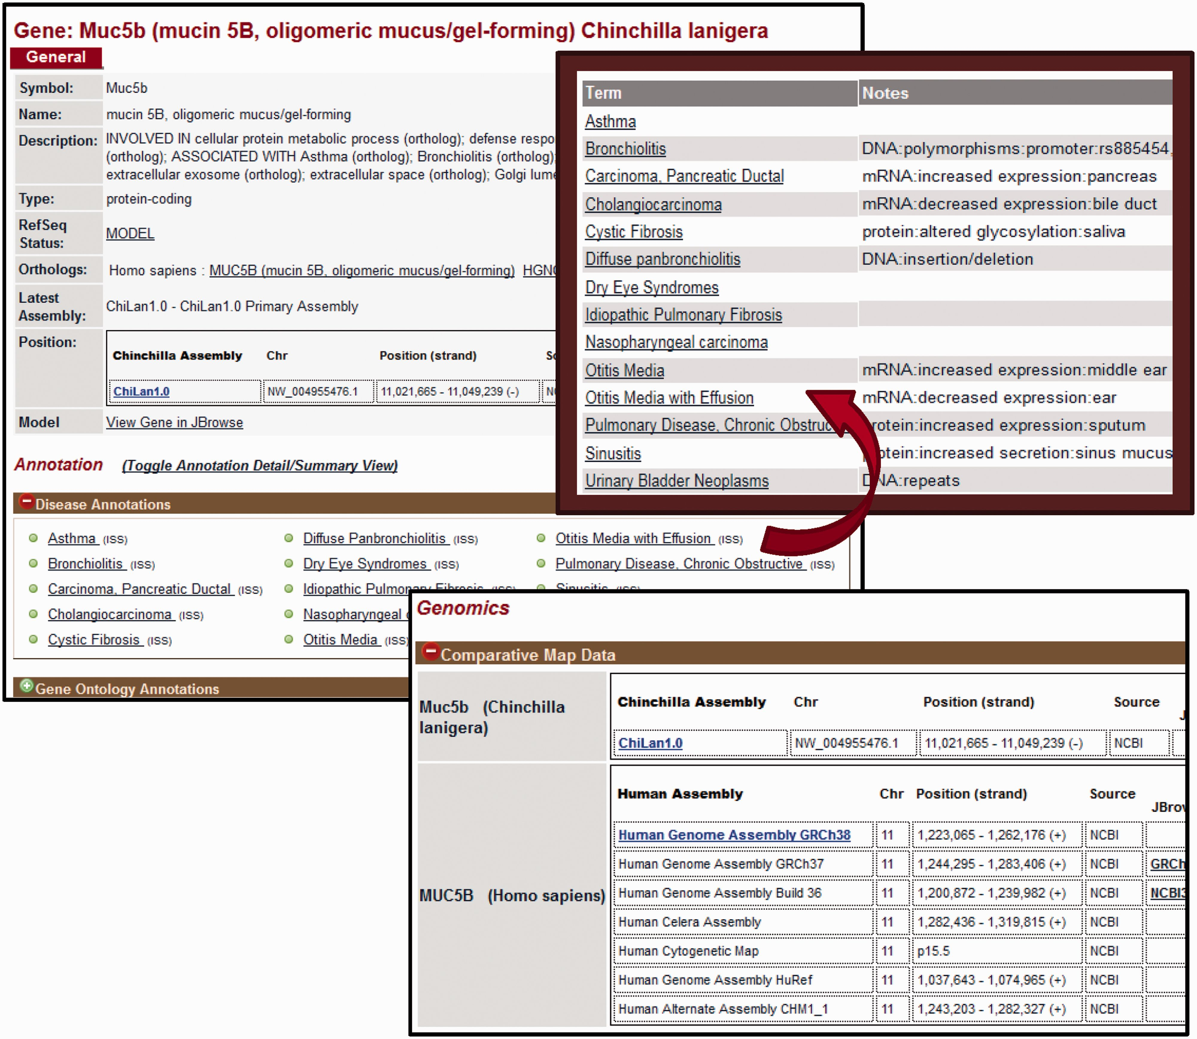
Figure 2. Gene Report Page for Chinchilla. CRRD gene reports display basic information about the gene including the ...
Notes:
Figure 2. Gene Report Page for Chinchilla. CRRD gene reports display basic information about the gene including the symbol and name of the gene, a description based on the functional annotations for that gene, the gene type as assigned by NCBI and the RefSeq status of the gene. In addition, a link is given to the human ortholog (top left). The Annotations section includes Gene Ontology (GO), Disease and Pathway annotations inferred to chinchilla genes from their human orthologs. When viewing the list of annotated terms, the ‘Toggle Annotation Detail/Summary View’ link can be used to show additional details (top right). Comparative map data includes the scaffold positions for chinchilla genes and positions on multiple assemblies for human (bottom).
Unless provided in the caption above, the following copyright applies to the content of this slide: © The Author(s) 2016. Published by Oxford University Press. This is an Open Access article distributed under the terms of the Creative Commons Attribution License ( http://creativecommons.org/licenses/by/4.0/ ), which permits unrestricted reuse, distribution, and reproduction in any medium, provided the original work is properly cited.

