Slide 1
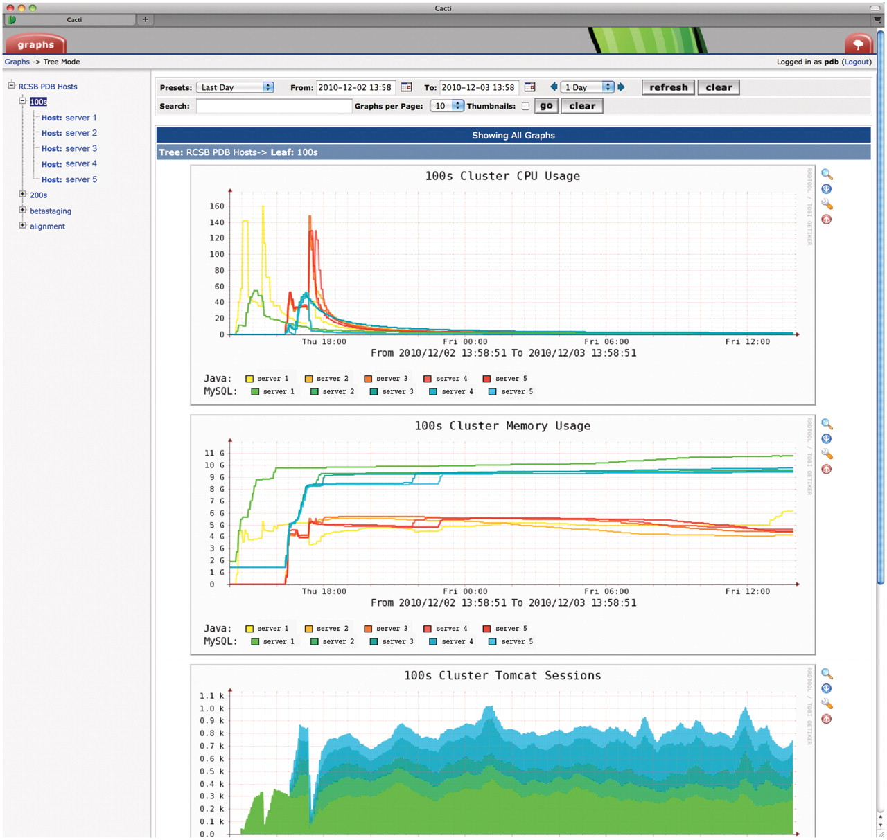
Figure 4. Screenshot of Cacti monitoring tool (www.cacti.net). Parameters such as internal and external traffic, CPU ...
Notes:
Figure 4. Screenshot of Cacti monitoring tool (www.cacti.net). Parameters such as internal and external traffic, CPU and memory usage, thread counts and Tomcat session counts are collected every few minutes and presented in graphical form for each server or cluster. The time window starts after the cluster had just been reinstalled with a new quarterly software release and shows the server load during successive Selenium tests on each server. Server names are redacted for security reasons.
Unless provided in the caption above, the following copyright applies to the content of this slide: © The Author(s) 2011. Published by Oxford University Press.This is Open Access article distributed under the terms of the Creative Commons Attribution Non-Commercial License (http://creativecommons.org/licenses/by-nc/2.5), which permits unrestricted non-commercial use, distribution, and reproduction in any medium, provided the original work is properly cited.

