Slide 1
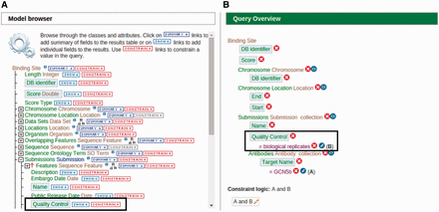
Figure 5. An example of modifying a template using the ‘QueryBuilder’ tool. An existing ‘ChIP target(s) → Binding ...
Notes:
Figure 5. An example of modifying a template using the ‘QueryBuilder’ tool. An existing ‘ChIP target(s) → Binding sites’ template is being modified to display an additional attribute and limit the output by applying a filter. (A) Using the ‘Model browser’ on the left, we enable the attribute ‘quality control’ by clicking the ‘SHOW’ button. This will display quality control attributes in the final result. We can also limit the results by applying a constraint value of ‘biological replicates’ to the quality control attribute by clicking the ‘CONSTRAIN’ button. (B) The ‘Query Overview’ to the right shows that the filter ‘biological replicates’ has been applied to the attribute quality control.
Unless provided in the caption above, the following copyright applies to the content of this slide: © The Author(s) 2015. Published by Oxford University Press. This is an Open Access article distributed under the terms of the Creative Commons Attribution License ( http://creativecommons.org/licenses/by/4.0/ ), which permits unrestricted reuse, distribution, and reproduction in any medium, provided the original work is properly cited.

