Slide 1
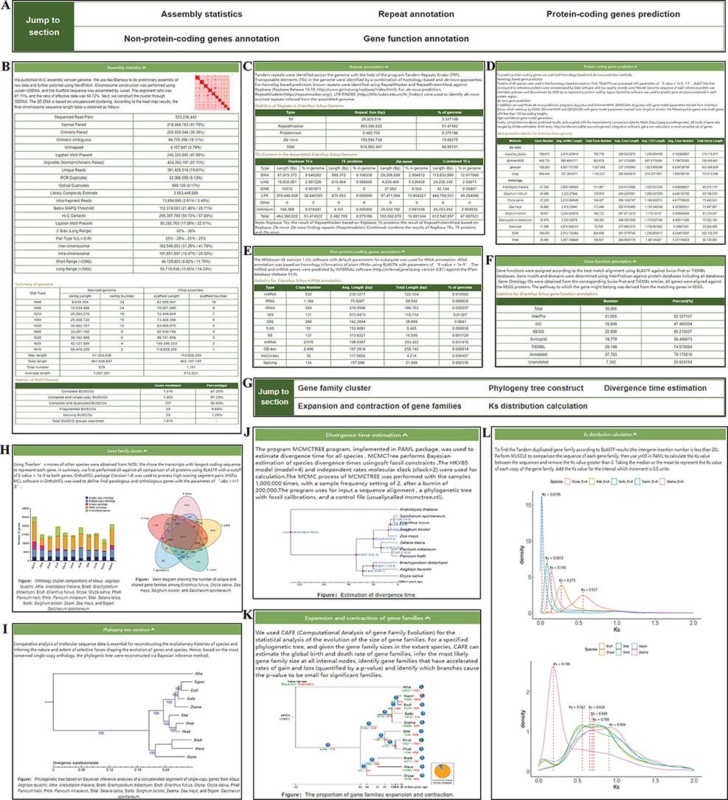
Figure 3. ‘Genome’ module. The ‘Genome’ module has subpages: ‘Statistics’ (A–F) and ‘Analysis’ pages (G–L). (A) The ...
Notes:
Figure 3. ‘Genome’ module. The ‘Genome’ module has subpages: ‘Statistics’ (A–F) and ‘Analysis’ pages (G–L). (A) The navigation bar of the ‘Statistics’ page provides quick access to each section. (B) Assembly statistics. (C) Repeat annotation. (D) Protein-coding genes prediction. (E) Nonprotein-coding genes annotation. (F) Gene functional annotation. (G) The navigation bar of the ‘Analysis’ page. (H) Gene family cluster. (I) Phylogenetic tree. (J) Divergence time. (K) Expansion and contraction of gene families. (L) Ks distribution.
Unless provided in the caption above, the following copyright applies to the content of this slide: © The Author(s) 2022. Published by Oxford University Press.This is an Open Access article distributed under the terms of the Creative Commons Attribution-NonCommercial License (https://creativecommons.org/licenses/by-nc/4.0/), which permits non-commercial re-use, distribution, and reproduction in any medium, provided the original work is properly cited. For commercial re-use, please contact journals.permissions@oup.com

