Slide 1
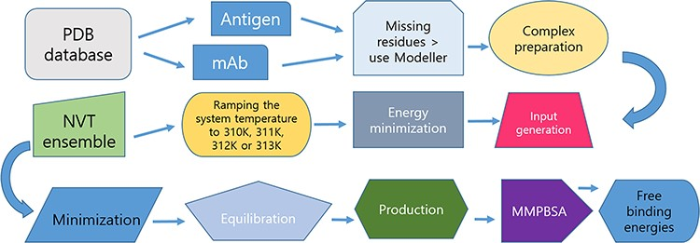
Figure 1. Protocol for data preparation and managing of the simulations.
Notes:
Figure 1. Protocol for data preparation and managing of the simulations.
Unless provided in the caption above, the following copyright applies to the content of this slide: © The Author(s) 2024. Published by Oxford University Press.This is an Open Access article distributed under the terms of the Creative Commons Attribution License (https://creativecommons.org/licenses/by/4.0/), which permits unrestricted reuse, distribution, and reproduction in any medium, provided the original work is properly cited.

Slide 2
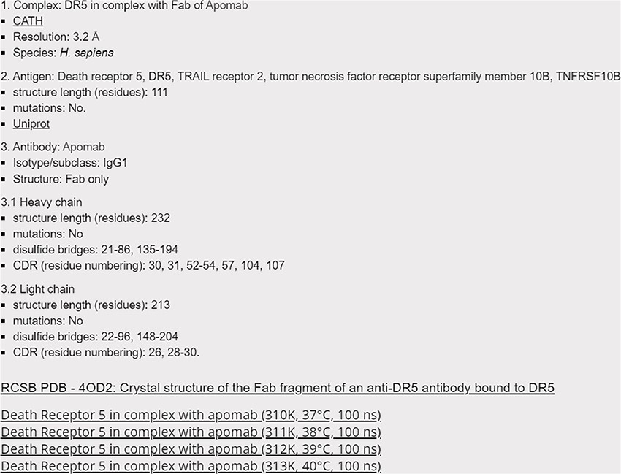
Figure 2. Screenshot of the 4OD2 entry (Death Receptor 5 in complex with apomab), with hyperlinks to CATH, Uniprot and ...
Notes:
Figure 2. Screenshot of the 4OD2 entry (Death Receptor 5 in complex with apomab), with hyperlinks to CATH, Uniprot and RCSB databases, as well as to Harvard Dataverse for accessing the raw data.
Unless provided in the caption above, the following copyright applies to the content of this slide: © The Author(s) 2024. Published by Oxford University Press.This is an Open Access article distributed under the terms of the Creative Commons Attribution License (https://creativecommons.org/licenses/by/4.0/), which permits unrestricted reuse, distribution, and reproduction in any medium, provided the original work is properly cited.

Slide 3
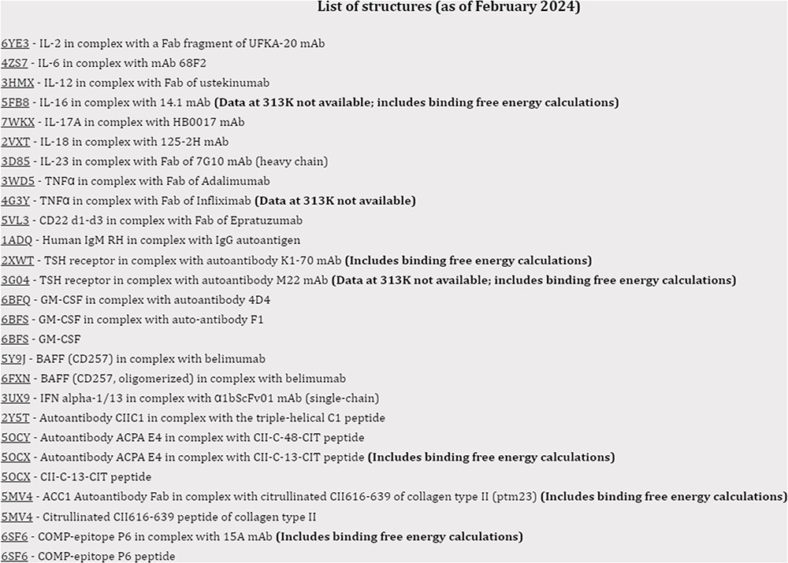
Figure 3. Screenshot of the index page with simulations for the structures relevant for autoimmune conditions.
Notes:
Figure 3. Screenshot of the index page with simulations for the structures relevant for autoimmune conditions.
Unless provided in the caption above, the following copyright applies to the content of this slide: © The Author(s) 2024. Published by Oxford University Press.This is an Open Access article distributed under the terms of the Creative Commons Attribution License (https://creativecommons.org/licenses/by/4.0/), which permits unrestricted reuse, distribution, and reproduction in any medium, provided the original work is properly cited.

Slide 4
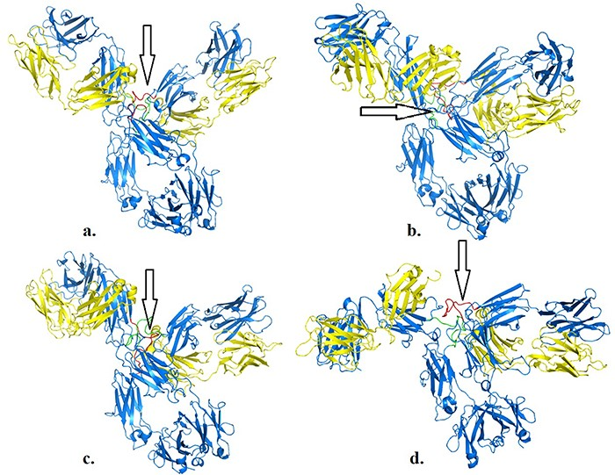
Figure 4. Structures of pembrolizumab (PDB 5DK3) after 100 ns at 310 K (a), 311 K (b), 312 K (c) and 313 K (d). Hinge ...
Notes:
Figure 4. Structures of pembrolizumab (PDB 5DK3) after 100 ns at 310 K (a), 311 K (b), 312 K (c) and 313 K (d). Hinge regions are indicated by arrows.
Unless provided in the caption above, the following copyright applies to the content of this slide: © The Author(s) 2024. Published by Oxford University Press.This is an Open Access article distributed under the terms of the Creative Commons Attribution License (https://creativecommons.org/licenses/by/4.0/), which permits unrestricted reuse, distribution, and reproduction in any medium, provided the original work is properly cited.

Slide 5
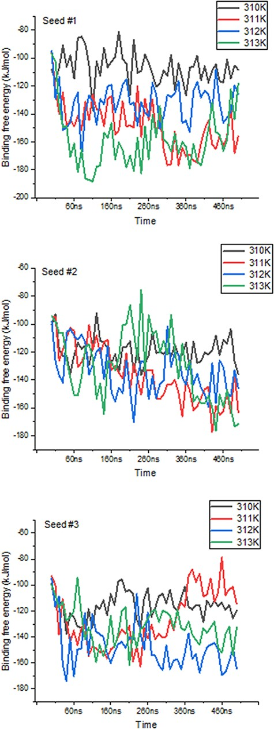
Figure 5. Variations in binding free energies between PD-1 and PD-L2 under different temperatures. Values obtained ...
Notes:
Figure 5. Variations in binding free energies between PD-1 and PD-L2 under different temperatures. Values obtained every 10 ns throughout the 500 ns-long simulations, for each seed and temperature point.
Unless provided in the caption above, the following copyright applies to the content of this slide: © The Author(s) 2024. Published by Oxford University Press.This is an Open Access article distributed under the terms of the Creative Commons Attribution License (https://creativecommons.org/licenses/by/4.0/), which permits unrestricted reuse, distribution, and reproduction in any medium, provided the original work is properly cited.

