Slide 1
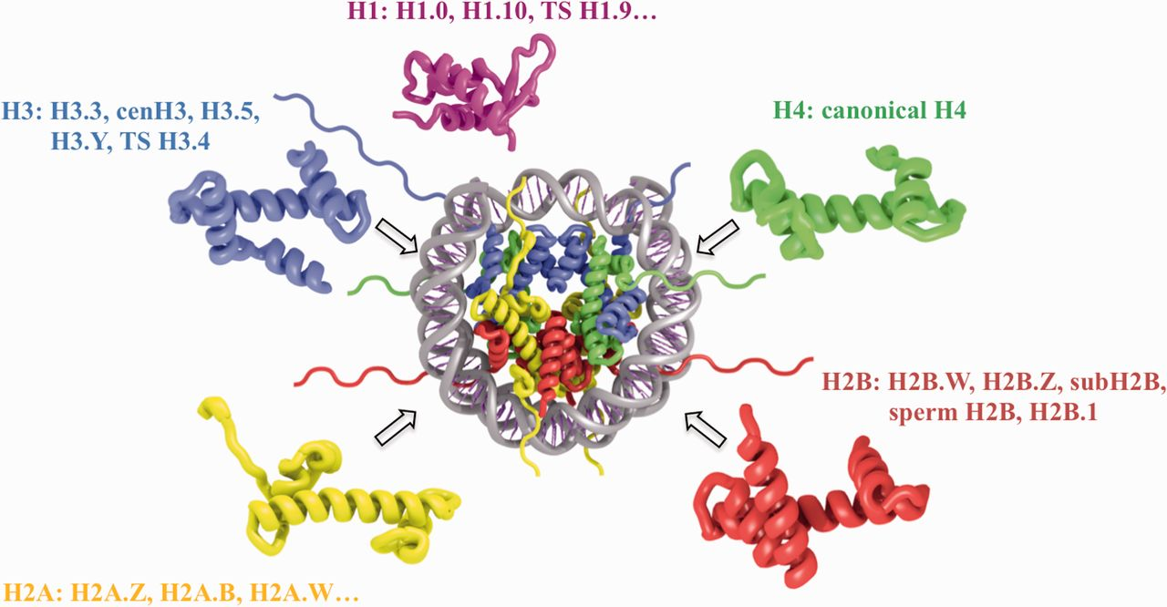
Figure 1. Schematic representation of nucleosome structure and its composition of different histone variants. The ...
Notes:
Figure 1. Schematic representation of nucleosome structure and its composition of different histone variants. The nucleosome core is formed by 147 bp of DNA and an octamer of H3, H4, H2A and H2B histones (depicted in blue, green, yellow and red, respectively). H1 linker histone (magenta) is associated with the nucleosome core near the DNA entry exit points. Selected histone variant names for each histone type are shown.
Unless provided in the caption above, the following copyright applies to the content of this slide: Published by Oxford University Press 2015. This work is written by US Government employees and is in the public domain in the United States.

Slide 2
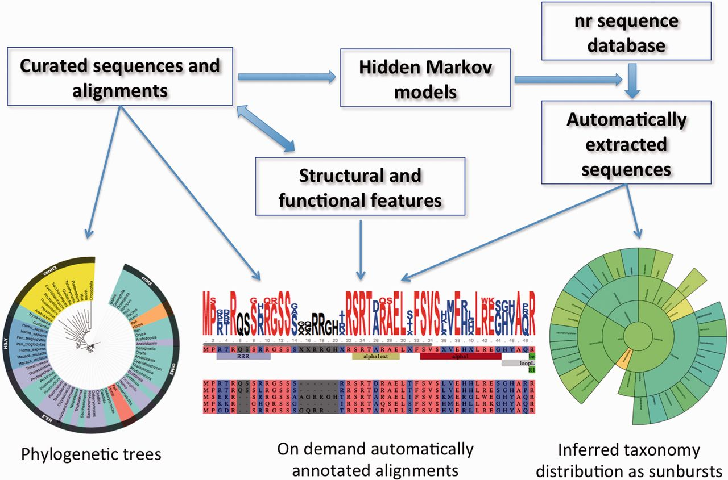
Figure 2. Information flow, main data types and widgets in HistoneDB 2.0 (see text for description).
Notes:
Figure 2. Information flow, main data types and widgets in HistoneDB 2.0 (see text for description).
Unless provided in the caption above, the following copyright applies to the content of this slide: Published by Oxford University Press 2015. This work is written by US Government employees and is in the public domain in the United States.

Slide 3
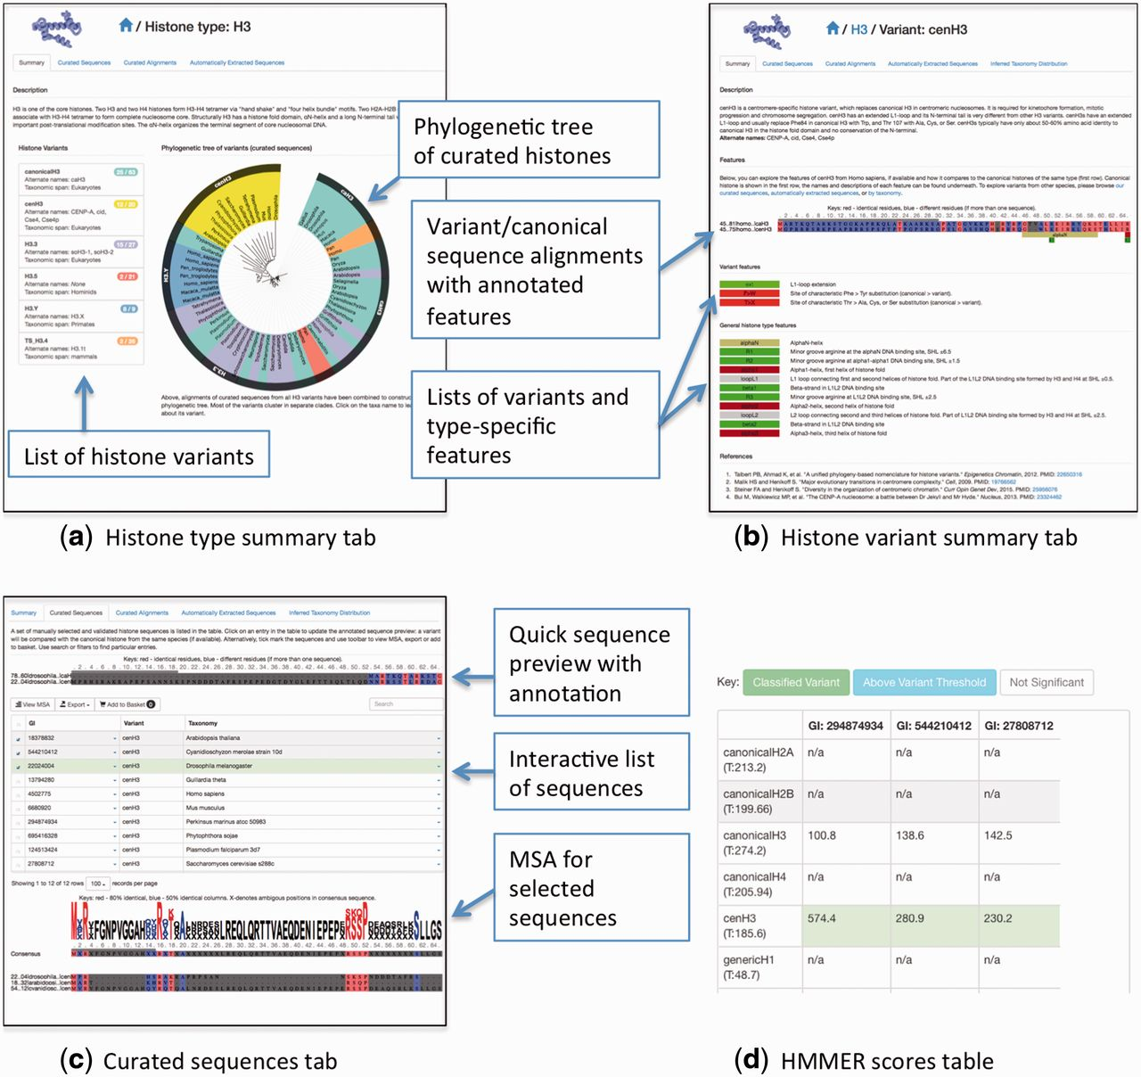
Figure 3 A summary of HistoneDB 2.0 web site. (a) information page for a given histone type, (b) a summary page for a ...
Notes:
Figure 3 A summary of HistoneDB 2.0 web site. (a) information page for a given histone type, (b) a summary page for a typical histone variant, (c) ‘Curated sequences’ tab of the histone variant page, (d) a table view of HMMER scores used to classify the selected sequences from the automatically extracted set (access via ‘Advanced’ menu, ‘Score against all HMMs’ button).
Unless provided in the caption above, the following copyright applies to the content of this slide: Published by Oxford University Press 2015. This work is written by US Government employees and is in the public domain in the United States.

