Slide 1
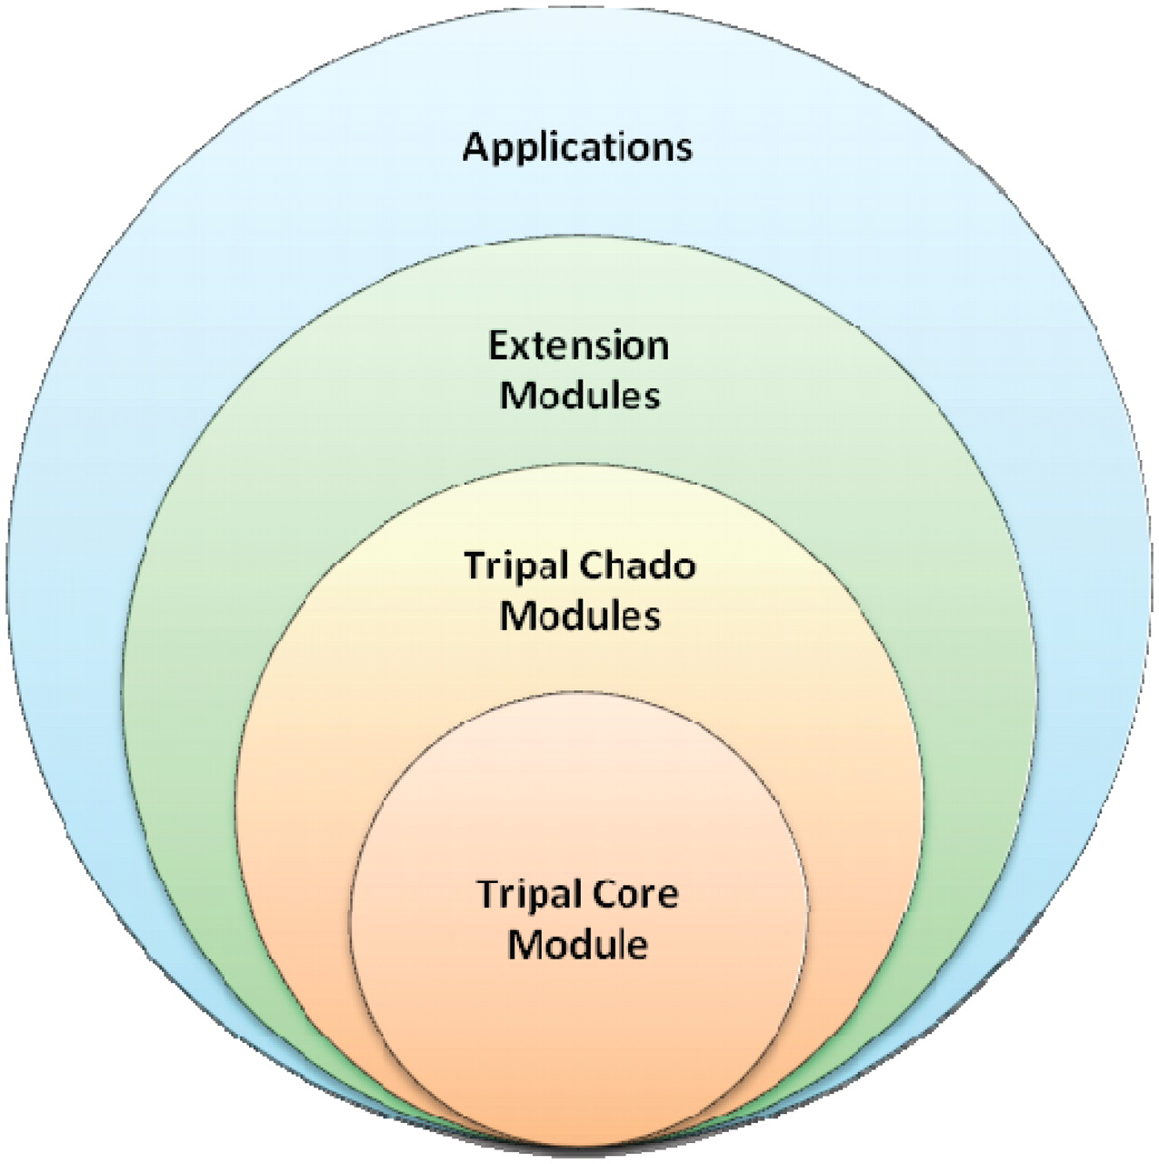
Figure 11. Tripal is designed in hierarchical layers. The baseTripal package consists of the Tripal core and Tripal ...
Notes:
Figure 11. Tripal is designed in hierarchical layers. The baseTripal package consists of the Tripal core and Tripal Chado modules. Extension modules use the Tripal Core and Tripal Chado Modules and provide additional functionality not provided by the base package. Applications use a combination of the Core, Chado and extension modules, as well as, other Drupal modules.
Unless provided in the caption above, the following copyright applies to the content of this slide: © The Author(s) 2011. Published by Oxford University Press.This is an Open Access article distributed under the terms of the Creative Commons Attribution Non-Commercial License (http://creativecommons.org/licenses/by-nc/3.0), which permits unrestricted non-commercial use, distribution, and reproduction in any medium, provided the original work is properly cited.

