Slide 1
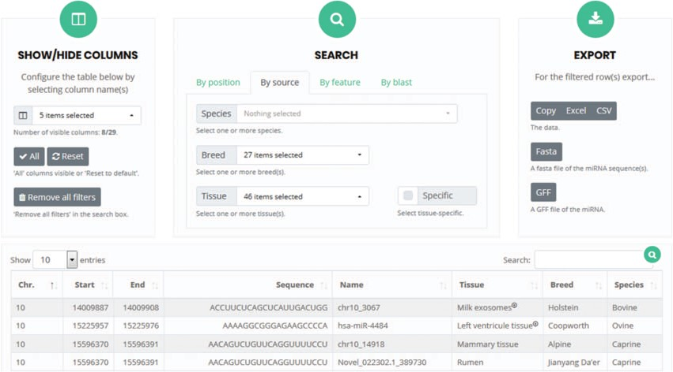
Figure 7 User interface for `search and browse’. Columns can be selected so that only specific features will be ...
Notes:
Figure 7 User interface for `search and browse’. Columns can be selected so that only specific features will be visible. The search box allows the detection of microRNAs present in the RumimiR database as a function of the selected choices. The results can be exported in different formats, such as Excel or Fasta.
Unless provided in the caption above, the following copyright applies to the content of this slide: © The Author(s) 2019. Published by Oxford University Press.This is an Open Access article distributed under the terms of the Creative Commons Attribution License (http://creativecommons.org/licenses/by/4.0/), which permits unrestricted reuse, distribution, and reproduction in any medium, provided the original work is properly cited.

