Slide 1
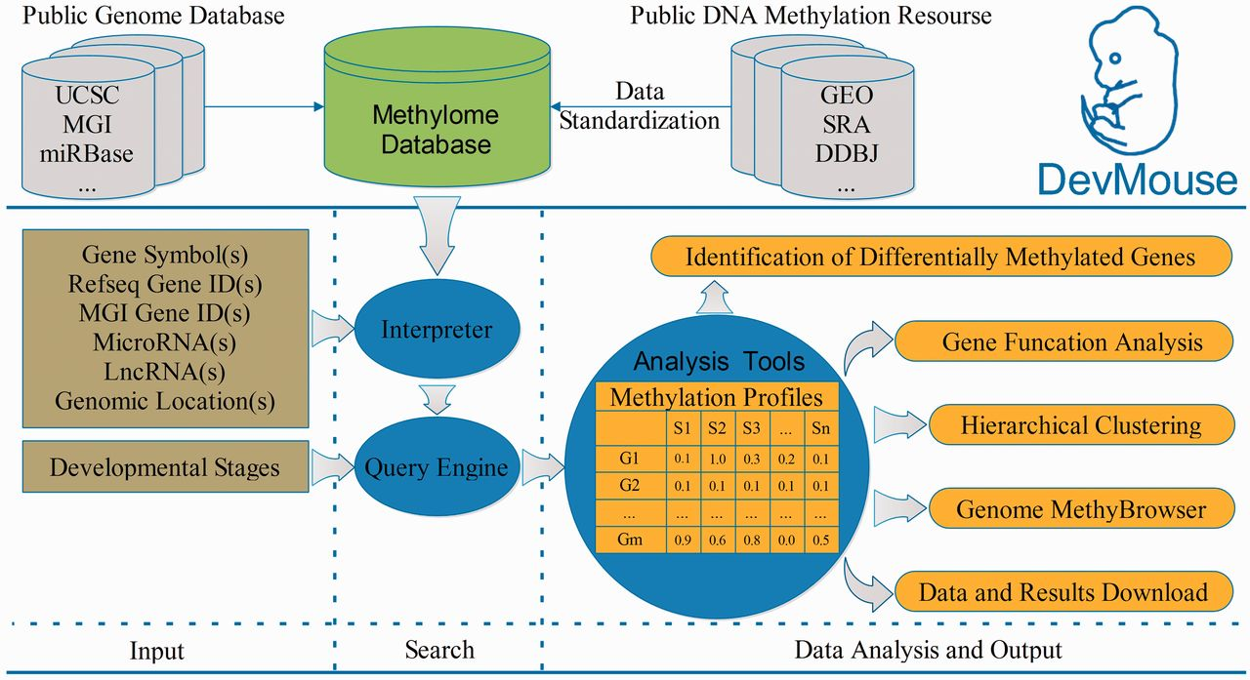
Figure 1. Overview of building and workflow of DevMouse. DevMouse integrates DNA methylomes of mouse development from ...
Notes:
Figure 1. Overview of building and workflow of DevMouse. DevMouse integrates DNA methylomes of mouse development from public DNA methylation resources and the mouse genome information. Users can input multiple genome items to the query engine to gain the methylation profiles of genes/regions in different developmental stages. The analysis tools enable users to carry out online analysis on the methylation profiles, including identification of differentially methylated genes/regions, gene function analysis, hierarchical clustering and visualization in MethyBrowser. All search and analysis results can be downloaded as flat format for further analysis.
Unless provided in the caption above, the following copyright applies to the content of this slide: © The Author(s) 2014. Published by Oxford University Press.This is an Open Access article distributed under the terms of the Creative Commons Attribution License (http://creativecommons.org/licenses/by/3.0/), which permits unrestricted reuse, distribution, and reproduction in any medium, provided the original work is properly cited.

