Slide 1
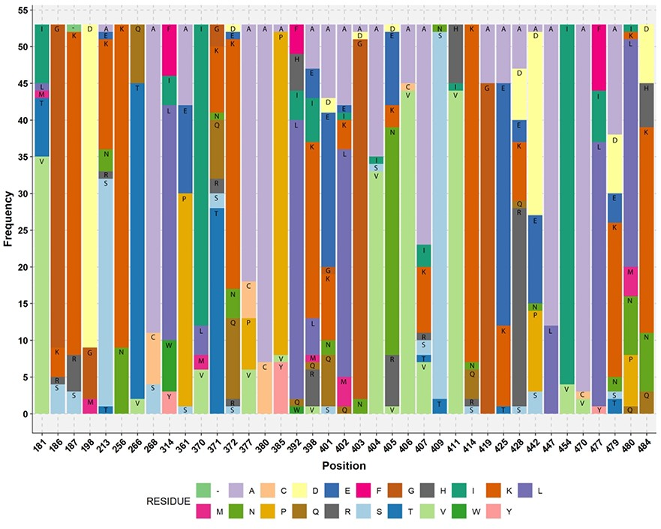
Figure 4 Stacked bar plot showing the amino acid residue of acetogens corresponding to the reference M. thermoacetica ...
Notes:
Figure 4 Stacked bar plot showing the amino acid residue of acetogens corresponding to the reference M. thermoacetica FTHFS aa sequence. The aa residue position of M. thermoacetica is shown on the x-axis and the frequency of the aa residue in the multiple alignment of 53 sequences of known acetogens (M. thermoacetica included) is shown on the y-axis. Minus sign (−) denotes absence of any amino acid residue.
Unless provided in the caption above, the following copyright applies to the content of this slide: © The Author(s) 2019. Published by Oxford University Press.This is an Open Access article distributed under the terms of the Creative Commons Attribution Non-Commercial License (http://creativecommons.org/licenses/by-nc/4.0/), which permits non-commercial re-use, distribution, and reproduction in any medium, provided the original work is properly cited. For commercial re-use, please contact journals.permissions@oup.com

