Slide 1
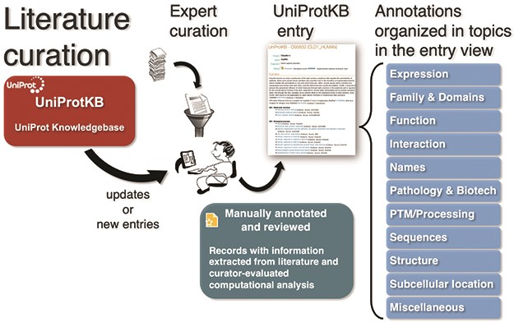
Figure 1 UniProt Knowledgebase annotation process. Manually protein-annotated documents (Swiss-Prot) are associated ...
Notes:
Figure 1 UniProt Knowledgebase annotation process. Manually protein-annotated documents (Swiss-Prot) are associated with UniProt entry categories (Function, Name & Taxonomy, etc.) according to the type of information available in the publication, improving the organization of the annotations within the knowledge base. A much larger set of publications (TrEMBL) is then automatically annotated according to their source characteristics.
Unless provided in the caption above, the following copyright applies to the content of this slide: © The Author(s) 2020. Published by Oxford University Press.This is an Open Access article distributed under the terms of the Creative Commons Attribution License (http://creativecommons.org/licenses/by/4.0/), which permits unrestricted reuse, distribution, and reproduction in any medium, provided the original work is properly cited.

