Slide 1
Figure 1 Homepage of cpnDB.
Notes:
Figure 1 Homepage of cpnDB.
Unless provided in the caption above, the following copyright applies to the content of this slide: © The Author(s) 2019. Published by Oxford University Press.This is an Open Access article distributed under the terms of the Creative Commons Attribution License (http://creativecommons.org/licenses/by/4.0/), which permits unrestricted reuse, distribution, and reproduction in any medium, provided the original work is properly cited.

Slide 2
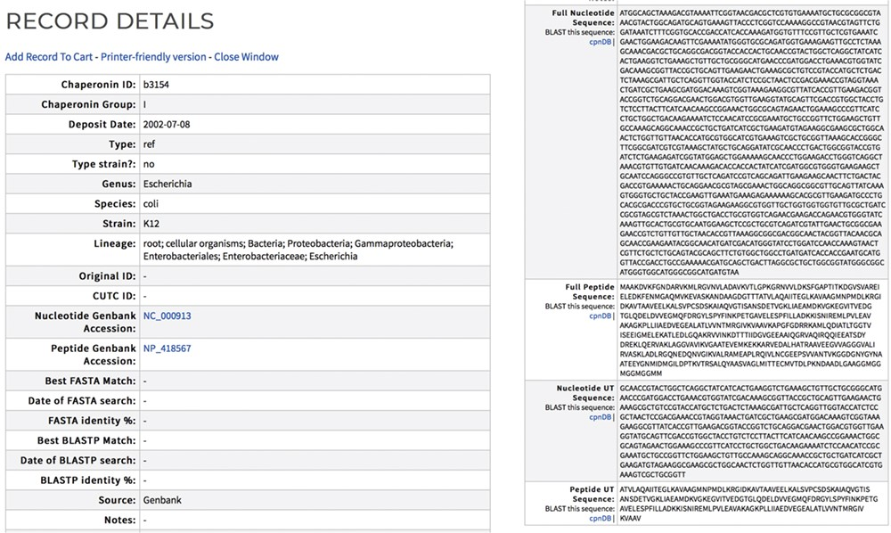
Figure 2 Sample cpnDB record for E. coli strain K12. External links to the corresponding Genbank record are included.
Notes:
Figure 2 Sample cpnDB record for E. coli strain K12. External links to the corresponding Genbank record are included.
Unless provided in the caption above, the following copyright applies to the content of this slide: © The Author(s) 2019. Published by Oxford University Press.This is an Open Access article distributed under the terms of the Creative Commons Attribution License (http://creativecommons.org/licenses/by/4.0/), which permits unrestricted reuse, distribution, and reproduction in any medium, provided the original work is properly cited.

Slide 3
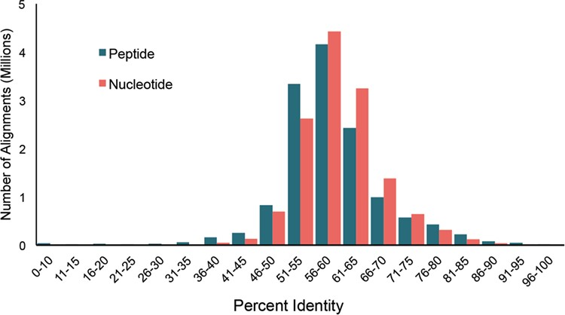
Figure 3 Distribution of pairwise percent identities for bacterial cpn60 UT sequences in cpnDB_nr (version 11 May ...
Notes:
Figure 3 Distribution of pairwise percent identities for bacterial cpn60 UT sequences in cpnDB_nr (version 11 May 2018; 5235 species).
Unless provided in the caption above, the following copyright applies to the content of this slide: © The Author(s) 2019. Published by Oxford University Press.This is an Open Access article distributed under the terms of the Creative Commons Attribution License (http://creativecommons.org/licenses/by/4.0/), which permits unrestricted reuse, distribution, and reproduction in any medium, provided the original work is properly cited.

Slide 4
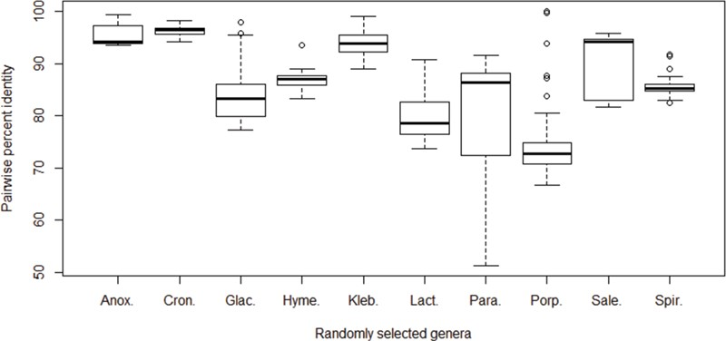
Figure 4 Pairwise percent identities of the cpn60 gene among species. The cpn60 sequences of species from 10 randomly ...
Notes:
Figure 4 Pairwise percent identities of the cpn60 gene among species. The cpn60 sequences of species from 10 randomly selected bacterial genera with at least 6 unique species records were aligned to calculate pairwise identities. Genera from left to right: Anoxybacillus (6 species), Cronobacter (6 species), Glaciecola (10 species), Hymenobacter (6 species), Klebsiella (9 species), Lactococcus (7 species), Paracoccus (9 species), Porphyromonas (17 species), Salegentibacter (6 species) and Spirosoma (7 species).
Unless provided in the caption above, the following copyright applies to the content of this slide: © The Author(s) 2019. Published by Oxford University Press.This is an Open Access article distributed under the terms of the Creative Commons Attribution License (http://creativecommons.org/licenses/by/4.0/), which permits unrestricted reuse, distribution, and reproduction in any medium, provided the original work is properly cited.

