Slide 1
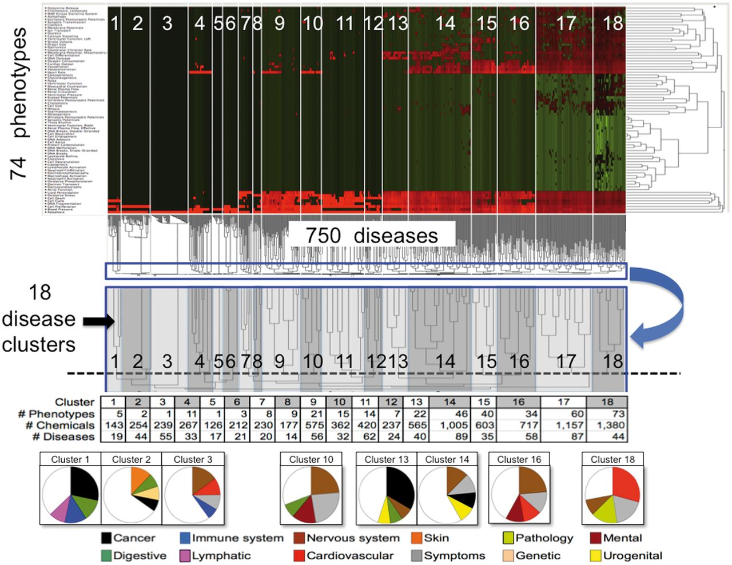
Figure 5. CTD phenotypes inferred to diseases through shared chemicals. A matrix of 74 phenotypes (rows) by 750 ...
Notes:
Figure 5. CTD phenotypes inferred to diseases through shared chemicals. A matrix of 74 phenotypes (rows) by 750 diseases (columns) was constructed where each cell represented the number of shared chemicals. The matrix was analysed by two-dimensional hierarchical clustering and visualized as a heatmap where the normalized number of shared chemicals are colored (green = low; black = medium; red = high). The similarities among the number of shared chemicals for diseases across all phenotypes are shown in the dendrogram beneath the heatmap, where the lengths of the lines are inversely proportional to the similarity (i.e., short = highly similar, long = dissimilar). An enlargement (blue boxes, blue arrow) shows how the disease dendrogram was trimmed to select 18 disease clusters (dotted line, with clusters numbered), and these boundaries are also represented on the heatmap (numbered white boxes). Below, the number of unique phenotypes, chemicals and diseases are charted for each cluster. In pie charts at the very bottom, predominant disease classes for some of the clusters are shown (only the top four disease classes are graphed). For example, of the 19 diseases in cluster 1, 28% of them represent cancers, 13% digestive system diseases, 13% immune system diseases and 9% lymphatic diseases. To the right of the heatmap, the similarities among the number of shared chemicals for phenotypes across all diseases are also shown in another dendrogram, where the lengths of the lines are inversely proportional to the similarity.
Unless provided in the caption above, the following copyright applies to the content of this slide: © The Author(s) 2013. Published by Oxford University Press.This is an Open Access article distributed under the terms of the Creative Commons Attribution License (http://creativecommons.org/licenses/by/3.0/), which permits unrestricted reuse, distribution, and reproduction in any medium, provided the original work is properly cited.

