Slide 1
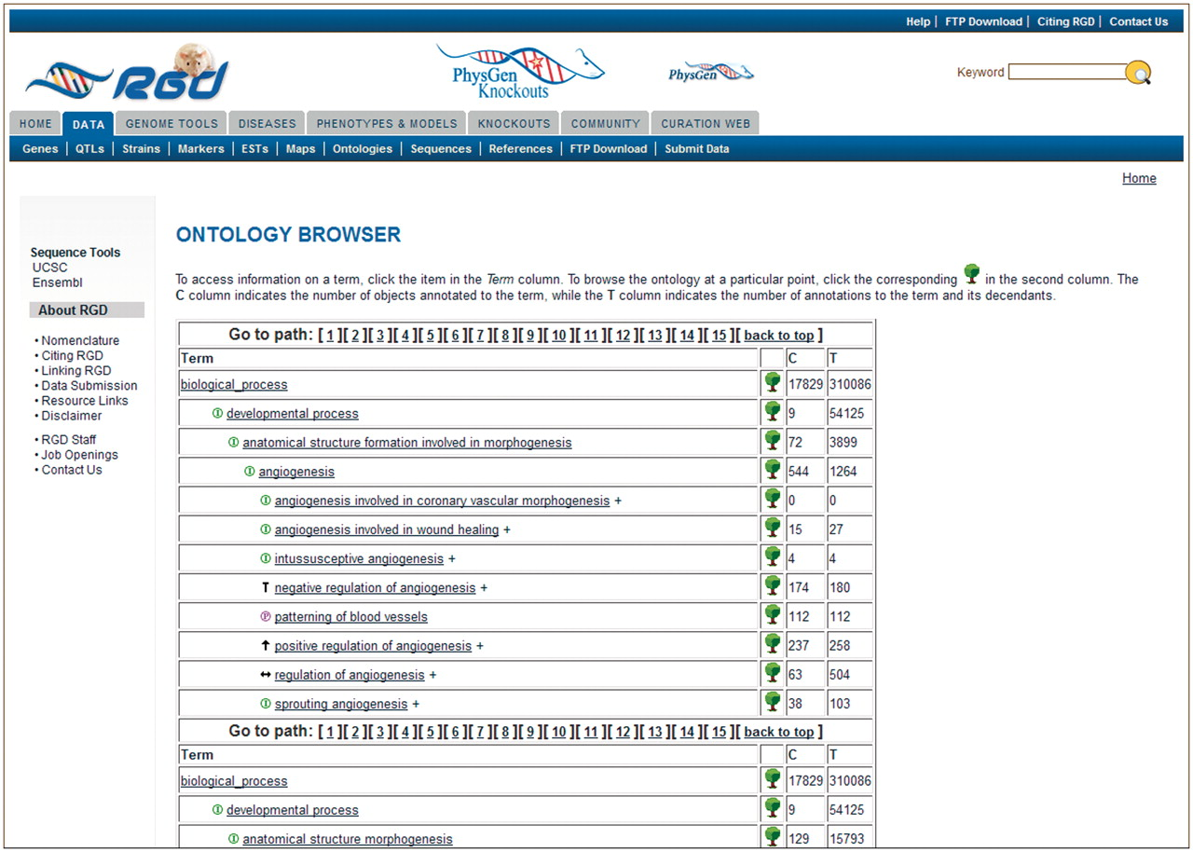
Figure 3. Old RGD ontology browser. Terms are displayed in an expandable tree format with each term being a link to an ...
Notes:
Figure 3. Old RGD ontology browser. Terms are displayed in an expandable tree format with each term being a link to an ontology report page listing all RGD annotations using that term. This example has 15 paths for the term ‘angiogenesis’, with most of the paths not visible without scrolling. The ‘C’ column contains the number of objects annotated to the term on each line, and the ‘T’ column contains the total number of annotations to the term and its children. Clicking the tree icon on each line resets the view to show that line’s term with all its children.
Unless provided in the caption above, the following copyright applies to the content of this slide: © The Author(s) 2012. Published by Oxford University Press.This is an Open Access article distributed under the terms of the Creative Commons Attribution Non-Commercial License (http://creativecommons.org/licenses/by-nc/3.0), which permits unrestricted non-commercial use, distribution, and reproduction in any medium, provided the original work is properly cited.

