Slide 1
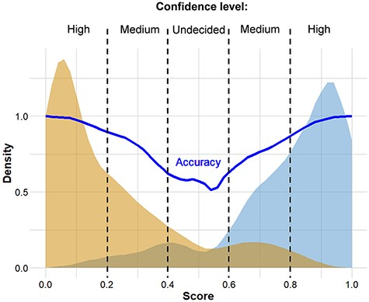
Figure 2. Distribution of scores predicted for genomes associated with known ‘mild’ and ‘severe’ clinical outcomes. The ...
Notes:
Figure 2. Distribution of scores predicted for genomes associated with known ‘mild’ and ‘severe’ clinical outcomes. The thick continuous line indicates confidence defined as the probability of correct prediction, scores below 0.20 and above 0.80 indicate high confidence in predicting ‘mild’ and ‘severe’ outcomes, respectively. Intermittent scores are considered medium or low confidence, respectively.
Unless provided in the caption above, the following copyright applies to the content of this slide: © The Author(s) 2021. Published by Oxford University Press.This is an Open Access article distributed under the terms of the Creative Commons Attribution License (http://creativecommons.org/licenses/by/4.0/), which permits unrestricted reuse, distribution, and reproduction in any medium, provided the original work is properly cited.

