Slide 1
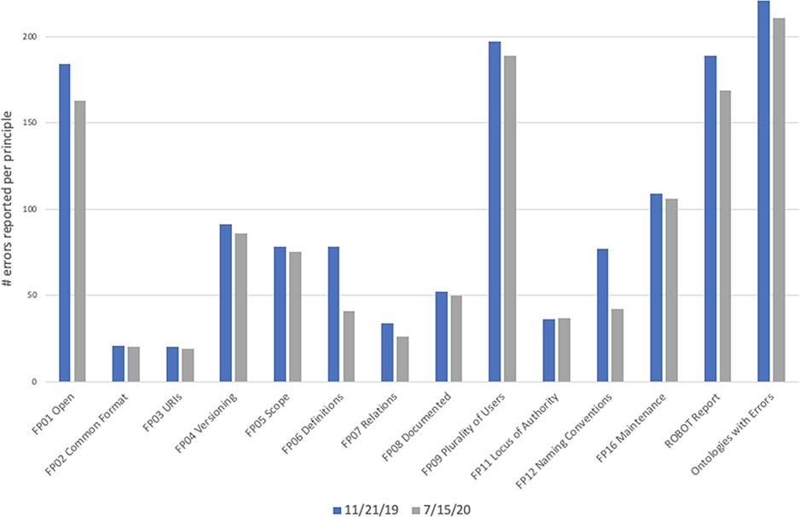
Figure 3. Number of errors reported by dashboard on 11 November 2019 (blue bars) and 15 July 2020 (gray bars). The ...
Notes:
Figure 3. Number of errors reported by dashboard on 11 November 2019 (blue bars) and 15 July 2020 (gray bars). The final column, ‘Ontologies with Errors’, is the total number of ontologies that had one or more errors, not a count of all errors. While more ontologies joined the OBO Foundry between these two dates, we only included statistics for the 223 ontologies that were present and active in both the first run and the second run. The automated checks remained the same during this time period.
Unless provided in the caption above, the following copyright applies to the content of this slide: © The Author(s) 2021. Published by Oxford University Press.This is an Open Access article distributed under the terms of the Creative Commons Attribution License (https://creativecommons.org/licenses/by/4.0/), which permits unrestricted reuse, distribution, and reproduction in any medium, provided the original work is properly cited.

