Slide 1
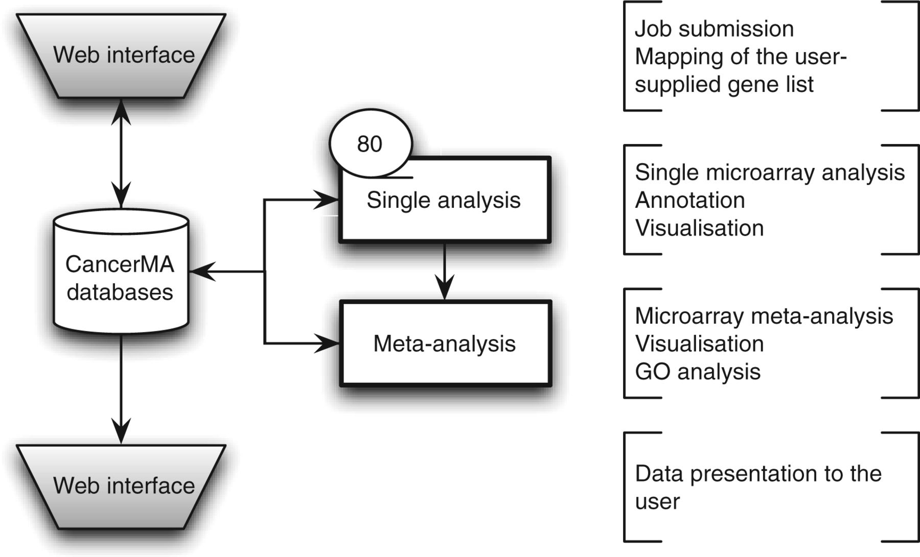
Figure 1 CancerMA workflow. The web interface box indicates the areas where the user provides input and/or can view ...
Notes:
Figure 1 CancerMA workflow. The web interface box indicates the areas where the user provides input and/or can view the mapping or analysis results. The analysis is carried out automatically without any user input. The single analysis determines the differential expression for 80 cancer microarray datasets individually, whereas the meta-analysis combines the results form the individual analyses to a differential meta-expression profile.
Unless provided in the caption above, the following copyright applies to the content of this slide: © The Author(s) 2012. Published by Oxford University Press.This is an Open Access article distributed under the terms of the Creative Commons Attribution Non-Commercial License (http://creativecommons.org/licenses/by-nc/3.0/), which permits unrestricted non-commercial use, distribution, and reproduction in any medium, provided the original work is properly cited.

Slide 2
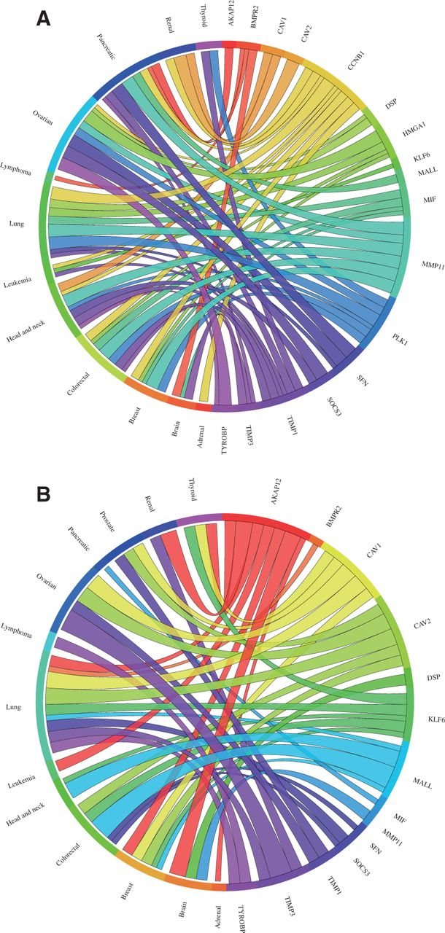
Figure 2 Circos plots showing the meta-change in gene expression in relation to corresponding cancer types. The plot ...
Notes:
Figure 2 Circos plots showing the meta-change in gene expression in relation to corresponding cancer types. The plot shows the meta-up- and meta-downregulated genes of the validation dataset from Kettunen et al. (29): (A) The expression of the genes DSP, CCNB1, PLK1, MIF, HMGA1, SFN, TIMP1 and MMP11 was found to be upregulated, whereas (B) the expression of the genes AKAP12, BMPR2, COPEB/KLF6, SOCS3, BENE/MALL, TIMP3, CAV1, CAV2 and TYROBP was found to be downregulated in lung cancer consistent with the published results. Each connection between a gene and a cancer type indicates a statistically significant mean up- or downregulation for that cancer type derived from a number of combined array studies for cancer tissue versus normal tissue. The weight of the connection corresponds to the magnitude of the meta-change in gene expression.
Unless provided in the caption above, the following copyright applies to the content of this slide: © The Author(s) 2012. Published by Oxford University Press.This is an Open Access article distributed under the terms of the Creative Commons Attribution Non-Commercial License (http://creativecommons.org/licenses/by-nc/3.0/), which permits unrestricted non-commercial use, distribution, and reproduction in any medium, provided the original work is properly cited.

Slide 3
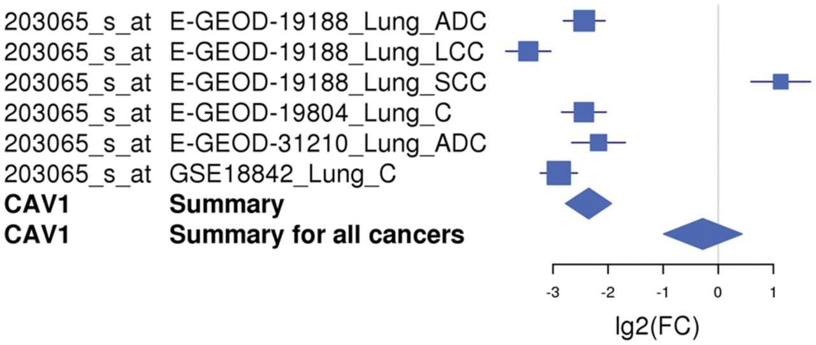
Figure 3 An example of a forest plot showing the expression of gene CAV1 downregulated in lung cancer. The expression ...
Notes:
Figure 3 An example of a forest plot showing the expression of gene CAV1 downregulated in lung cancer. The expression of the CAV1 gene is downregulated in five of six microarray studies and upregulated in one study. The forest plot shows the meta-log 2-fold change values for the individual studies as well as the total values for lung cancer and for all cancer types combined. Each study is illustrated by a square; the position on the x-axis representing the measure estimate (lg2FC ratio), the size proportional to the weight of the study and the horizontal line through it reflecting the confidence interval of the estimate.
Unless provided in the caption above, the following copyright applies to the content of this slide: © The Author(s) 2012. Published by Oxford University Press.This is an Open Access article distributed under the terms of the Creative Commons Attribution Non-Commercial License (http://creativecommons.org/licenses/by-nc/3.0/), which permits unrestricted non-commercial use, distribution, and reproduction in any medium, provided the original work is properly cited.

Slide 4
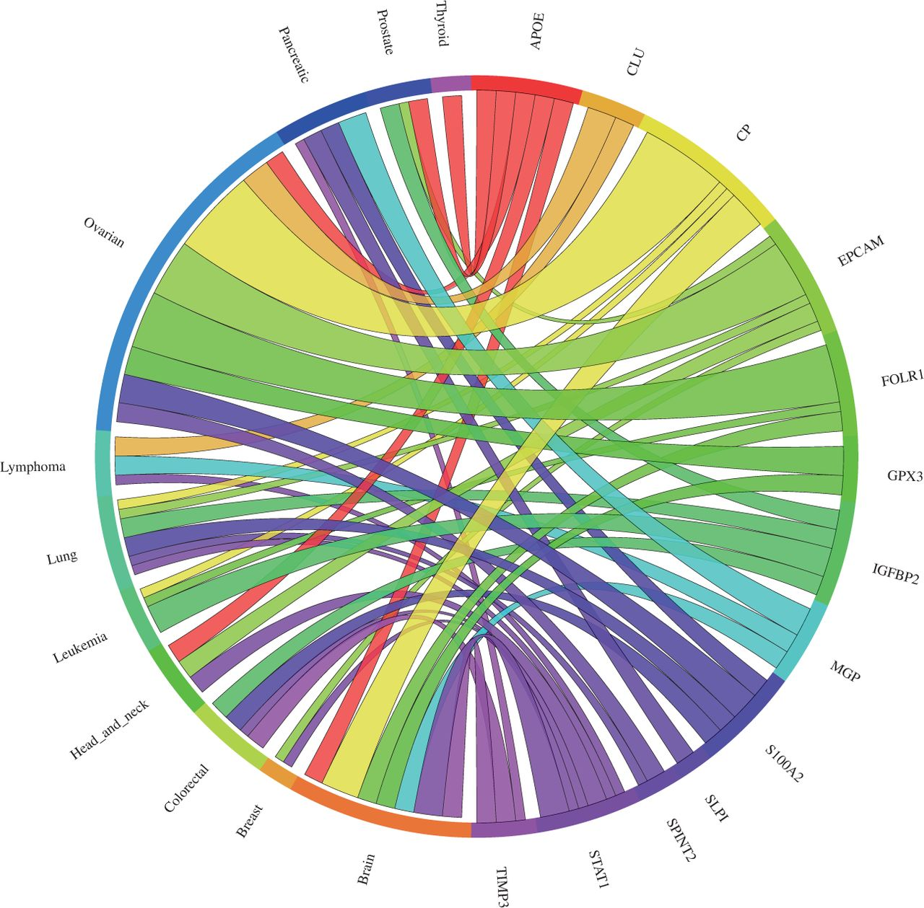
Figure 4 Circos plot showing the meta-change in gene expression in relation to corresponding cancer types. The plot ...
Notes:
Figure 4 Circos plot showing the meta-change in gene expression in relation to corresponding cancer types. The plot shows the meta-upregulated genes of the validation dataset from Hough et al. (30): The expression of the genes GPX3, CLU, EPCAM, SPINT2, FOLR1, S100A2, APOE and CP was found to be upregulated in ovarian cancer consistent with the published results. Each connection between a gene and a cancer type indicates a statistically significant mean up- or downregulation for that cancer type derived from a number of combined array studies for cancer tissue versus normal tissue. The weight of the connection corresponds to the magnitude of the meta-change in gene expression.
Unless provided in the caption above, the following copyright applies to the content of this slide: © The Author(s) 2012. Published by Oxford University Press.This is an Open Access article distributed under the terms of the Creative Commons Attribution Non-Commercial License (http://creativecommons.org/licenses/by-nc/3.0/), which permits unrestricted non-commercial use, distribution, and reproduction in any medium, provided the original work is properly cited.

