Slide 1
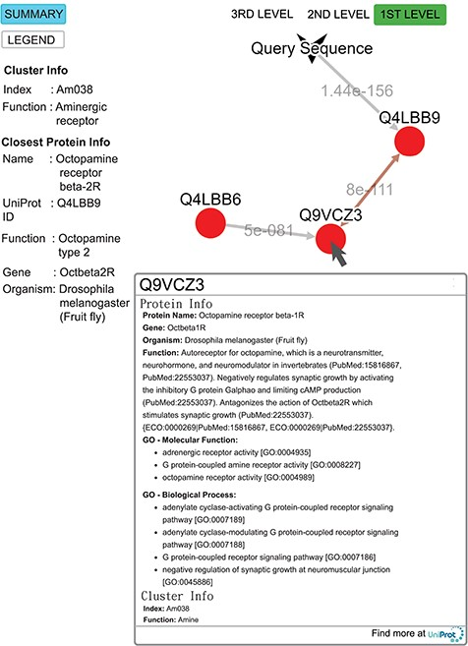
Figure 9 Query result for the submitted sequence G3M4F8 in SeQuery, showing the first-level cluster graph. Information ...
Notes:
Figure 9 Query result for the submitted sequence G3M4F8 in SeQuery, showing the first-level cluster graph. Information about both the cluster and the closest proteins are shown on the left-hand side. Upon clicking on a node such as Q9VCZ3, the user is presented with a modal box showing both the protein information and the cluster information of the node. A double-headed arrow is used to represent the shortest edge connecting two nodes in the core, and a single-headed arrow (directed toward the node closer to the core) is used to represent all other edges connecting two nodes in the cluster. The edge connecting the query sequence to its closest adjacent sequence is also represented by a single-headed arrow. Each edge is labeled with its length.
Unless provided in the caption above, the following copyright applies to the content of this slide: © The Author(s) 2019. Published by Oxford University Press.This is an Open Access article distributed under the terms of the Creative Commons Attribution License (http://creativecommons.org/licenses/by/4.0/), which permits unrestricted reuse, distribution, and reproduction in any medium, provided the original work is properly cited.

