Slide 1
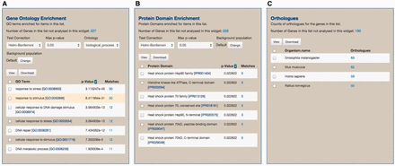
Figure 7. An example of the ‘List analysis’ page showing outputs of graphical and statistical analysis widgets. We used ...
Notes:
Figure 7. An example of the ‘List analysis’ page showing outputs of graphical and statistical analysis widgets. We used 30 genes annotated with the GO term ‘response to stress’ along with 270 randomly selected genes to generate the result. (A) As anticipated, GO enrichment analysis shows that the GO term ‘response to stress’, among other GO terms, is statistically significant. (B) Protein Domain enrichment analysis shows that many enriched domains were found including ‘Heat shock protein HSP90 family’ domain. (C) Numerous orthologs, including 59 Human genes, were found among 300 uploaded genes. These orthologous gene lists can be used for further analysis via MOD compliant InterMine variants.
Unless provided in the caption above, the following copyright applies to the content of this slide: © The Author(s) 2015. Published by Oxford University Press. This is an Open Access article distributed under the terms of the Creative Commons Attribution License ( http://creativecommons.org/licenses/by/4.0/ ), which permits unrestricted reuse, distribution, and reproduction in any medium, provided the original work is properly cited.

