Slide 1
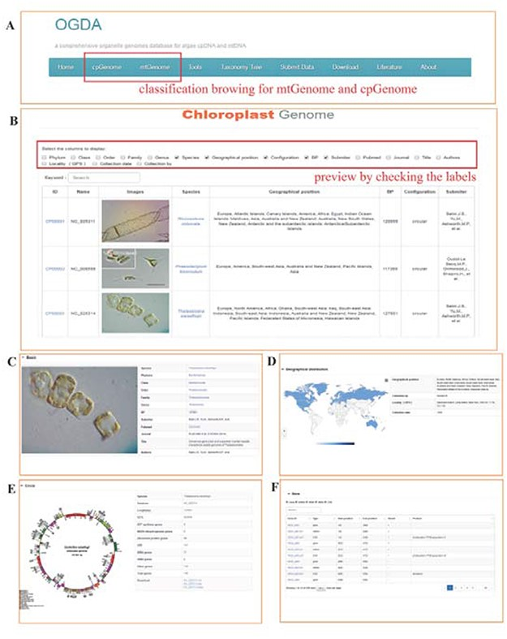
Figure 2. Screenshot of the database browser. (A) Navigation bar of the database, ‘cpGenome’ and ‘mtGenome’ can be ...
Notes:
Figure 2. Screenshot of the database browser. (A) Navigation bar of the database, ‘cpGenome’ and ‘mtGenome’ can be browsed separately. (B) Example preview results, with the following detailed genome information: (C) basic information, including identification images, taxonomy, acceptance number, genome length (bp) and published papers; (D) geographical distribution and collection information; (E) circle map of the genome and (F) coding gene display.
Unless provided in the caption above, the following copyright applies to the content of this slide: © The Author(s) 2020. Published by Oxford University Press.This is an Open Access article distributed under the terms of the Creative Commons Attribution License (http://creativecommons.org/licenses/by/4.0/), which permits unrestricted reuse, distribution, and reproduction in any medium, provided the original work is properly cited.

