Slide 1
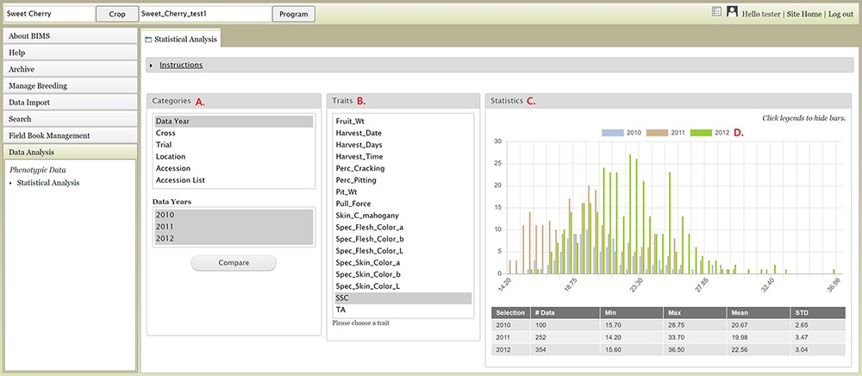
Figure 15. BIMS interface where users can compare trait values among different datasets. A. Categories section where ...
Notes:
Figure 15. BIMS interface where users can compare trait values among different datasets. A. Categories section where users can choose multiple datasets B. Traits section to choose a trait statistics of the chosen dataset. C. Statistics section where users can view a graph with the distribution of the trait values for each dataset. D. Legends can be deselected to view subsets.
Unless provided in the caption above, the following copyright applies to the content of this slide: © The Author(s) 2021. Published by Oxford University Press.This is an Open Access article distributed under the terms of the Creative Commons Attribution License (http://creativecommons.org/licenses/by/4.0/), which permits unrestricted reuse, distribution, and reproduction in any medium, provided the original work is properly cited.

