Slide 1
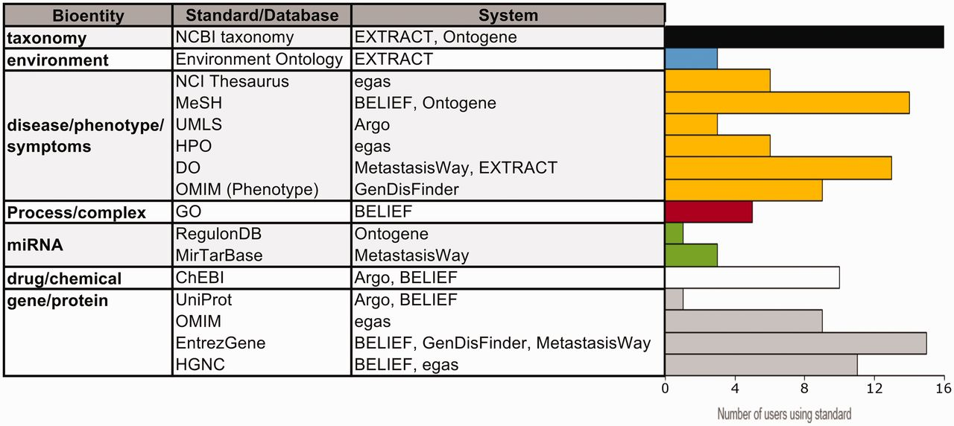
Figure 5. Usage of standards/databases proposed by the systems. The table describes most of the bioentities and ...
Notes:
Figure 5. Usage of standards/databases proposed by the systems. The table describes most of the bioentities and standards/databases proposed by the different systems, and the bar graphs show the number of IAT evaluators using each standard/database. Note that environment is a specialized bioentity type which is only used by the microbial and metagenomics communities. Data from 25 users.
Unless provided in the caption above, the following copyright applies to the content of this slide: Published by Oxford University Press 2016. This work is written by US Government employees and is in the public domain in the US.

