Slide 1
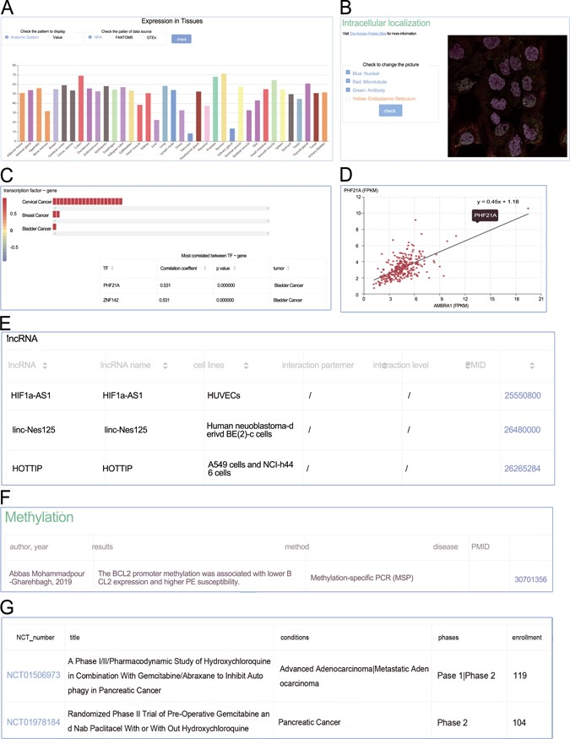
Figure 4 Screenshots from the genes section. (A) Expression profiles; (B) intracellular location; (C) heat plot; (D) ...
Notes:
Figure 4 Screenshots from the genes section. (A) Expression profiles; (B) intracellular location; (C) heat plot; (D) scatter plot; (E) manual curated regulators; (F) DNA methylation; (G) animal models.
Unless provided in the caption above, the following copyright applies to the content of this slide: © The Author(s) 2020. Published by Oxford University Press.This is an Open Access article distributed under the terms of the Creative Commons Attribution License (http://creativecommons.org/licenses/by/4.0/), which permits unrestricted reuse, distribution, and reproduction in any medium, provided the original work is properly cited.

