Slide 1
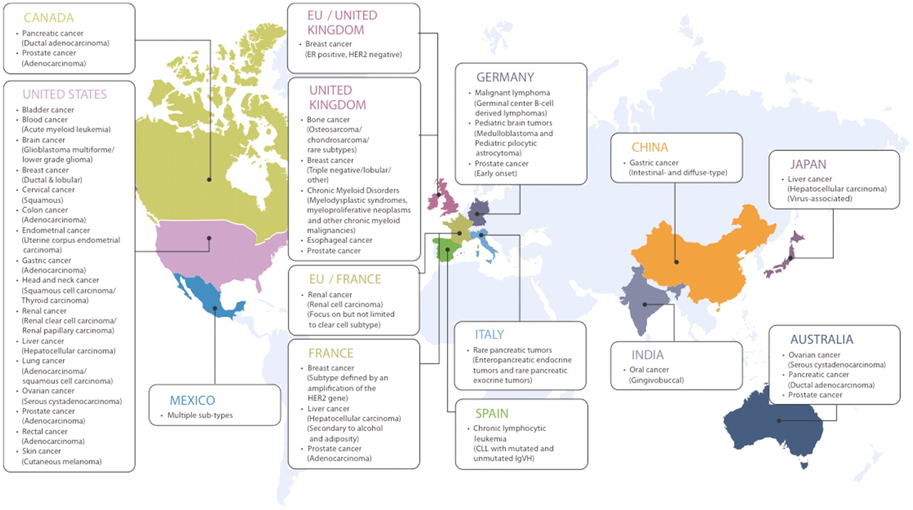
Figure 1. International Cancer Genome Consortium (ICGC) projects (March 2011).
Notes:
Figure 1. International Cancer Genome Consortium (ICGC) projects (March 2011).
Unless provided in the caption above, the following copyright applies to the content of this slide: © The Author(s) 2011. Published by Oxford University Press.This is Open Access article distributed under the terms of the Creative Commons Attribution Non-Commercial License (http://creativecommons.org/licenses/by-nc/2.5), which permits unrestricted non-commercial use, distribution, and reproduction in any medium, provided the original work is properly cited.

Slide 2
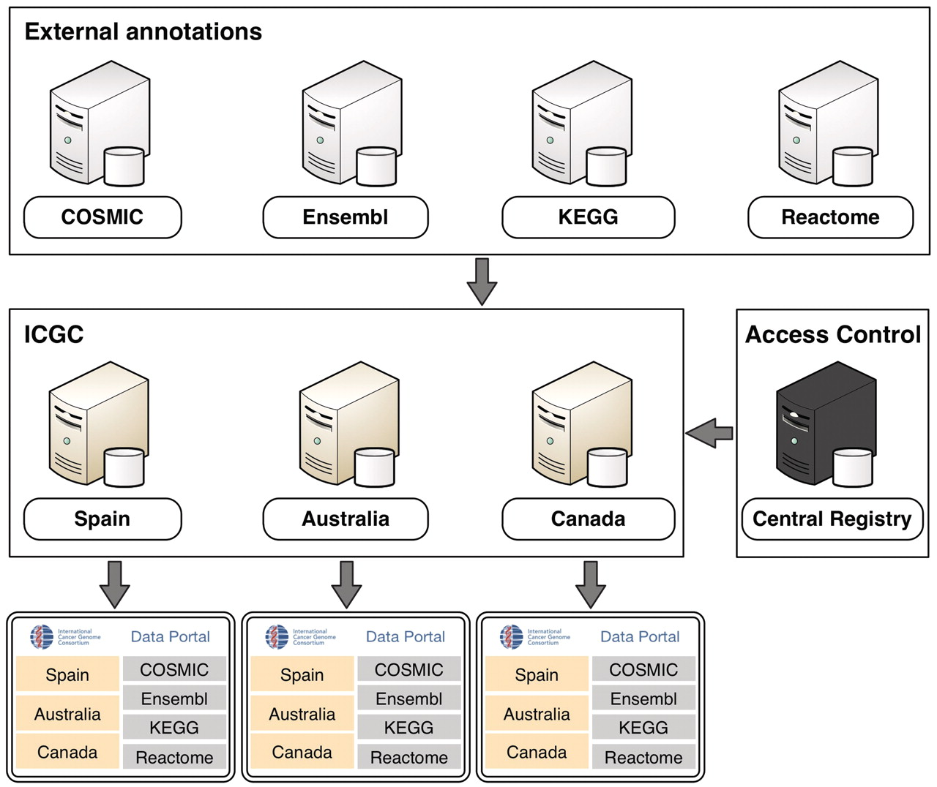
Figure 2. An overview of the ICGC Data Portal architecture.
Notes:
Figure 2. An overview of the ICGC Data Portal architecture.
Unless provided in the caption above, the following copyright applies to the content of this slide: © The Author(s) 2011. Published by Oxford University Press.This is Open Access article distributed under the terms of the Creative Commons Attribution Non-Commercial License (http://creativecommons.org/licenses/by-nc/2.5), which permits unrestricted non-commercial use, distribution, and reproduction in any medium, provided the original work is properly cited.

Slide 3
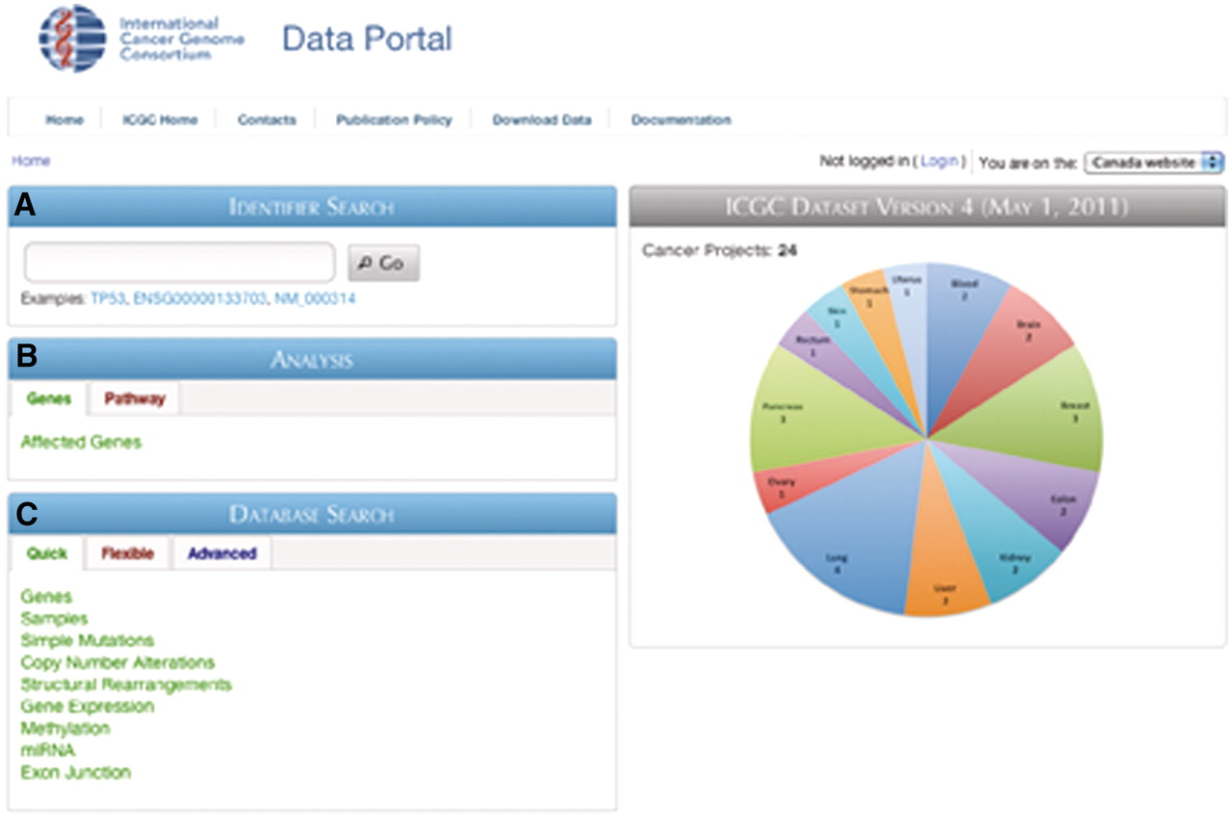
Figure 3. Screenshot of the ICGC Data Portal home page. Three main entry points are available: (A) Identifier search, ...
Notes:
Figure 3. Screenshot of the ICGC Data Portal home page. Three main entry points are available: (A) Identifier search, (B) Analysis and (C) Database search.
Unless provided in the caption above, the following copyright applies to the content of this slide: © The Author(s) 2011. Published by Oxford University Press.This is Open Access article distributed under the terms of the Creative Commons Attribution Non-Commercial License (http://creativecommons.org/licenses/by-nc/2.5), which permits unrestricted non-commercial use, distribution, and reproduction in any medium, provided the original work is properly cited.

Slide 4
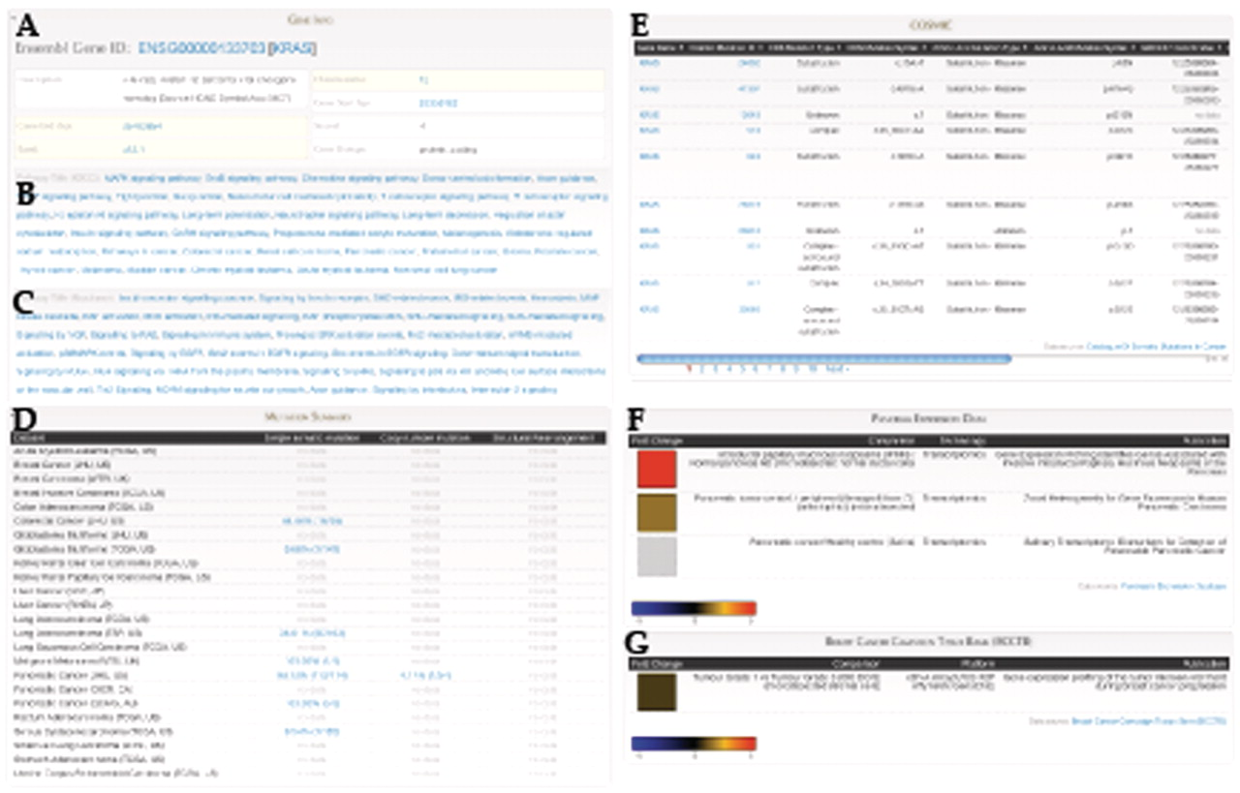
Figure 4. Gene Report for KRAS includes: (A) Gene annotation data from Ensembl, Pathway annotation from (B) KEGG and ...
Notes:
Figure 4. Gene Report for KRAS includes: (A) Gene annotation data from Ensembl, Pathway annotation from (B) KEGG and (C) Reactome, (D) Summary of mutation frequencies in each cancer project, (E) Mutation data from COSMIC, Expression data from (F) Pancreatic Expression Database and (G) Breast Cancer Campaign Tissue Bank (BCCTB). Different sections of this page come from federated BioMart sources.
Unless provided in the caption above, the following copyright applies to the content of this slide: © The Author(s) 2011. Published by Oxford University Press.This is Open Access article distributed under the terms of the Creative Commons Attribution Non-Commercial License (http://creativecommons.org/licenses/by-nc/2.5), which permits unrestricted non-commercial use, distribution, and reproduction in any medium, provided the original work is properly cited.

Slide 5
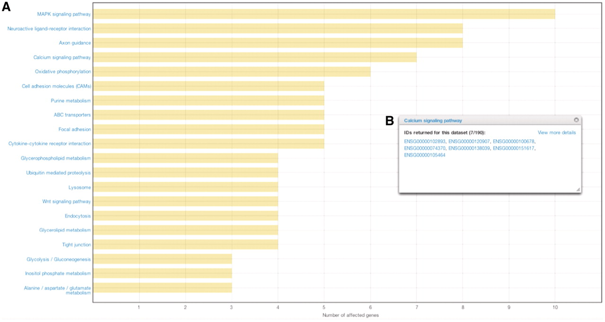
Figure 5. Results from affected pathways analysis for breast cancer (JHU, US). (A) Affected pathways are shown in a ...
Notes:
Figure 5. Results from affected pathways analysis for breast cancer (JHU, US). (A) Affected pathways are shown in a chart, with bars representing the number of affected genes in each pathway. (B) By clicking on the bar, users are able to view and download the genes that were mutated in each pathway.
Unless provided in the caption above, the following copyright applies to the content of this slide: © The Author(s) 2011. Published by Oxford University Press.This is Open Access article distributed under the terms of the Creative Commons Attribution Non-Commercial License (http://creativecommons.org/licenses/by-nc/2.5), which permits unrestricted non-commercial use, distribution, and reproduction in any medium, provided the original work is properly cited.

Slide 6
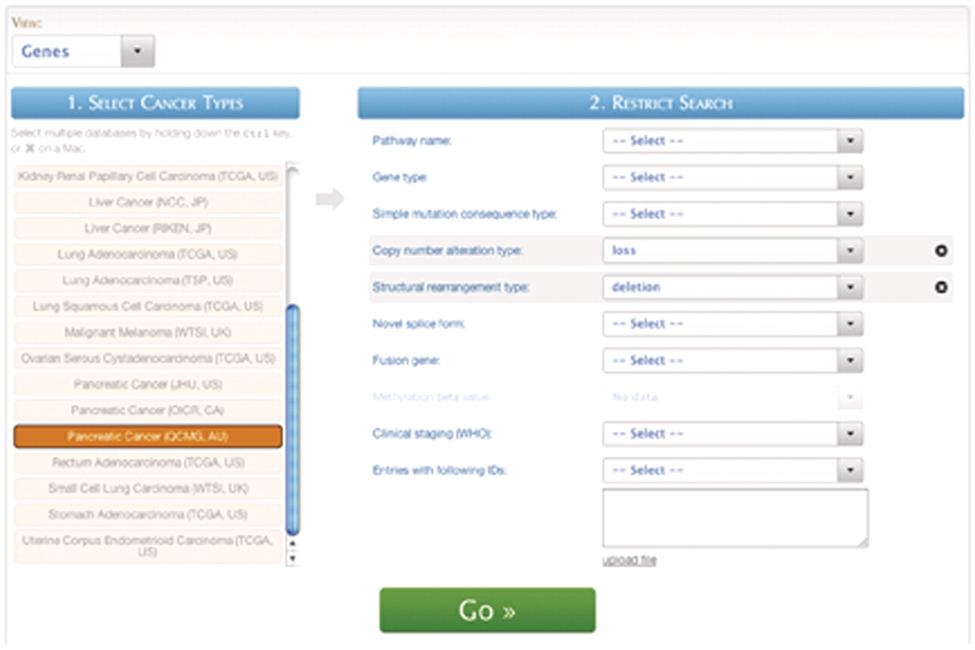
Figure 6. A screenshot of the Quickquery interface.
Notes:
Figure 6. A screenshot of the Quickquery interface.
Unless provided in the caption above, the following copyright applies to the content of this slide: © The Author(s) 2011. Published by Oxford University Press.This is Open Access article distributed under the terms of the Creative Commons Attribution Non-Commercial License (http://creativecommons.org/licenses/by-nc/2.5), which permits unrestricted non-commercial use, distribution, and reproduction in any medium, provided the original work is properly cited.

Slide 7
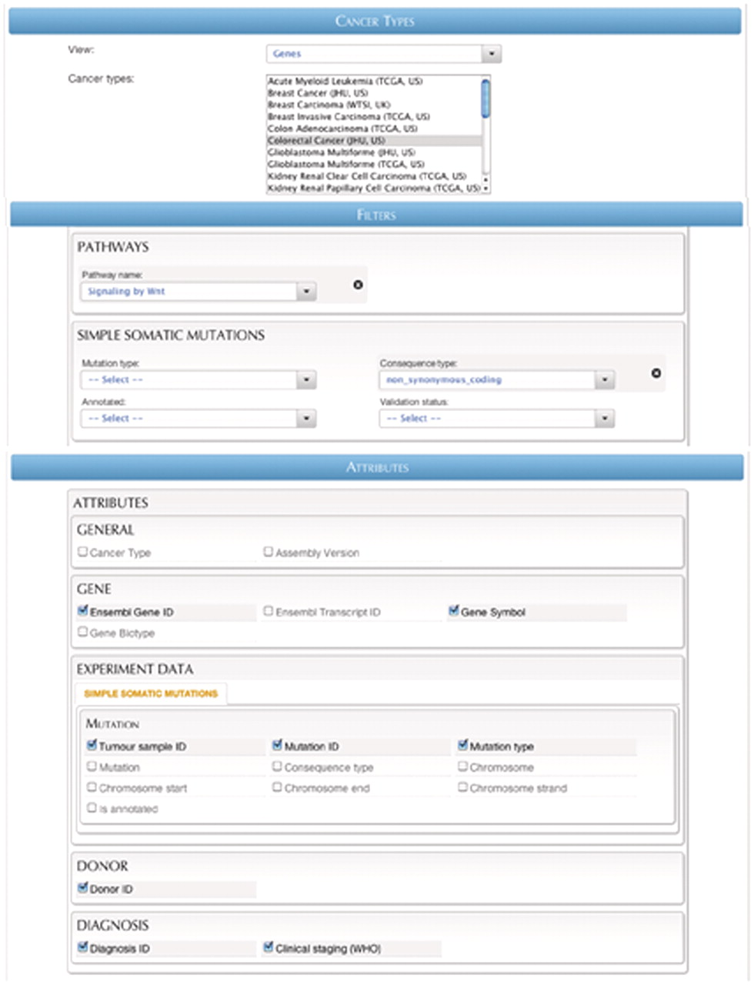
Figure 7. A screenshot of the Flexiblequery interface.
Notes:
Figure 7. A screenshot of the Flexiblequery interface.
Unless provided in the caption above, the following copyright applies to the content of this slide: © The Author(s) 2011. Published by Oxford University Press.This is Open Access article distributed under the terms of the Creative Commons Attribution Non-Commercial License (http://creativecommons.org/licenses/by-nc/2.5), which permits unrestricted non-commercial use, distribution, and reproduction in any medium, provided the original work is properly cited.

Slide 8
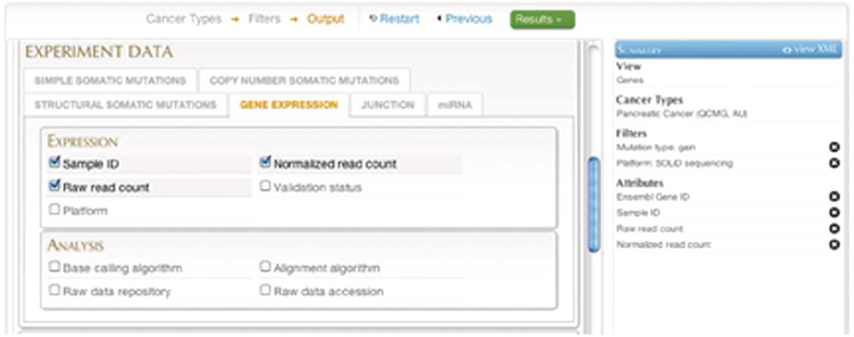
Figure 8. A screenshot of the Advancedquery interface.
Notes:
Figure 8. A screenshot of the Advancedquery interface.
Unless provided in the caption above, the following copyright applies to the content of this slide: © The Author(s) 2011. Published by Oxford University Press.This is Open Access article distributed under the terms of the Creative Commons Attribution Non-Commercial License (http://creativecommons.org/licenses/by-nc/2.5), which permits unrestricted non-commercial use, distribution, and reproduction in any medium, provided the original work is properly cited.

