Slide 1
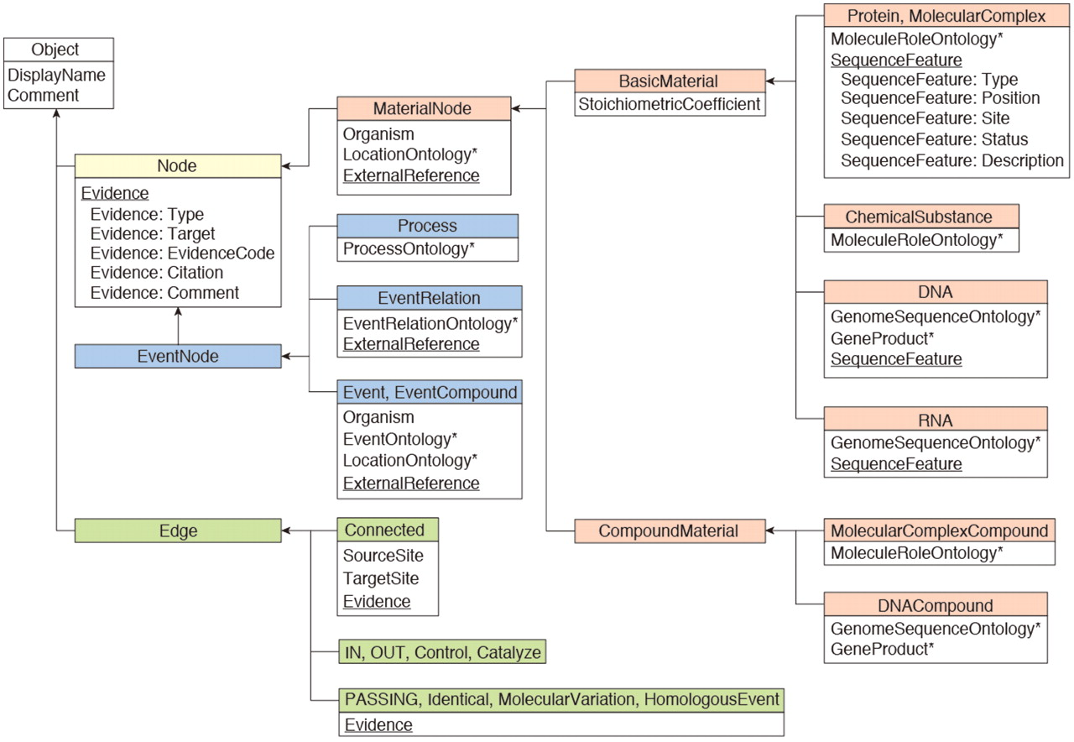
Figure 1. INOH data model. Boxes represent class objects (nodes and edges) and their attribute(s), and arrows show ...
Notes:
Figure 1. INOH data model. Boxes represent class objects (nodes and edges) and their attribute(s), and arrows show inheritance relationships. Multiple values are allowed at underlined attributes. Asterisks indicate that the value for the attribute is filled from INOH ontology terms.
Unless provided in the caption above, the following copyright applies to the content of this slide: © The Author(s) 2011. Published by Oxford University Press.This is an Open Access article distributed under the terms of the Creative Commons Attribution Non-Commercial License (http://creativecommons.org/licenses/by-nc/3.0), which permits unrestricted non-commercial use, distribution, and reproduction in any medium, provided the original work is properly cited.

Slide 2
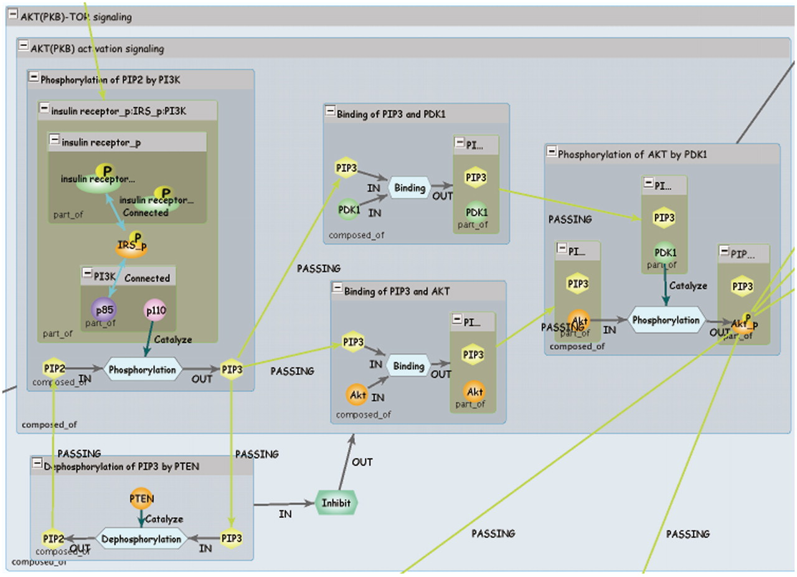
Figure 2. INOH pathway. Each blue window represents event of different granularity, and green window represents ...
Notes:
Figure 2. INOH pathway. Each blue window represents event of different granularity, and green window represents molecular complex. Light blue hexagons are Process nodes that show molecular interactions, and green hexagon is EventRelation node that shows positive/negative indirect relation between events.
Unless provided in the caption above, the following copyright applies to the content of this slide: © The Author(s) 2011. Published by Oxford University Press.This is an Open Access article distributed under the terms of the Creative Commons Attribution Non-Commercial License (http://creativecommons.org/licenses/by-nc/3.0), which permits unrestricted non-commercial use, distribution, and reproduction in any medium, provided the original work is properly cited.

Slide 3
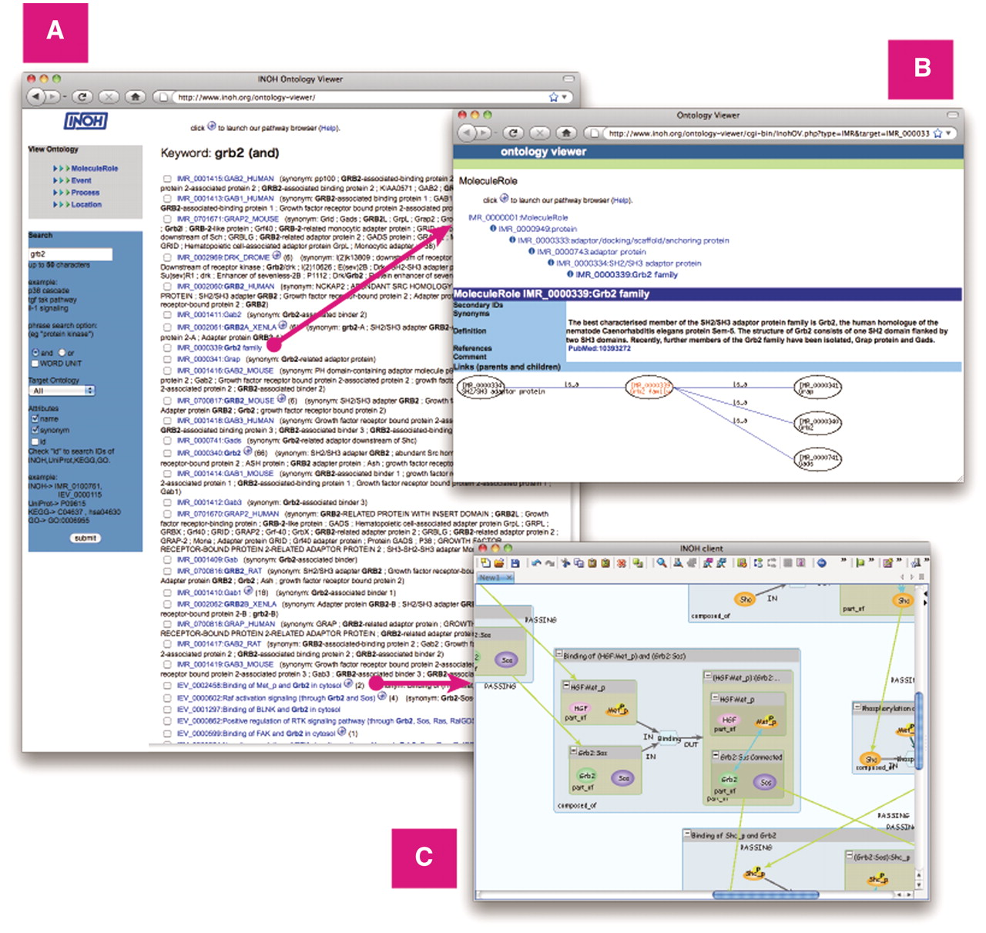
Figure 3. Screenshot of Ontology Viewer. (A) Example of search result. (B) Attribute and ontology hierarchy view. (C) ...
Notes:
Figure 3. Screenshot of Ontology Viewer. (A) Example of search result. (B) Attribute and ontology hierarchy view. (C) Example of INOH pathway data accessed through INOH Ontology Viewer.
Unless provided in the caption above, the following copyright applies to the content of this slide: © The Author(s) 2011. Published by Oxford University Press.This is an Open Access article distributed under the terms of the Creative Commons Attribution Non-Commercial License (http://creativecommons.org/licenses/by-nc/3.0), which permits unrestricted non-commercial use, distribution, and reproduction in any medium, provided the original work is properly cited.

Slide 4
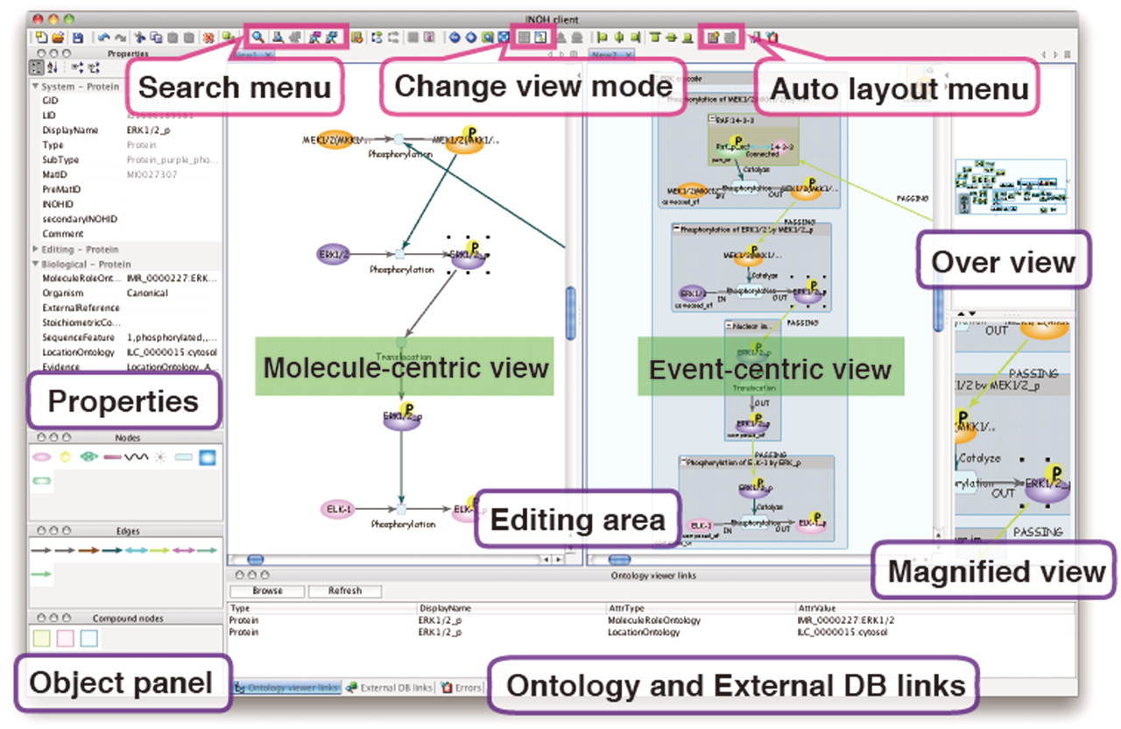
Figure 4. Screenshot of INOH Client. Window consists of five areas; tool panel (Objects and Properties panels), diagram ...
Notes:
Figure 4. Screenshot of INOH Client. Window consists of five areas; tool panel (Objects and Properties panels), diagram editing area, over view area, magnified view area and external DB links area. User can search and download pathways, and pathways can be then modified and saved. When switching from normal view to reduced view in toolbar, picture focusing on molecular transition is displayed in diagram editing area.
Unless provided in the caption above, the following copyright applies to the content of this slide: © The Author(s) 2011. Published by Oxford University Press.This is an Open Access article distributed under the terms of the Creative Commons Attribution Non-Commercial License (http://creativecommons.org/licenses/by-nc/3.0), which permits unrestricted non-commercial use, distribution, and reproduction in any medium, provided the original work is properly cited.

Slide 5
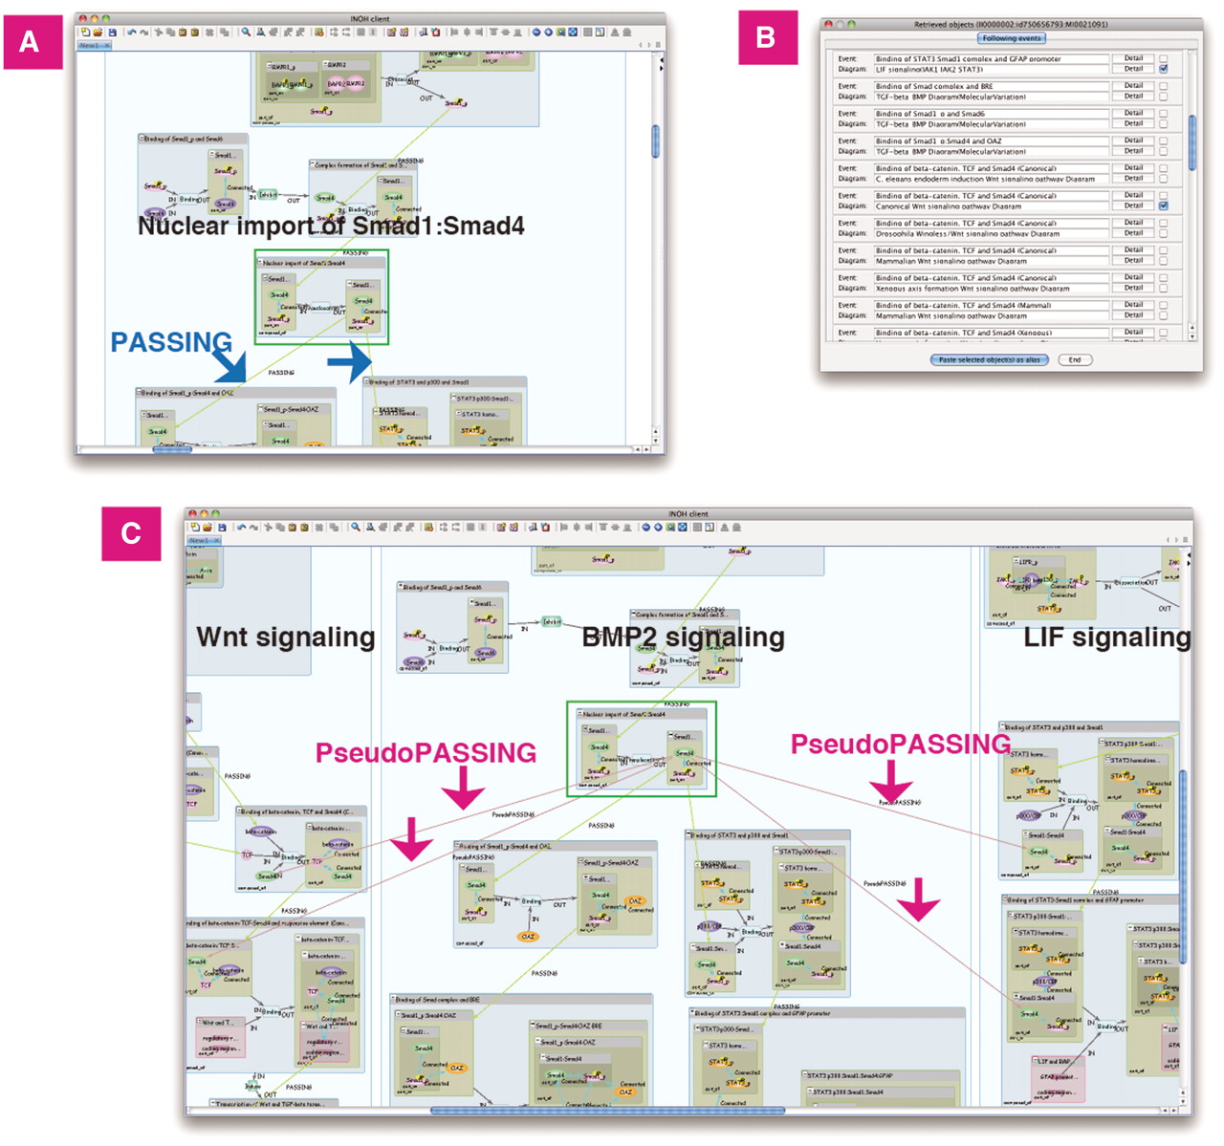
Figure 5. Previous/following event search. BMP2 signaling does ‘cross-talk’ with Wnt and LIF signaling. (A) Search ...
Notes:
Figure 5. Previous/following event search. BMP2 signaling does ‘cross-talk’ with Wnt and LIF signaling. (A) Search following events of ‘Nuclear import of Smad1:Smad4’ in BMP2 signaling. The curated following events are connected to the event by the PASSING edges. (B) List of following events and its diagram. (C) Wnt and LIF signaling is pasted on same canvas. The inferred following events are connected by the PseudoPASSING edges.
Unless provided in the caption above, the following copyright applies to the content of this slide: © The Author(s) 2011. Published by Oxford University Press.This is an Open Access article distributed under the terms of the Creative Commons Attribution Non-Commercial License (http://creativecommons.org/licenses/by-nc/3.0), which permits unrestricted non-commercial use, distribution, and reproduction in any medium, provided the original work is properly cited.

Slide 6
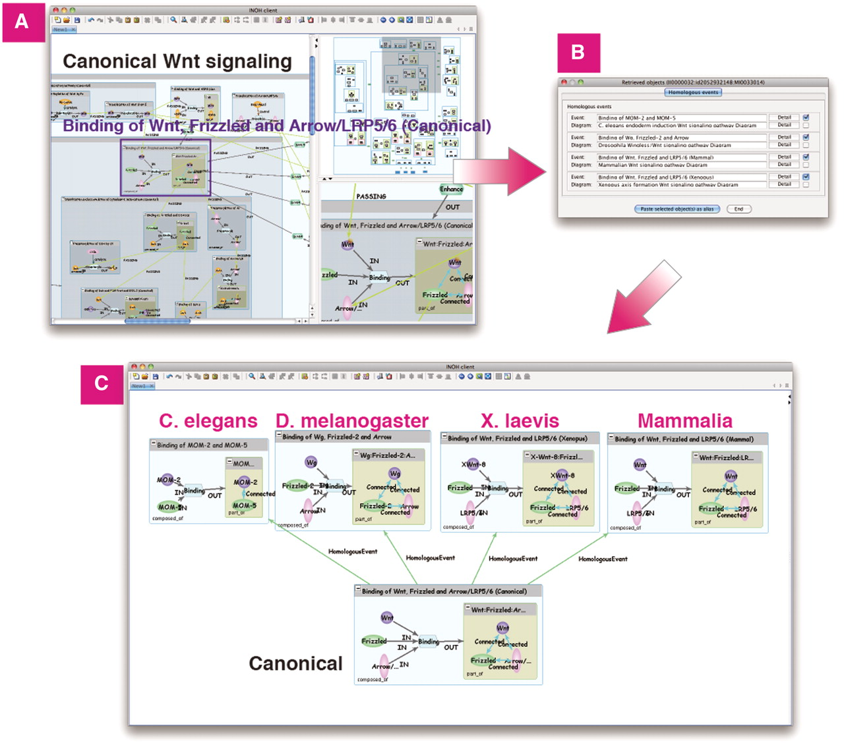
Figure 6. Homologous search in Wnt signaling. (A) Search homologous events of ‘Binding of Wnt, Frizzled and ...
Notes:
Figure 6. Homologous search in Wnt signaling. (A) Search homologous events of ‘Binding of Wnt, Frizzled and Arrow/LRP5/6 (Canonical)’ in Wnt signaling. (B) List of homologous events and its diagrams. (C) Homologous events in C.elegans, D.melanogaster, X.laevis and Mammalia can be pasted on same canvas for comparison.
Unless provided in the caption above, the following copyright applies to the content of this slide: © The Author(s) 2011. Published by Oxford University Press.This is an Open Access article distributed under the terms of the Creative Commons Attribution Non-Commercial License (http://creativecommons.org/licenses/by-nc/3.0), which permits unrestricted non-commercial use, distribution, and reproduction in any medium, provided the original work is properly cited.

Slide 7
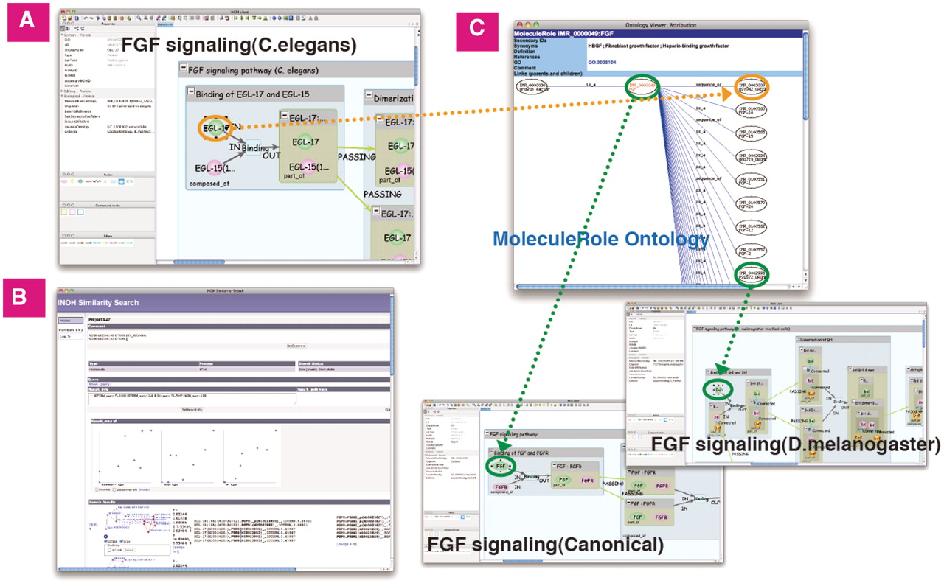
Figure 7. Similarity Search of FGF signaling (C.elegans). (A) The ligand-receptor binding in FGF signaling (C.elegans). ...
Notes:
Figure 7. Similarity Search of FGF signaling (C.elegans). (A) The ligand-receptor binding in FGF signaling (C.elegans). (B) Result screen of similarity search. (C) The hierarchical tree of ‘FGF’ molecule in MoleculeRole ontology and some signaling pathways similar to FGF signaling (C.elegans). Green/orange edges represent correspondence relation to MoleculeRole ontology.
Unless provided in the caption above, the following copyright applies to the content of this slide: © The Author(s) 2011. Published by Oxford University Press.This is an Open Access article distributed under the terms of the Creative Commons Attribution Non-Commercial License (http://creativecommons.org/licenses/by-nc/3.0), which permits unrestricted non-commercial use, distribution, and reproduction in any medium, provided the original work is properly cited.

Slide 8
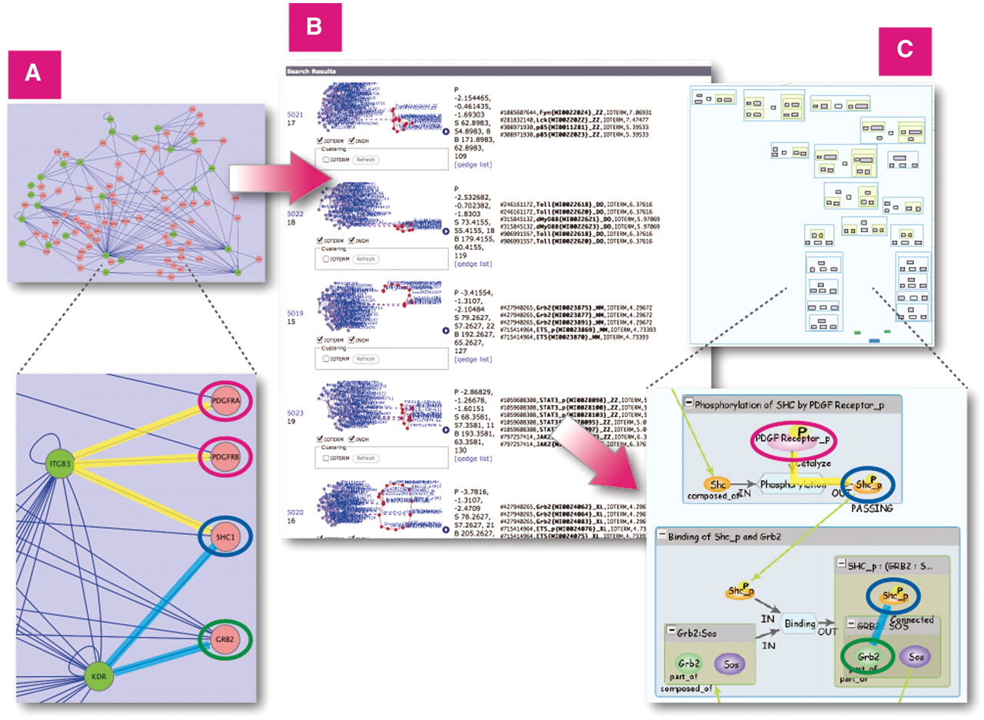
Figure 8. Similarity Search on all INOH pathways using large protein–protein network query. (A) Protein–protein network ...
Notes:
Figure 8. Similarity Search on all INOH pathways using large protein–protein network query. (A) Protein–protein network related to acute allergic diseases displayed in Cytoscape. (B) Results of similarity search on INOH pathways using network as query. (C) Example of INOH pathways that have similar molecules and interactions in protein–protein network dataset. Similar molecules and interactions are highlighted with same colors in (A) and (C). These results can be found here. http://www.inoh.org/similarity-search/project.php?session=1&pid=526.
Unless provided in the caption above, the following copyright applies to the content of this slide: © The Author(s) 2011. Published by Oxford University Press.This is an Open Access article distributed under the terms of the Creative Commons Attribution Non-Commercial License (http://creativecommons.org/licenses/by-nc/3.0), which permits unrestricted non-commercial use, distribution, and reproduction in any medium, provided the original work is properly cited.

