Slide 1
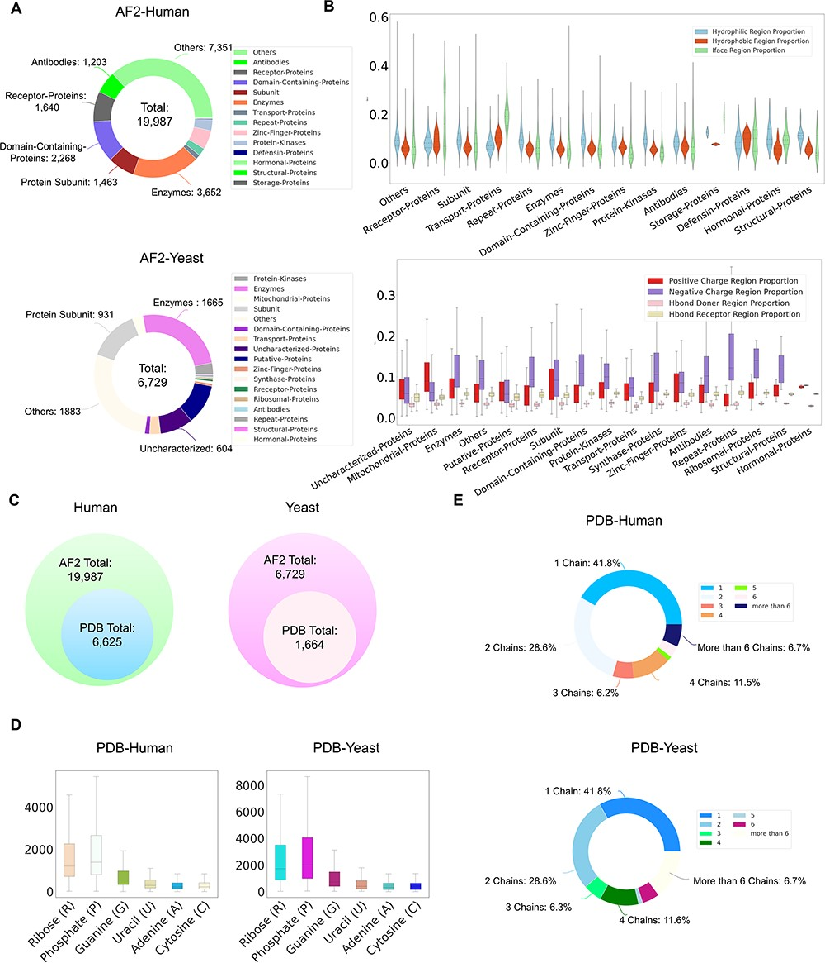
Figure 3. ProNet DB statistics for both human and yeast results in AlphaFold DB and PDB. (A) The functional ...
Notes:
Figure 3. ProNet DB statistics for both human and yeast results in AlphaFold DB and PDB. (A) The functional classification for protein structures in both AlphaFold DB and PDB. (B) The upper panel illustrates the protein surface physicochemical property distribution including hydrophilic, hydrophobic and interacting face region proportion of human protein surface in AlphaFold DB. The beneath panel reveals the distribution of the positive/negative charge region and the Hbond Donor/Receptor region proportion of yeast protein surface in AlphaFold DB. (C) Venn diagram shows the number of experimentally validated protein structures from PDB, compared with computationally predicted structures from AlphaFold DB. (D) Detailed comparison of the proportion of binding profiles of each RNA constituent in PDB, e.g. four bases: adenine (A)/guanine (G)/cytosine (C)/uracil (U) and two backbone constituents: phosphate (P) and ribose (R). (E) The proportion of the number of chains in the PDB database in human and yeast.
Unless provided in the caption above, the following copyright applies to the content of this slide: © The Author(s) 2024. Published by Oxford University Press.This is an Open Access article distributed under the terms of the Creative Commons Attribution License (https://creativecommons.org/licenses/by/4.0/), which permits unrestricted reuse, distribution, and reproduction in any medium, provided the original work is properly cited.

