Slide 1
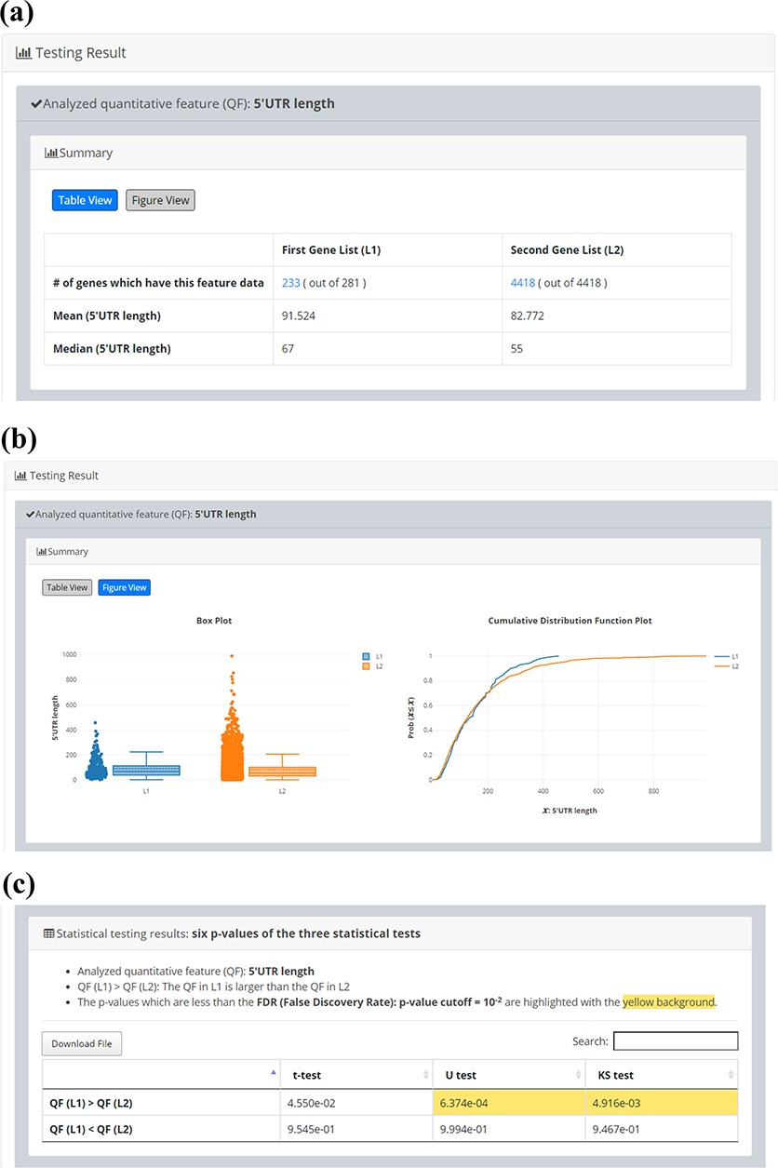
Figure 5. Quantitative comparison of 5’UTR length between 281 iESR genes and the background (4418 genes which have ...
Notes:
Figure 5. Quantitative comparison of 5’UTR length between 281 iESR genes and the background (4418 genes which have 5’UTR length data). (a) Table View (b) Figure View (c) Statistical testing results. It can be seen that the 5’UTR length of 281 iESR genes (L1) is statistically significantly longer than that of the background (L2) when using U test or KS test with p-value threshold 0.01. Note that only 233 out of 281 iESR genes have 5’UTR length data.
Unless provided in the caption above, the following copyright applies to the content of this slide: © The Author(s) 2020. Published by Oxford University Press.This is an Open Access article distributed under the terms of the Creative Commons Attribution License (http://creativecommons.org/licenses/by/4.0/), which permits unrestricted reuse, distribution, and reproduction in any medium, provided the original work is properly cited.

