Slide 1
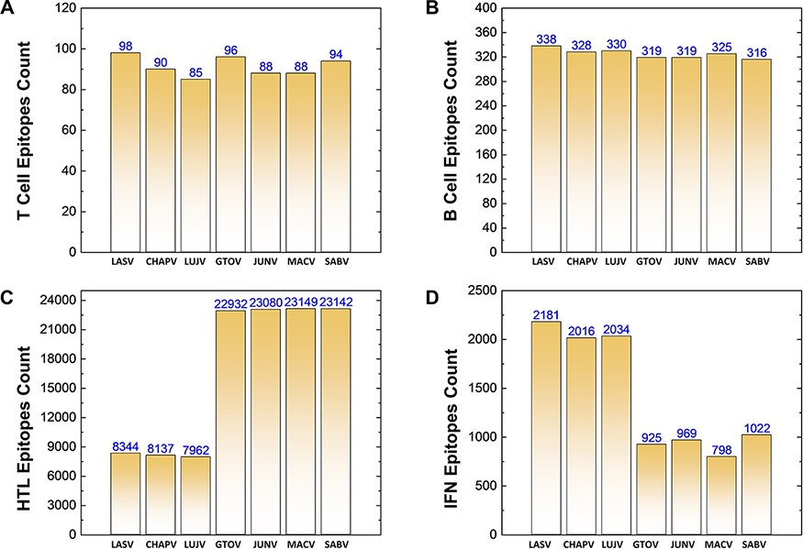
Figure 3. (A–D) Demonstrates the total identified number of predicted immune epitopes for each specific protein; (A) ...
Notes:
Figure 3. (A–D) Demonstrates the total identified number of predicted immune epitopes for each specific protein; (A) represents the total number of T-cell epitopes, (B) represents the total number of B-cell epitopes, (C) represents the total number of HTL epitopes, while (D) represents the total number of IFN epitopes predicted for each protein for the seven mammarena species, respectively.
Unless provided in the caption above, the following copyright applies to the content of this slide: © The Author(s) 2021. Published by Oxford University Press.This is an Open Access article distributed under the terms of the Creative Commons Attribution License (https://creativecommons.org/licenses/by/4.0/), which permits unrestricted reuse, distribution, and reproduction in any medium, provided the original work is properly cited.

