Slide 1
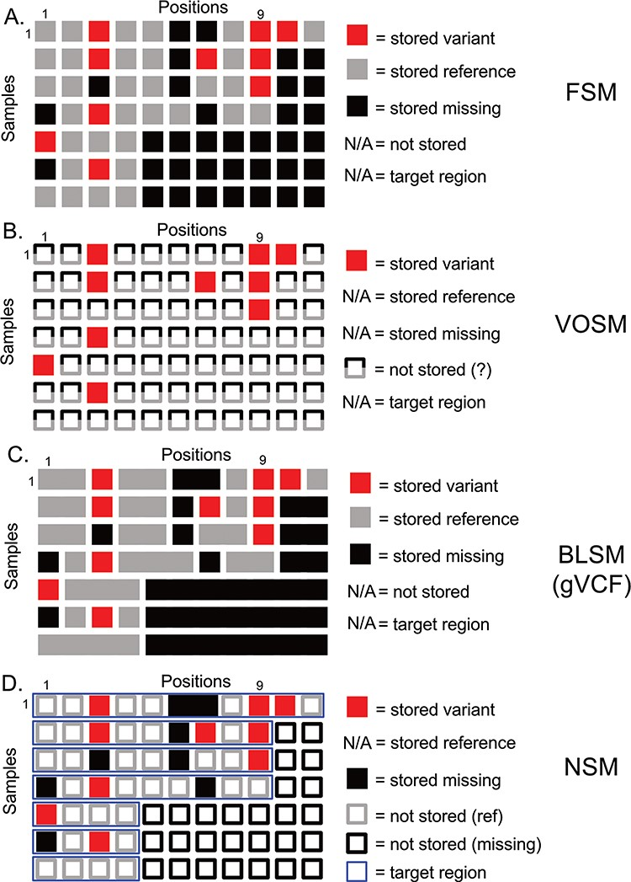
Figure 1 Overview of genetic variation storage models. This example shows the same 7 samples and 11 positions using ...
Notes:
Figure 1 Overview of genetic variation storage models. This example shows the same 7 samples and 11 positions using (A) Full Storage Model, (B) Variant Only Storage Model, (C) Block Storage Model and (D) NSM. The features and information stored in each model are listed to the right. FSM: Full Storage Model, VOSM: Variant Only Storage Model, BLSM: Block Storage Model, NSM: Negative Storage Model.
Unless provided in the caption above, the following copyright applies to the content of this slide: © The Author(s) 2020. Published by Oxford University Press.This is an Open Access article distributed under the terms of the Creative Commons Attribution License (http://creativecommons.org/licenses/by/4.0/), which permits unrestricted reuse, distribution, and reproduction in any medium, provided the original work is properly cited.

Slide 2
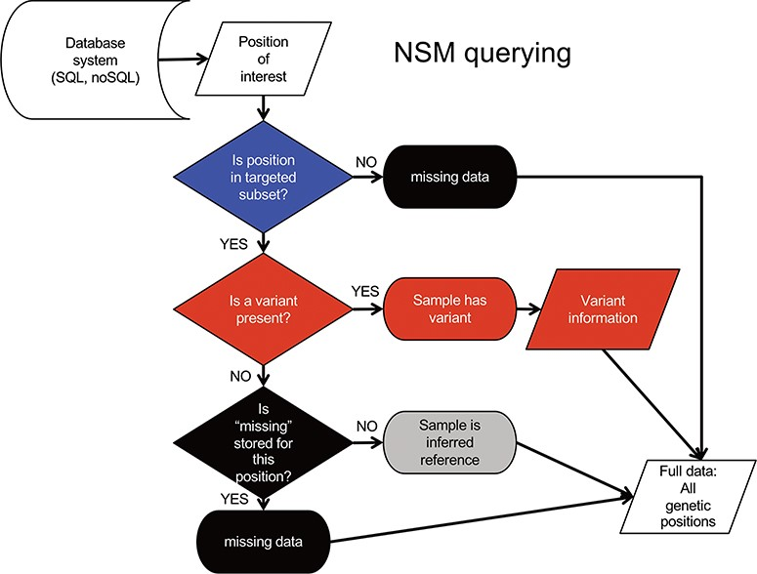
Figure 3 NSM data querying process. The process for extracting precise information for a given position based on the ...
Notes:
Figure 3 NSM data querying process. The process for extracting precise information for a given position based on the model and information stored in the database.
Unless provided in the caption above, the following copyright applies to the content of this slide: © The Author(s) 2020. Published by Oxford University Press.This is an Open Access article distributed under the terms of the Creative Commons Attribution License (http://creativecommons.org/licenses/by/4.0/), which permits unrestricted reuse, distribution, and reproduction in any medium, provided the original work is properly cited.

Slide 3
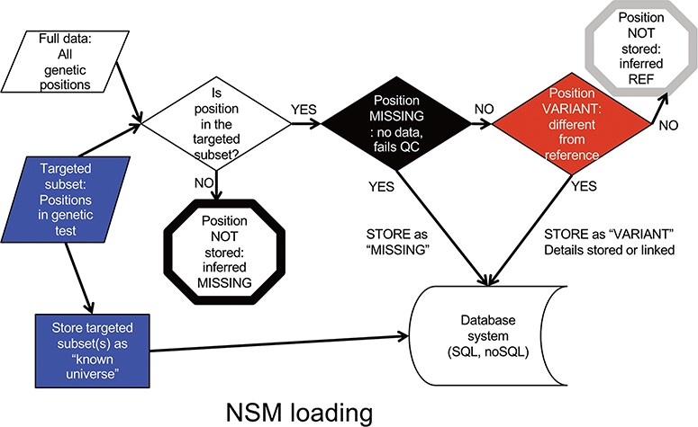
Figure 2 NSM data loading process. The process for determining what information should actually be stored in the ...
Notes:
Figure 2 NSM data loading process. The process for determining what information should actually be stored in the database.
Unless provided in the caption above, the following copyright applies to the content of this slide: © The Author(s) 2020. Published by Oxford University Press.This is an Open Access article distributed under the terms of the Creative Commons Attribution License (http://creativecommons.org/licenses/by/4.0/), which permits unrestricted reuse, distribution, and reproduction in any medium, provided the original work is properly cited.

