Slide 1
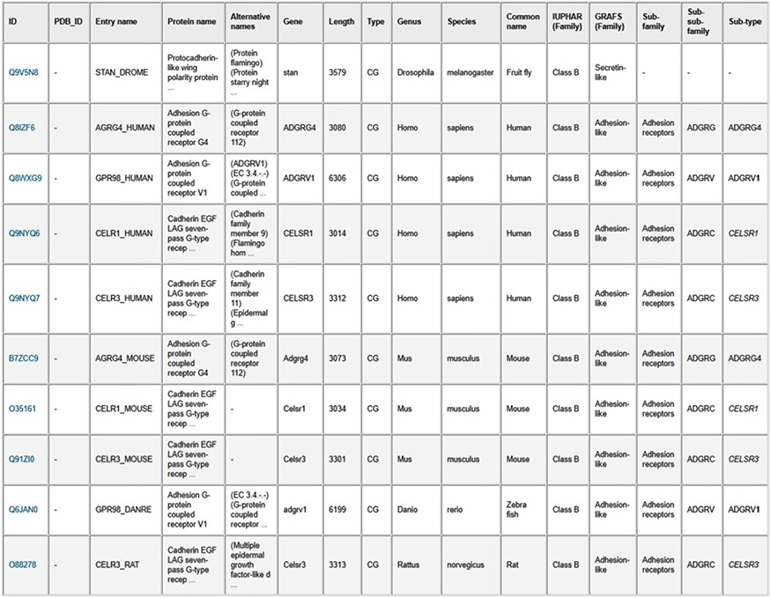
Figure 6. Results table from the search of GPCR sequences longer than 3000 amino acids using the web server. The table ...
Notes:
Figure 6. Results table from the search of GPCR sequences longer than 3000 amino acids using the web server. The table entries can be downloaded in CSV format by clicking on the “Result table” link, and the corresponding protein sequences can be downloaded in FASTA format by clicking on the “FASTA file” link.
Unless provided in the caption above, the following copyright applies to the content of this slide: © The Author(s) 2020. Published by Oxford University Press.This is an Open Access article distributed under the terms of the Creative Commons Attribution License (http://creativecommons.org/licenses/by/4.0/), which permits unrestricted reuse, distribution, and reproduction in any medium, provided the original work is properly cited.

